Slide 1
State of UPNAAI 2025
Manuela Rosa C. Castillo, MSN RN
UPNAAI President, 2023-2025

Slide 2
UPNAAI Mission & Vision
UPNAAI,INC
Sustainability
Increase Membership
Community Service
Innovation & Education

Slide 3
Sustainability
Special Fundraising Events
Annual Fundraiser: Souvenir Journal/Yearbook
Donors & Sponsors

Slide 4
Membership Growth
Notes:
: Active members: Life time members: 964; Associate members: 50; annual: 43; TOTAL 1057

Slide 5

2025 Membership Overview
Lifetime Members: 964 individuals committed to UPNAAI.
Associate Members: 50 individuals actively supporting the organization.
Annual Members: 43 members contributing yearly.
Total Active Members: 1,057, showcasing our growing community.
Membership growth highlights the importance of UPNAAI's mission.
Notes:
In 2025, UPNAAI proudly boasts a total of 1,057 active members, encompassing 964 lifetime members, 50 associate members, and 43 annual members. This growth demonstrates the ongoing commitment and support of our community towards the mission and vision of UPNAAI. Each membership category plays a crucial role in fostering engagement and furthering our initiatives.

Slide 6
UPNAAI Scholarship 2025
The UPNAAI Scholarship Fund is made possible by the generous donations and sponsors that enable UPNAAI to administer a full scholarship to a deserving student from Freshman year till Senior year provided they meet the academic requirements every semester till graduation. This year we are grateful & honored to announce that we have THREE (3) awardees for the UPNAAI Baccalaureate Scholarship.
The UPNAAI Scholarship Fund will also provide for Individual Achievement Awards. These one-time individual educational grants are awarded during the annual Balik Turo program at UPCN and co-sponsored by an UPNAAI Chapter and/or a UPCN Class.
All Undergraduate or graduate UPCN students are eligible for the scholarship provided they maintain academic excellence and also meet the Financial need.
This year we have awarded several students with one-time grants during the Annual Balik Turo event. These one-time grants were made possible through the generous donations of UPNEC and UPNAA Texas Chapters, Class ’65, Class ‘89

Slide 7
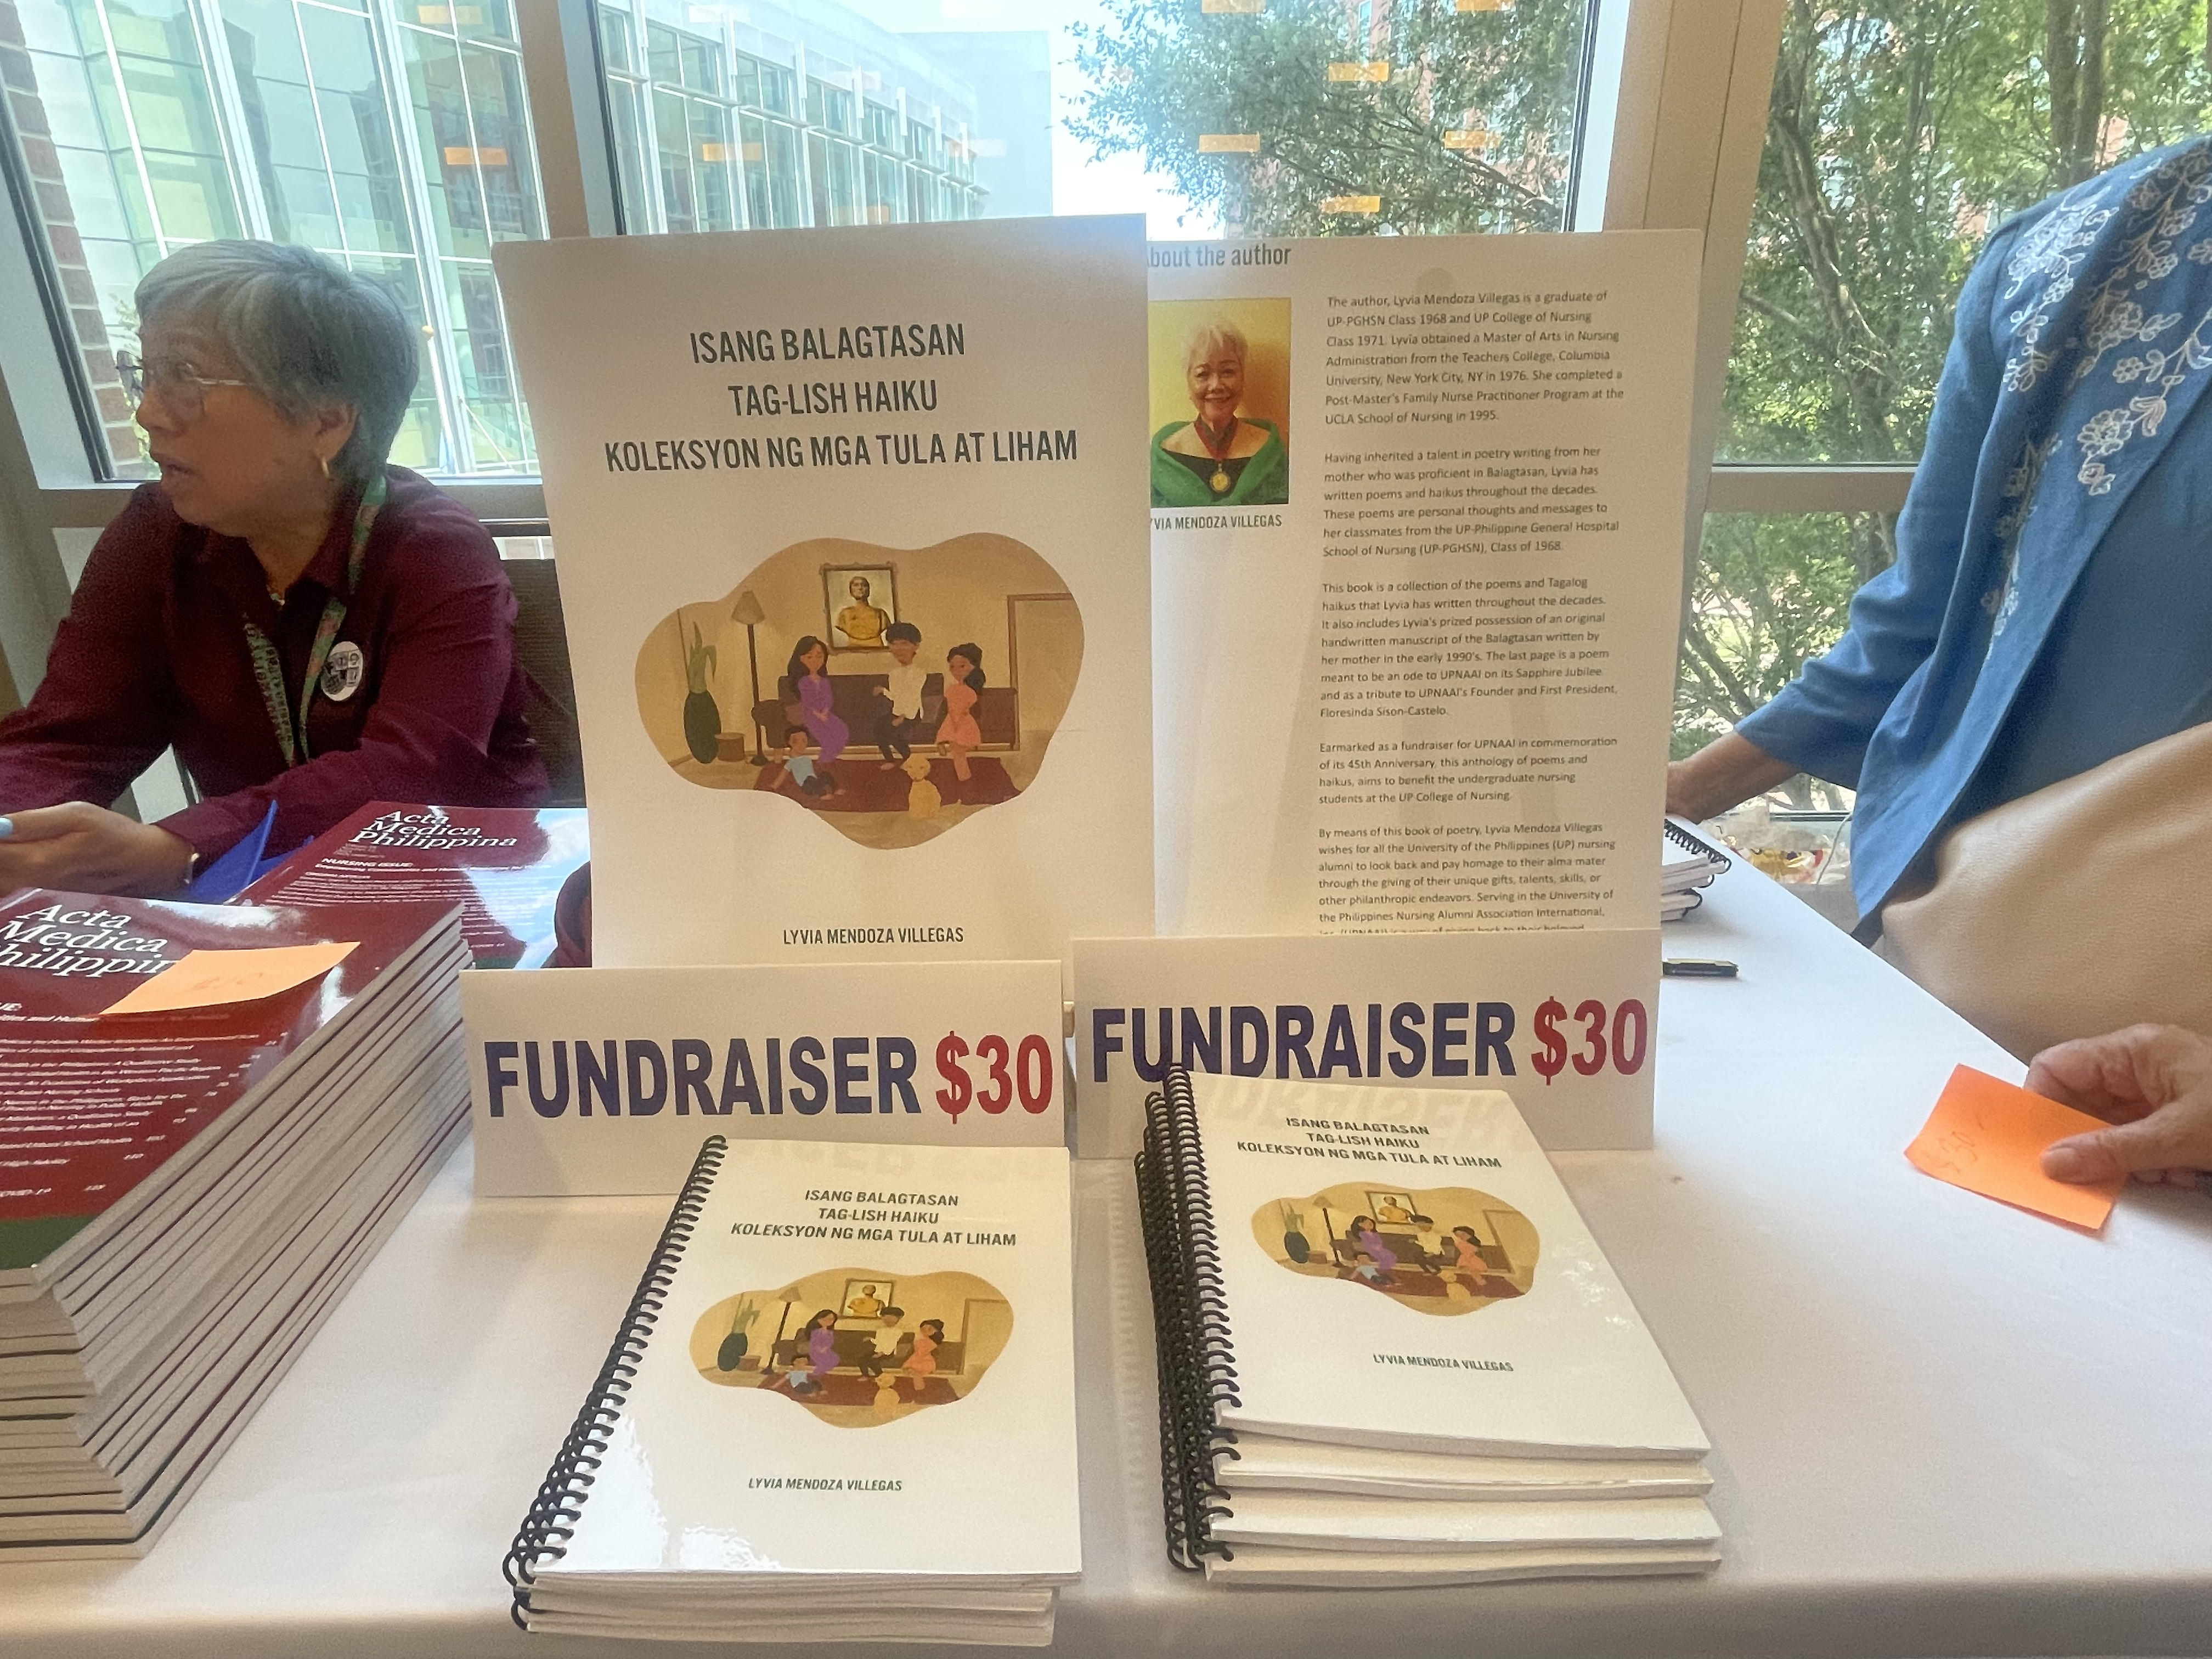
Special Fundraising projects
Notes:
Special fundraising projects like this “Isang Balagtasan Taglish Haiku Koleksyon ng mga Tula at Liham” authored by our very own Lyvia Villegas, UPCN Class 68. Net proceeds of $1000 will be geared towards Balik Turo till 2027.

Slide 8
Sustainability and Viability Projects & Charitable Donations
Fundraising Initiatives:
Giving Tuesdays
Benevity Matching Donations
Sablay Fundraiser
Charitable Contributions:
Casa de Luz – consistent recipient
Volunteer efforts within the local community and during the annual convention venue

Slide 9
Donors & Sponsors 2025
UPNAAI Convention Bronze Sponsor : UPCN Class 1990
UPNAAI Scholarship Grant Donors: Josephine Aparri, GN’65; Jean Perez,GN’65; Josie Castro,GN’65; Sonia DeGuia,BSN’79; UPNEC Chapter
2025 Balik Turo Donors: UPCN Class’65; UPNAA DelMarVa Chapter; UP-PGHSN Class ‘68;UPNAA RMRPS Chapter; UPNAA Texas Chapter
Giving Tuesday Benefactors: Rina Gangozo; Cory Reyes; Debbie Butuyan; Lyvia Villegas; Willy Ungco; Finnette Castaneda; Minnie Castillo; Mylene Supan-Rivas; Mylene Esco; Ramil Cabela; Lani Relucio
Lyvia Villegas- Author of Isang Balagtasan Taglish Haiku Koleksyon ng mga Tula at Liham, of which net sales proceeds will fund Balik Turo from 2025 till 2027
The Neil and Cherilyn Warren Endowment Fund
Delia Zambrano-Reyes Fund
Anna Lizo Nido-for jumpstarting the upnaai.org Website Redesign Fund
Lachme Sullesta-for your unparalleled generosity & services, for initiating the Dr. Otoniel R. Sullesta Memorial Scholarship Fund
Merle Abrenica & Josie Castro- ERC easel donations
UPNAAI Convention Photobooth sponsors- Earl and Geraldine Abaquin Perez and sons, Ernst and Gian

Slide 10
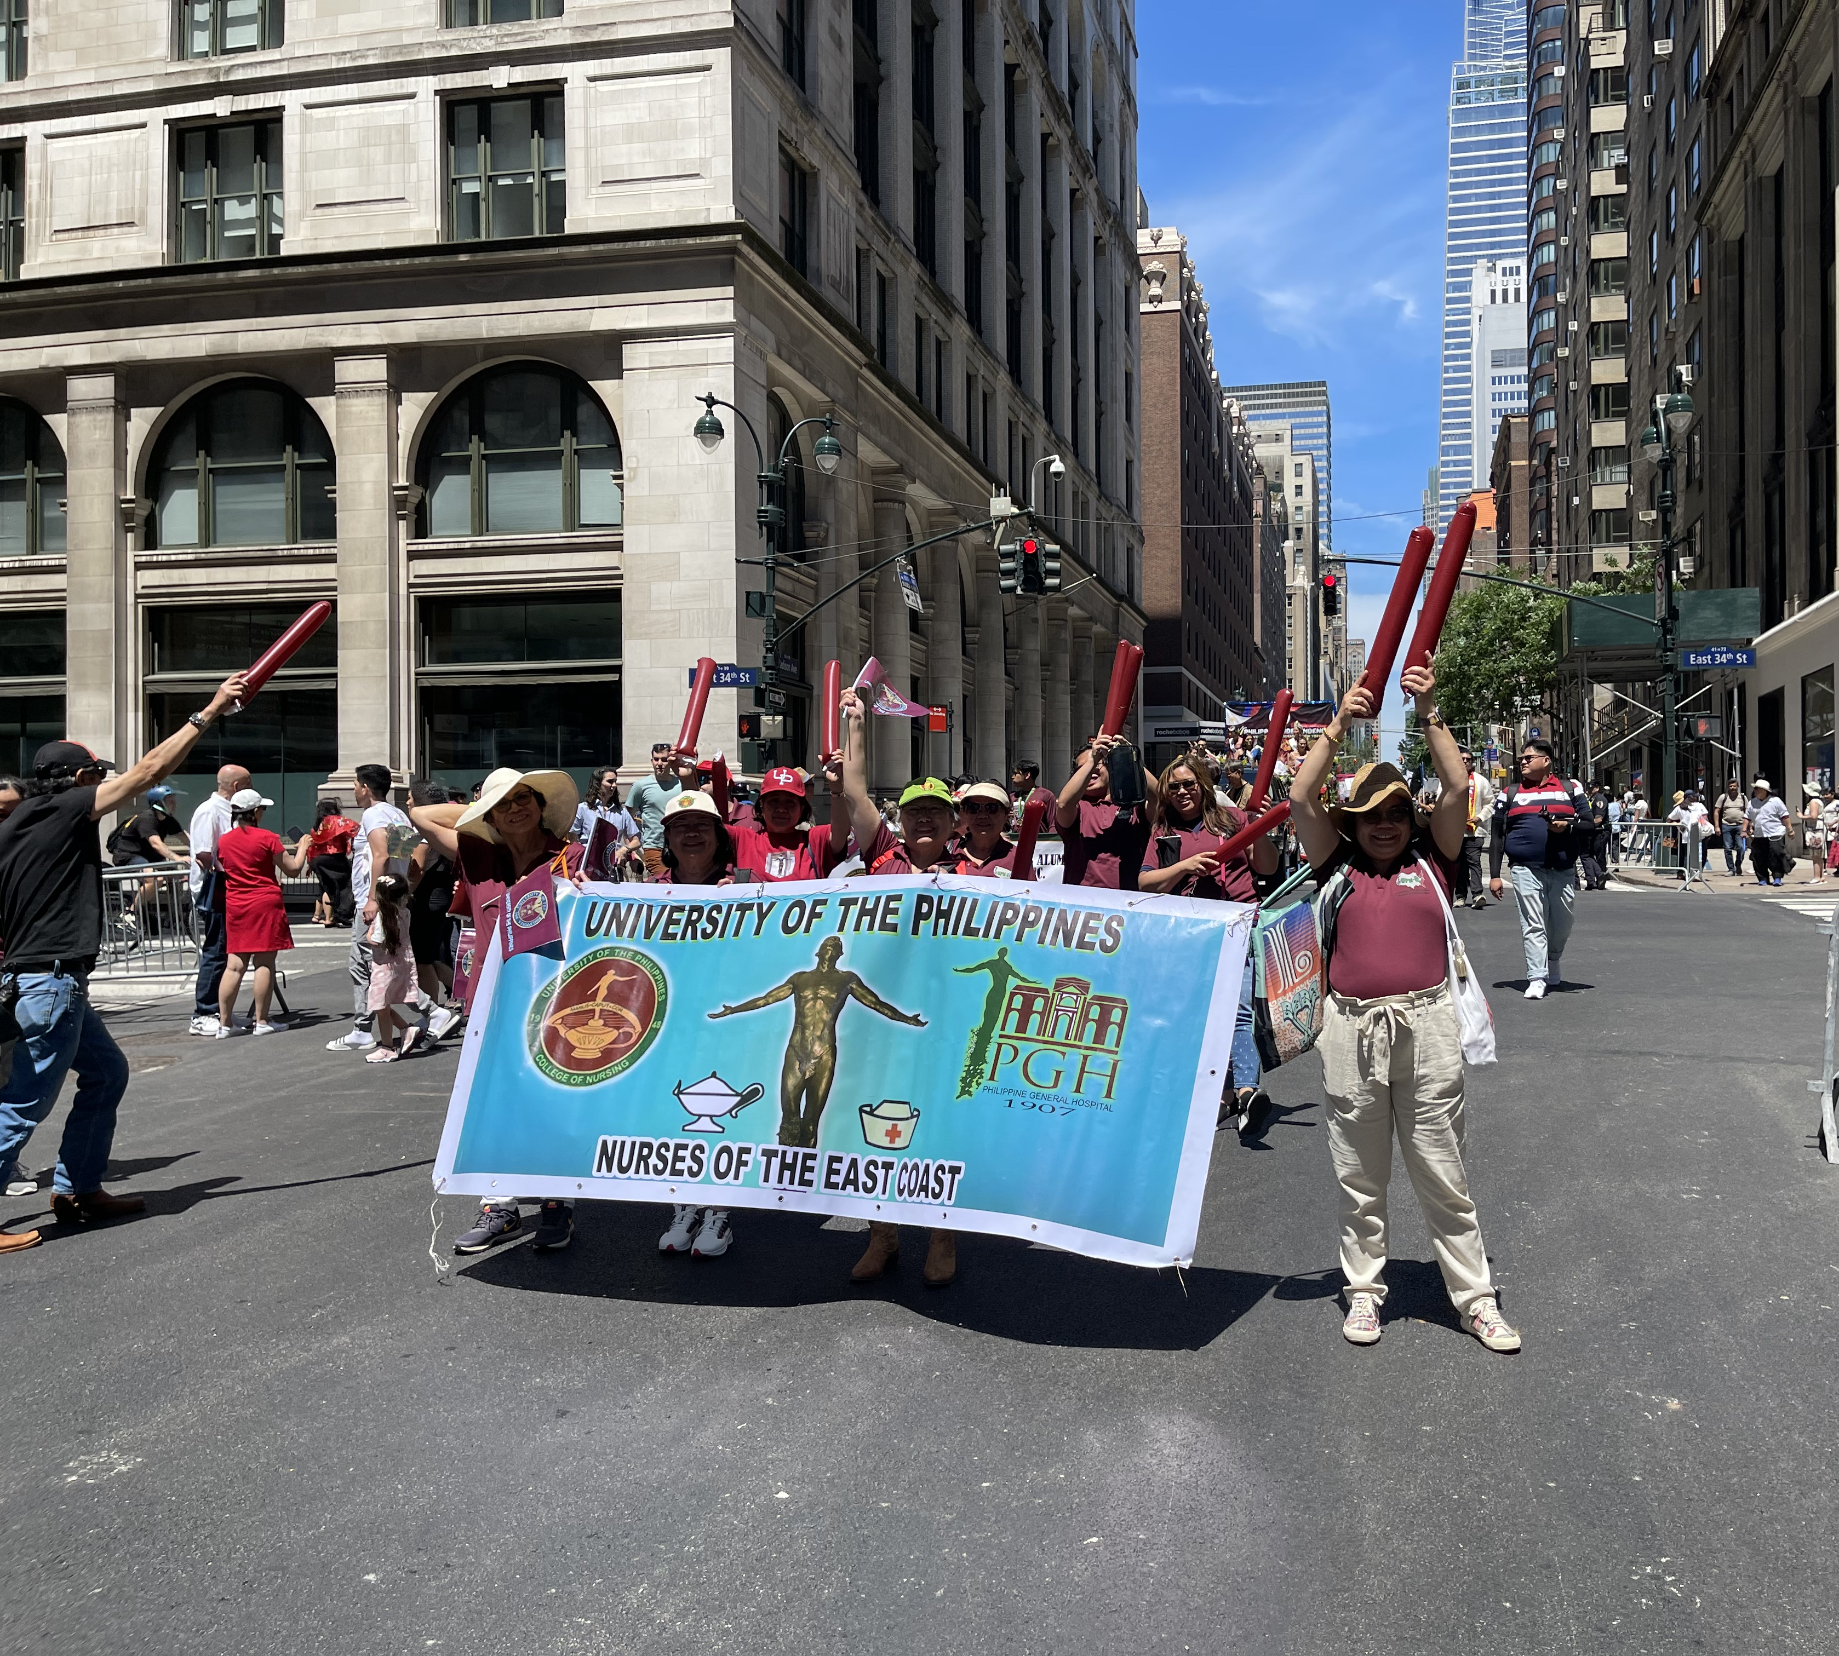
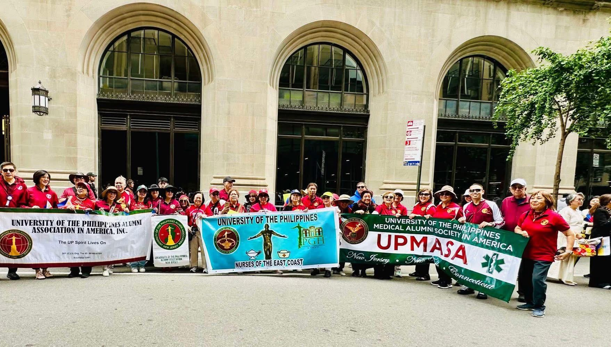
Community Events 2025
The UP Nurses East Coast Chapter takes part in the yearly Independence Day Parade organized by the Philippine Consulate of New York, joining over 200 organizations including fellow UP groups such as UPAA-NJ, UPAAA and UPMASA.

Slide 11
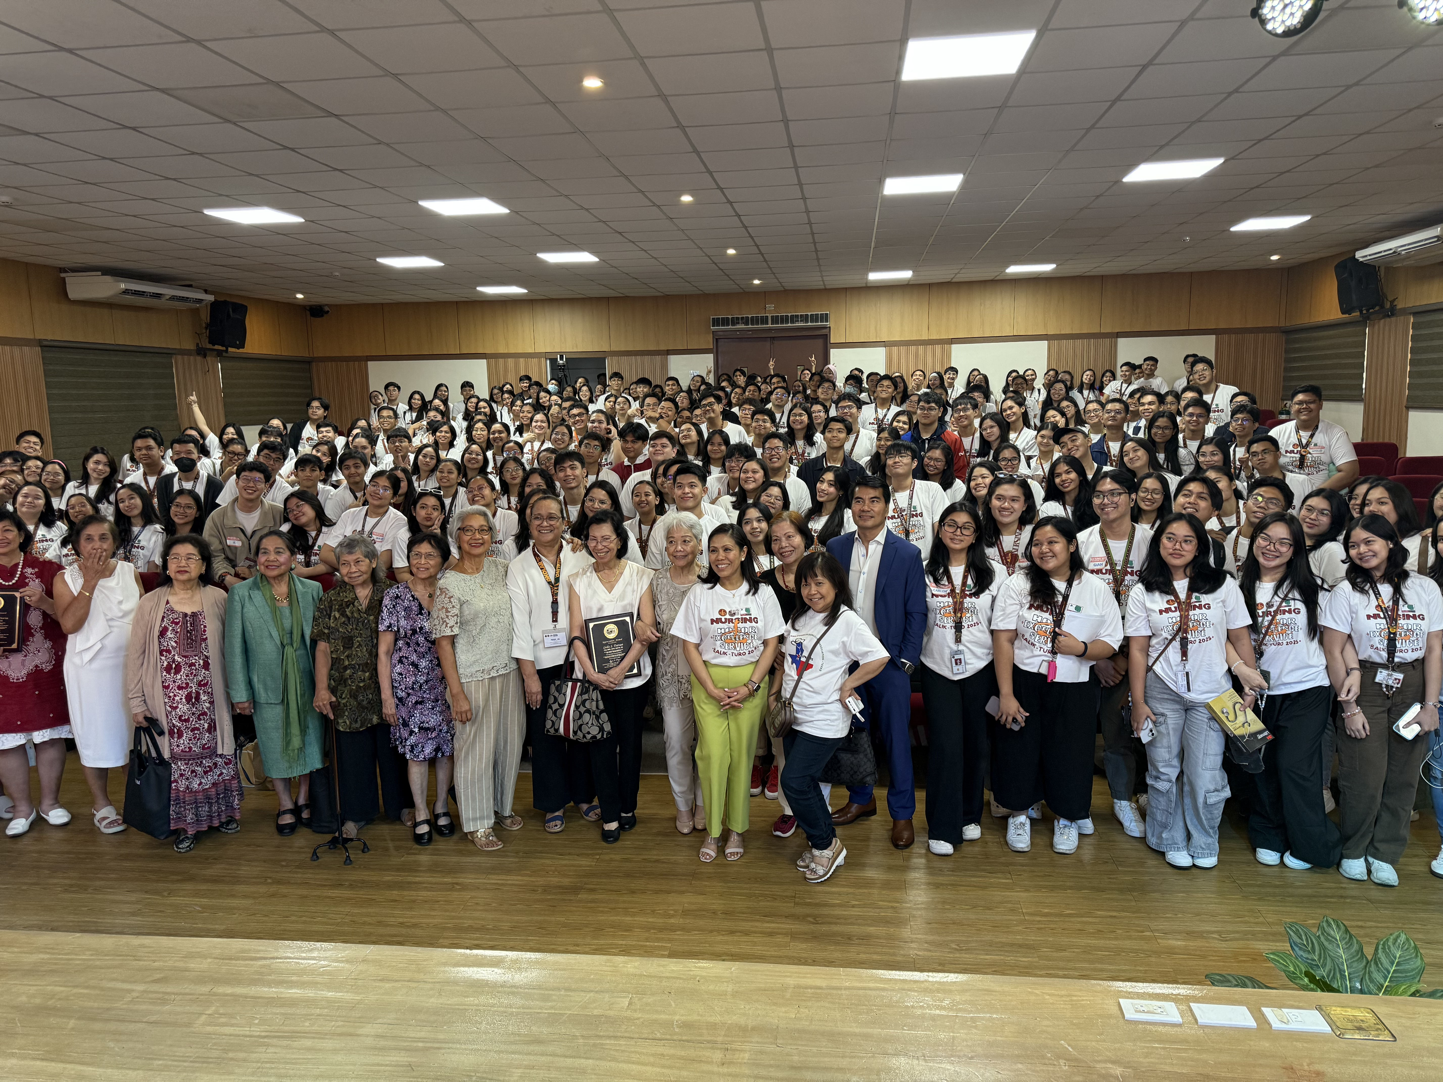
Education & INNOVATION:
Balik Turo 2025
LOGISTICS
Theme: Nursing Nexus- Connecting Passion, Purpose, and Progress
Co-sponsored by UPNAA-Rocky Mountain Region and Pacific State
Awarding of Academic Scholarship and One-time Educational Grants by UPNEC and UPNAA-Texas
Three Impactful and knowledgeable speakers
Littman Stethoscope Raffle giveaway compliments of Lyvia Villegas, BSN ‘71 and PGH Class 65
Balik Turo T-shirt design was created by UPCN student
Complimentary lunch for over 350 Students, Faculty and auxiliary services of UPCN
Evaluations & suggestions were all positive and engaging

Slide 12
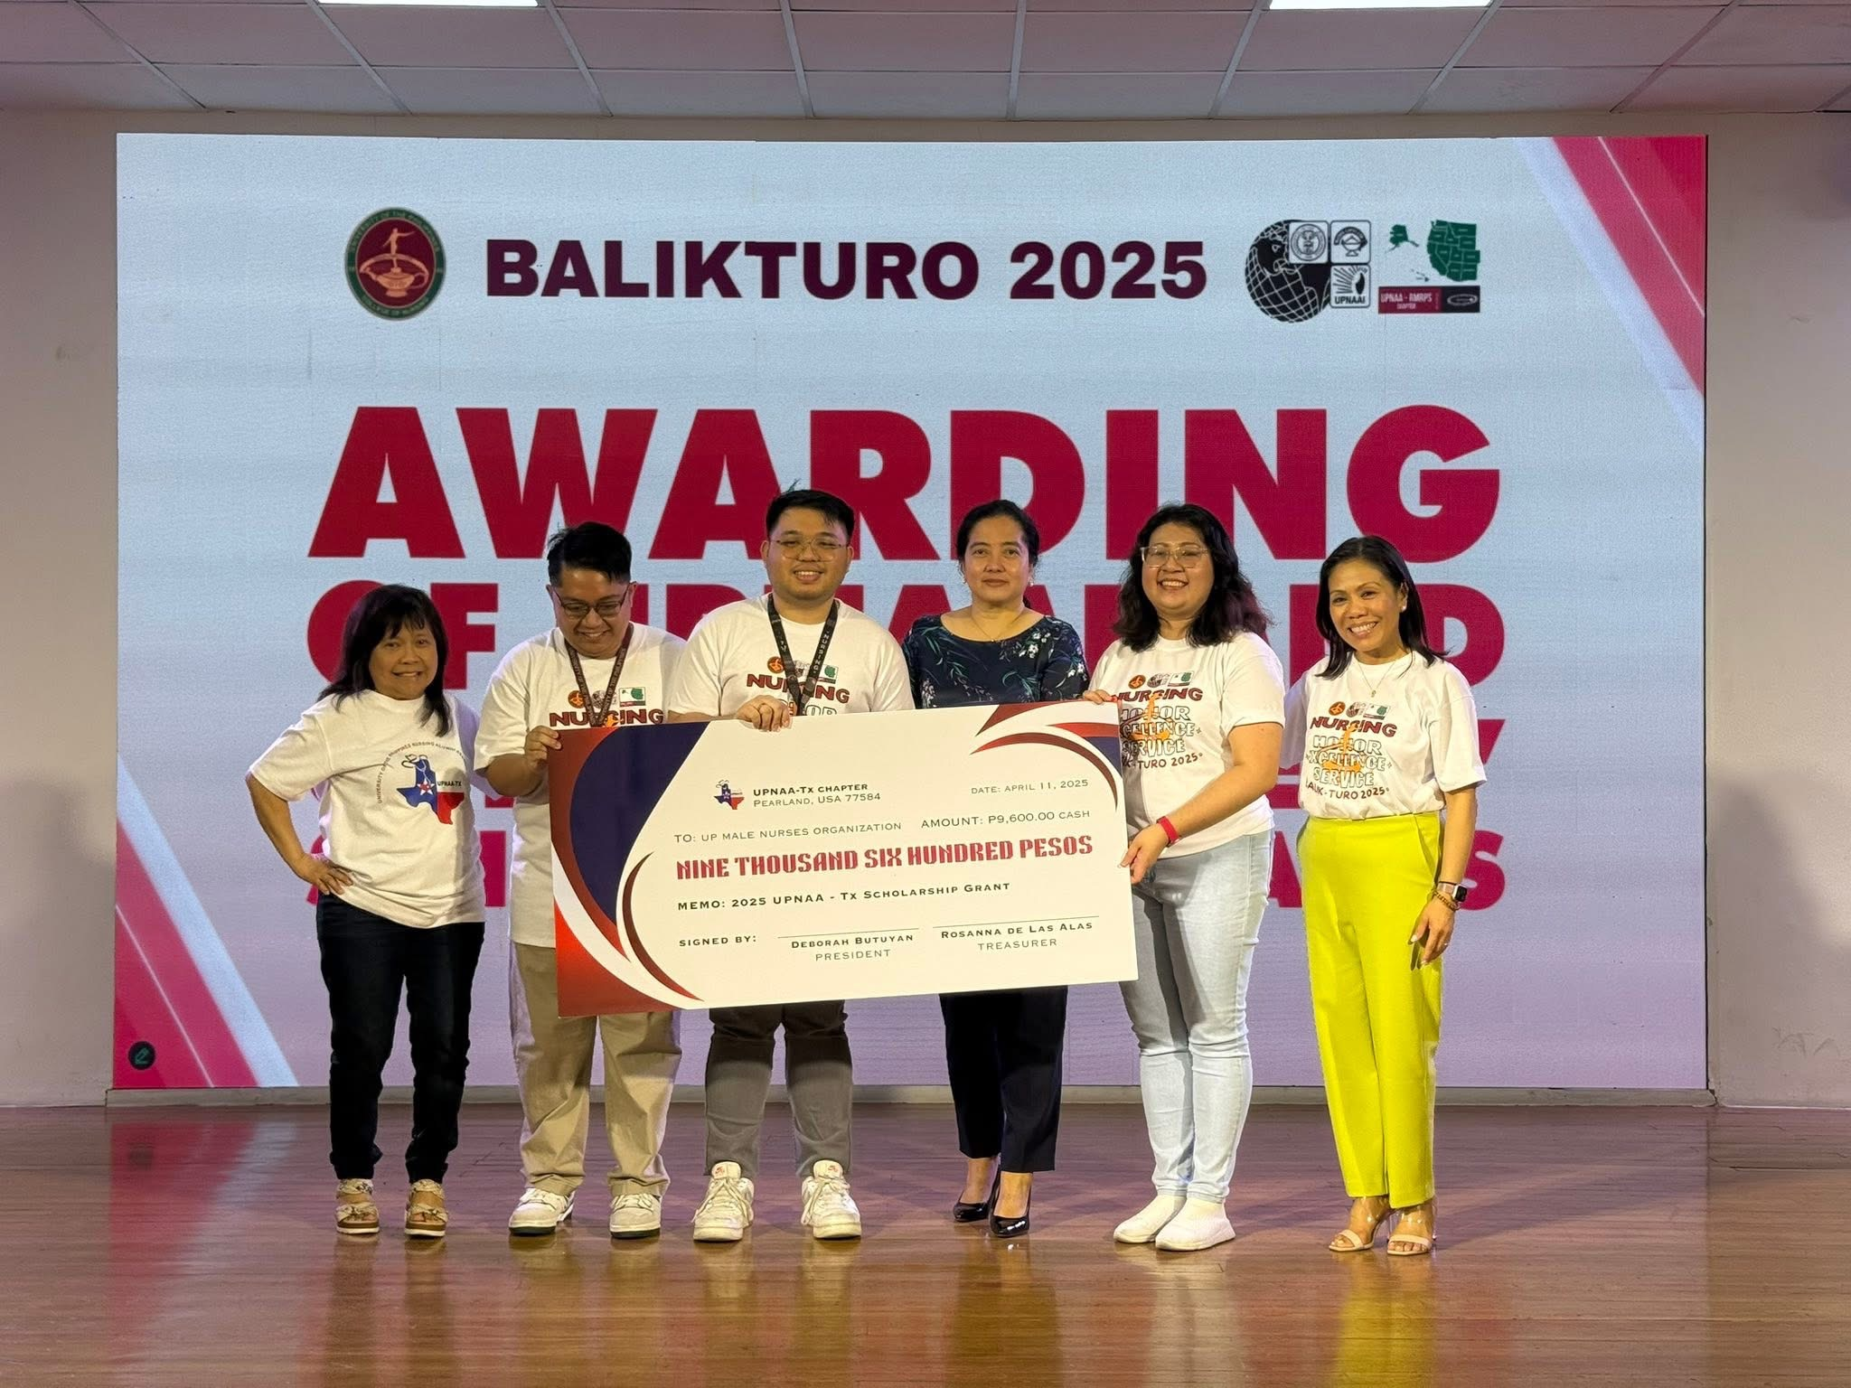
Academic Scholarship Awards 2025
UPNAA Texas Chapter awards the UP-Male Nurses Organization a one-time educational grant
UPNEC Chapter awards their Baccalaureate scholar their semestral stipend
UPNAA RMRPS Chapter awards two (2) UPCN students one-time educational grants

Slide 13

Volunteer Services 2025

Slide 14
Ratification of 2025 Constitution and Bylaws

Slide 15
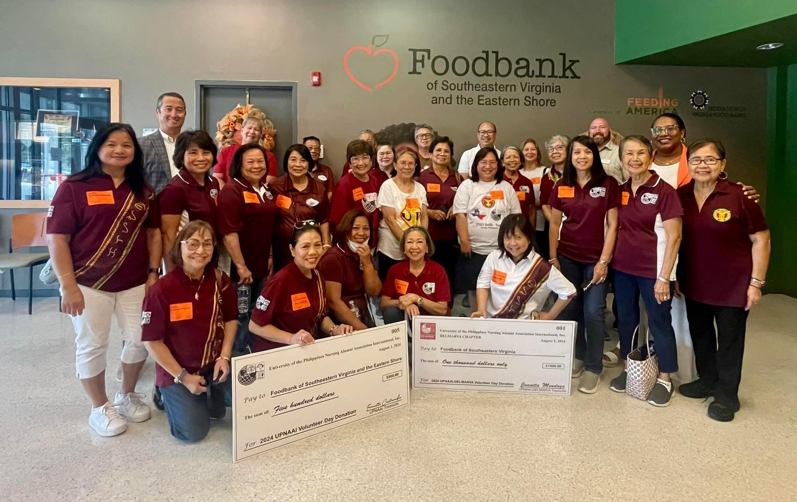
Community Service 2024
Annual Food Bank & Charity Event
Annual participation in local Food Bank activities
UPNAAI volunteers for a day as part of giving back to the community packing food supplies to be distributed to the local Food Pantry
Annual monetary donation to local community causes like “Fighting Hunger” initiatives, completed in Virginia Beach in 2024
This year the annual activity involves volunteering time to clean up the environment at the San Diego beach front

Slide 16
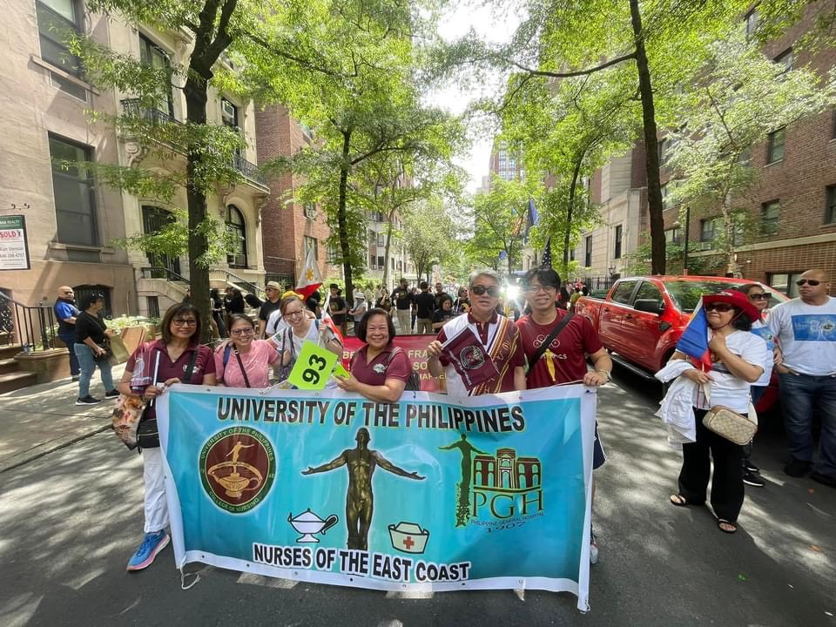
Community events 2024
UPNEC in NYC Parade 2024
UPNEC participates annually in the NYC parade celebrating Philippine Independence Day
Community events foster collaborations and networking among Filipinos and other healthcare professionals
Advocate our pride and culture as Filipinos, unifying us with the rest of the Filipino community in the Tristate-NY, NJ, Connecticut

Slide 17

Innovation & education: balik turo sponsors

Slide 18
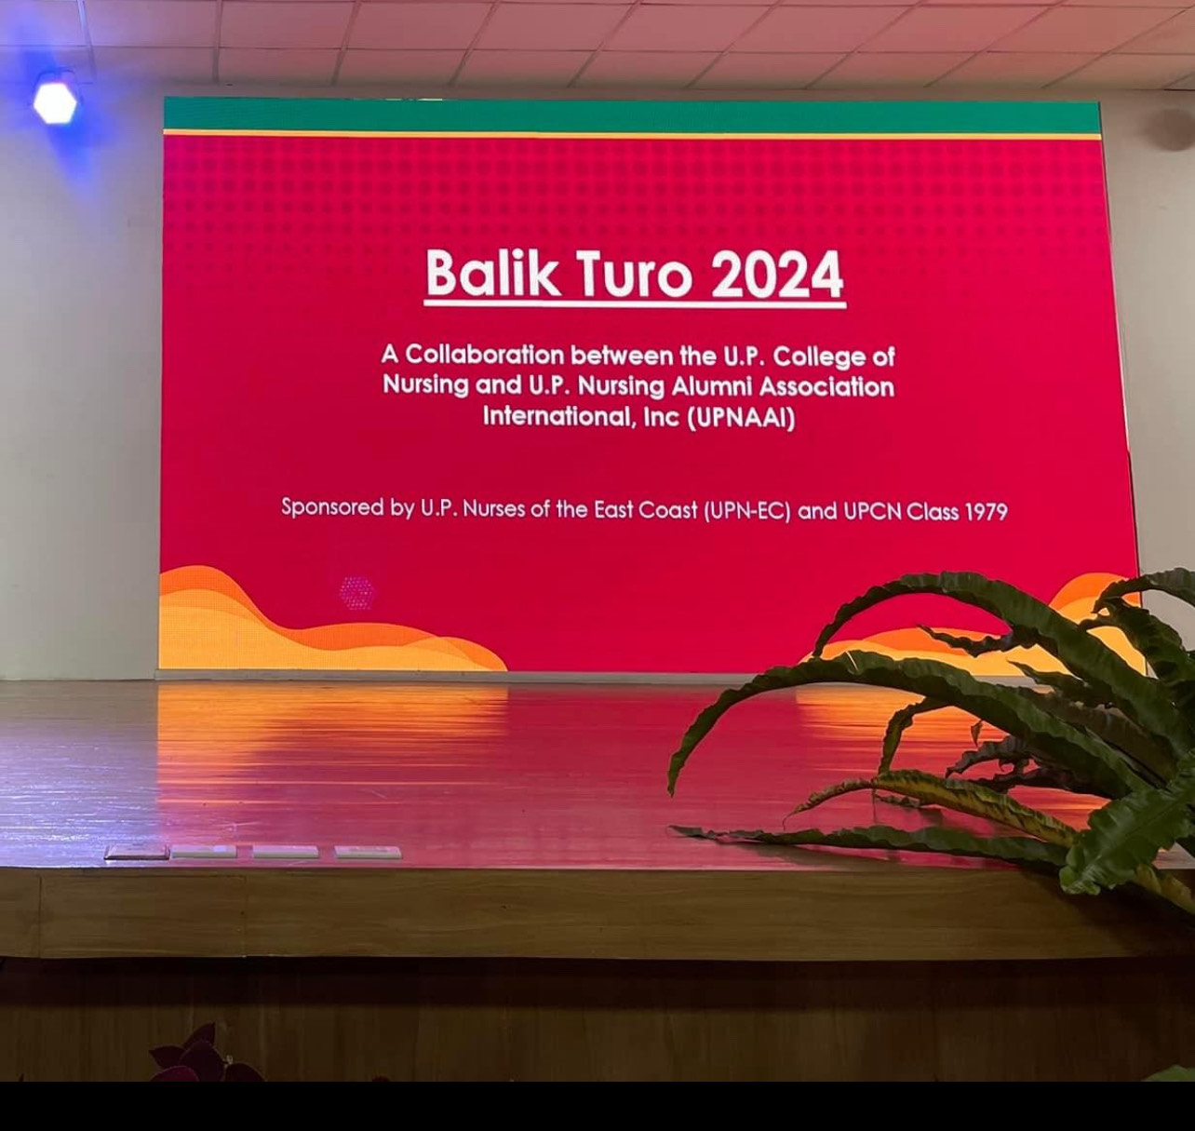
BALIK TURO 2024
LOGISTICS
2nd year collaboration with UPCN, co-sponsored by UPNEC and UPCN Class 1979
All UPCN Students attended the educational event; livestreamed in several classrooms at the college
Three (3) Speaker forum presentations by volunteer Alumni
Ten (10) Littman Stethoscope giveaways donated by Class 1968
Seven (7) total Academic scholarship grants awarded by UPNEC + UPNAA Texas (5) and UPNAA-Texas Chapter (2), amounting to $500+
Complimentary T-shirts, Bento boxed lunch provided to 347 students and Faculty, by the generous donations of Class 1979
Positive evaluations received

Slide 19
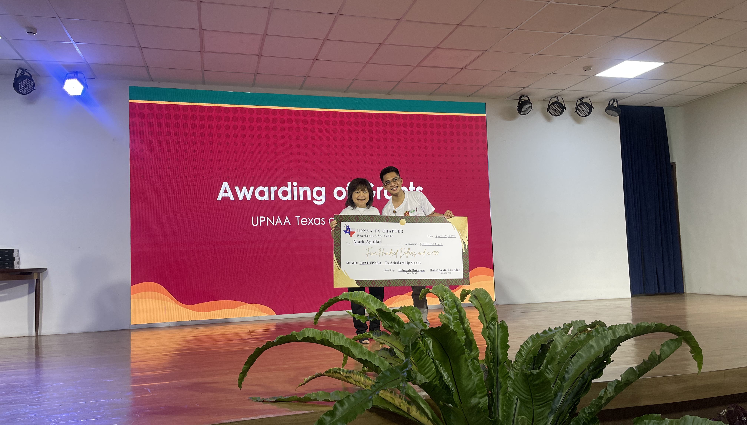
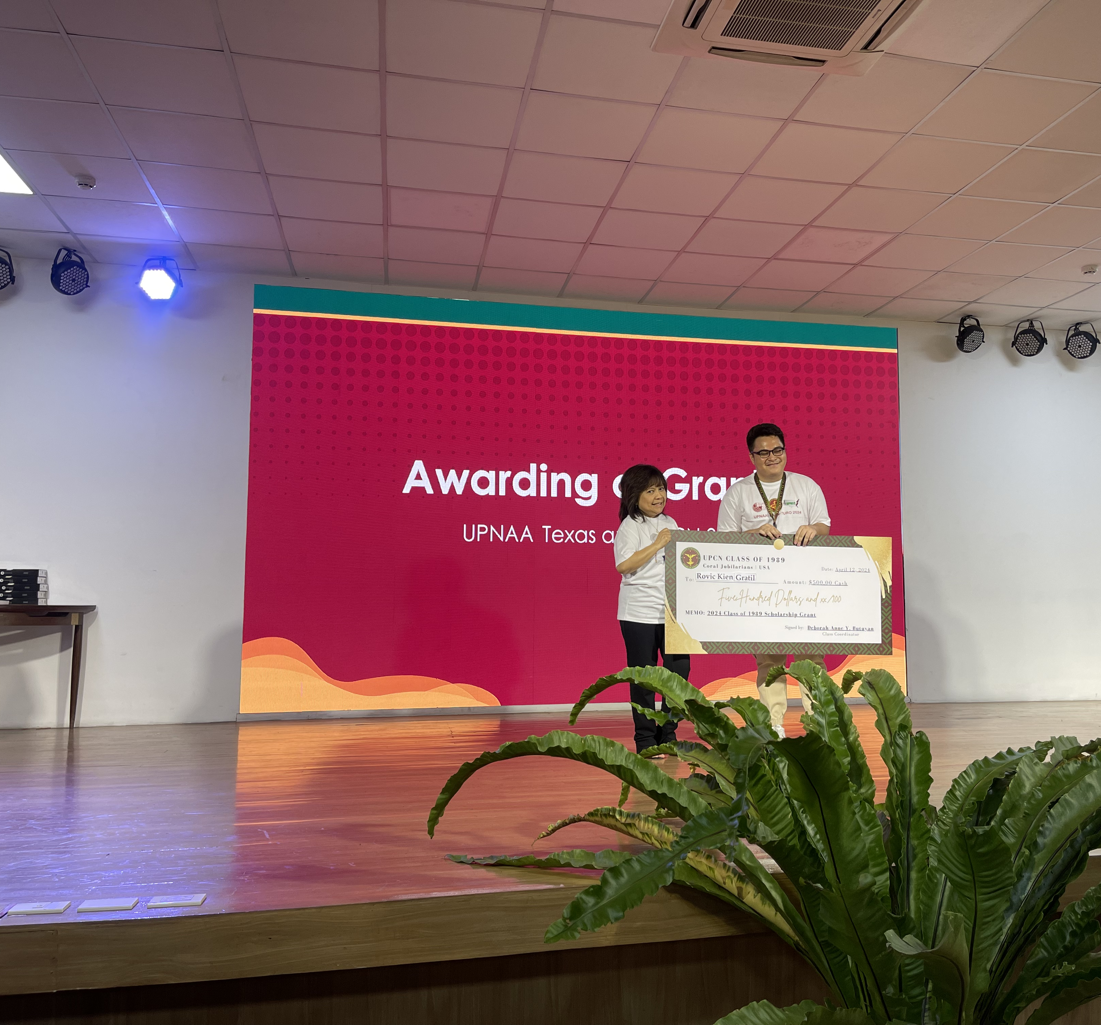
Academic Grant Awards 2024
UPNAA Texas awards total of five (5) one-time educational grants to deserving UPCN students
Elizabeth Gamboa Deleon Seeds of Hope Scholarship awards two (2) individual educational grants

Slide 20
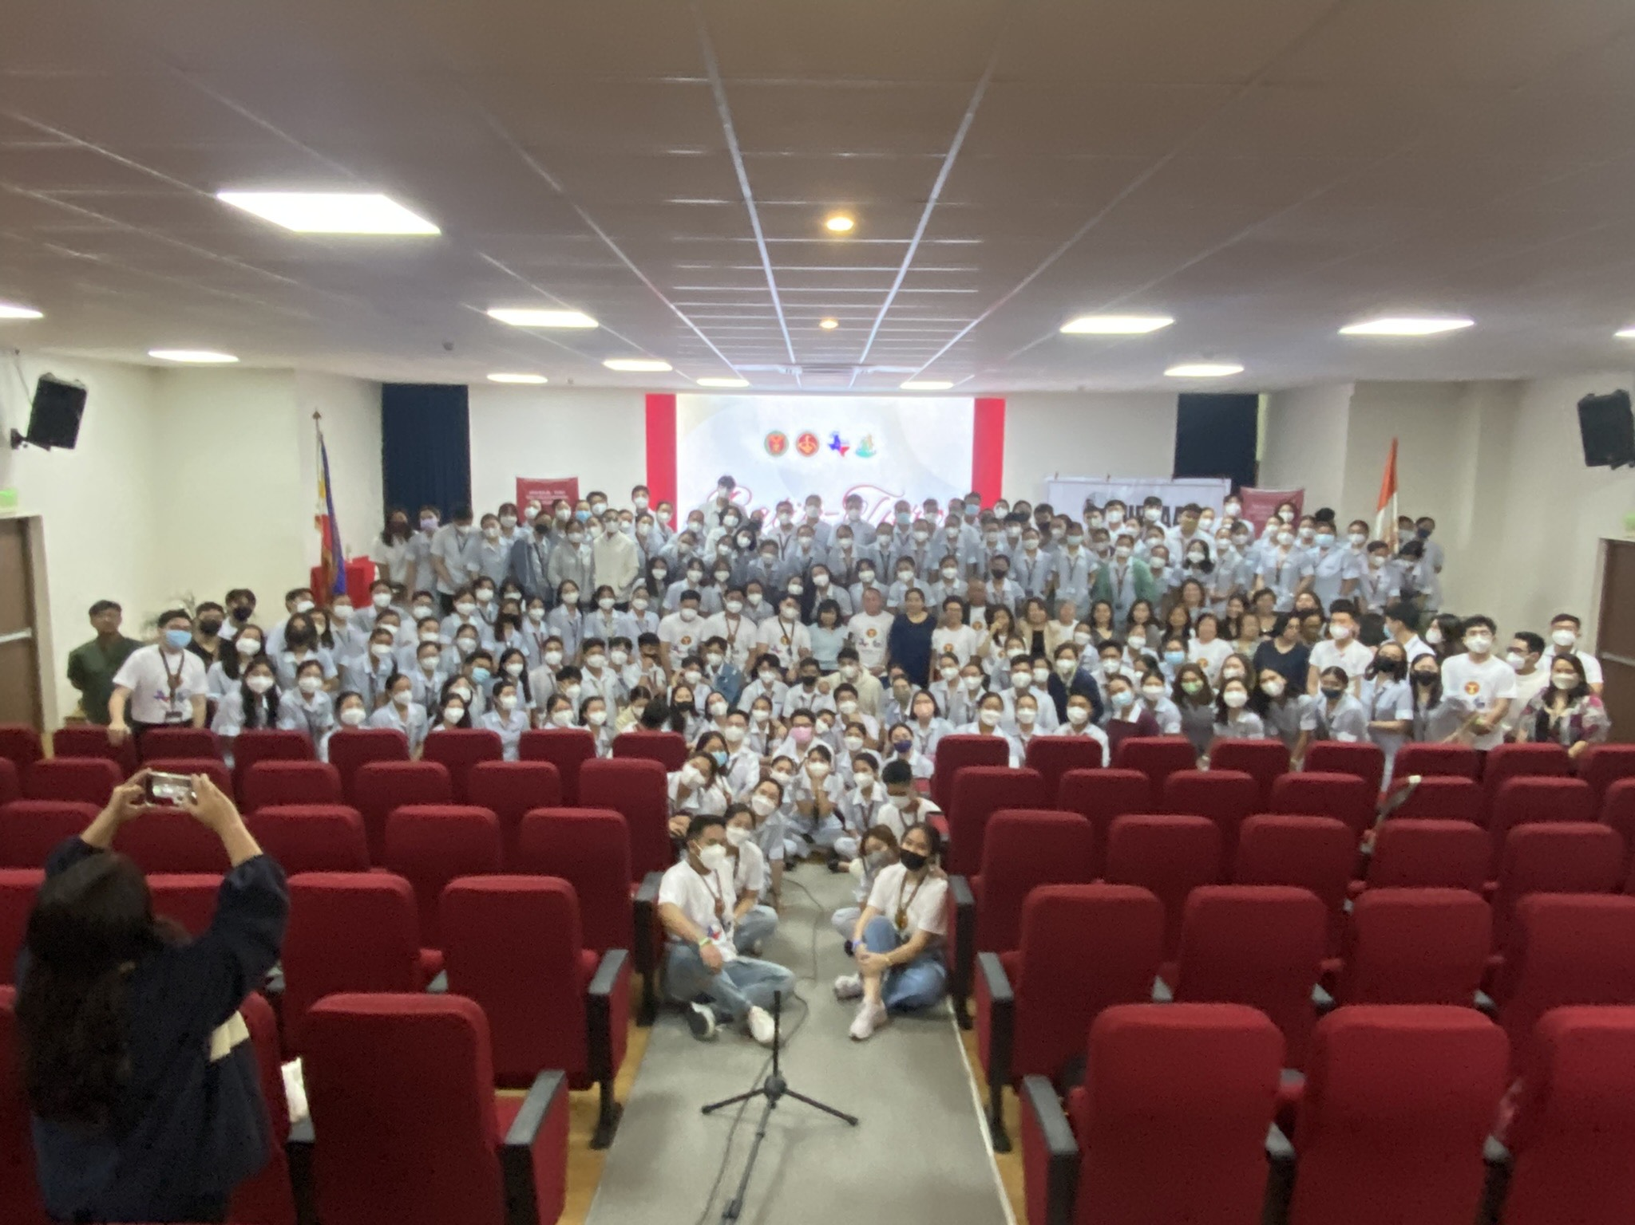
Education & Innovation:
Annual Balik Turo 2023
LOGISTICS
Initial collaboration with UPCN, UPNAA-Texas Chapter, UPCN Class 1989, with the assistance of UPCN Class 2023 Seniors
Over 200 senior and junior students in attendance,
Four Speaker presentations on current Best practices in Nursing by volunteer Alumni
Littman Stethoscope giveaways, donated by Anonymous donor from UPNAA Texas
Academic Scholarship Awards (2)-Elizabeth Gamboa Deleon Seeds of Hope Scholarship Project and UPAA Texas Individual Scholarship Grants (2)
Complimentary lunch for the 219 students and Faculty of UPCN sponsored by Class 1989
Evaluations & suggestions were all positive

Slide 21
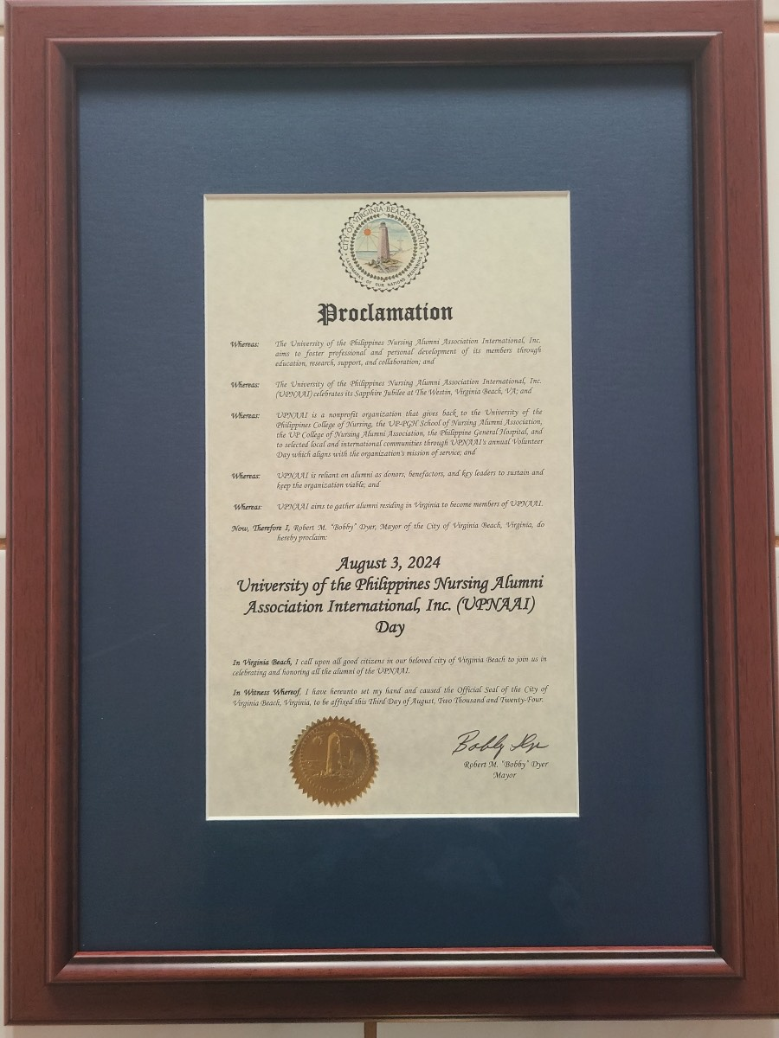
UPNAAI DAY PROCLAMATION 2024
August 3, 2024, UPNAAI DAY
UPNAAI, as a non-profit organization that aims to foster professional and personal development of it’s members through education, research, support and collaboration
UPNAAI gives back to the University of the Philippines College of Nursing, the UP-PGH School of Nursing, the UPCN Alumni Association and PGH, thru UPNAAI’s annual Volunteer Day, that is in alignment with the organization’s mission of service
To commemorate UPNAAI’s Sapphire Jubilee, and to honor the alumni of UPNAAI, August 3rd, 2024 is proclaimed as UPNAAI DAY---Robert “Bobby” Dyer, City of Virginia Mayor

Slide 22
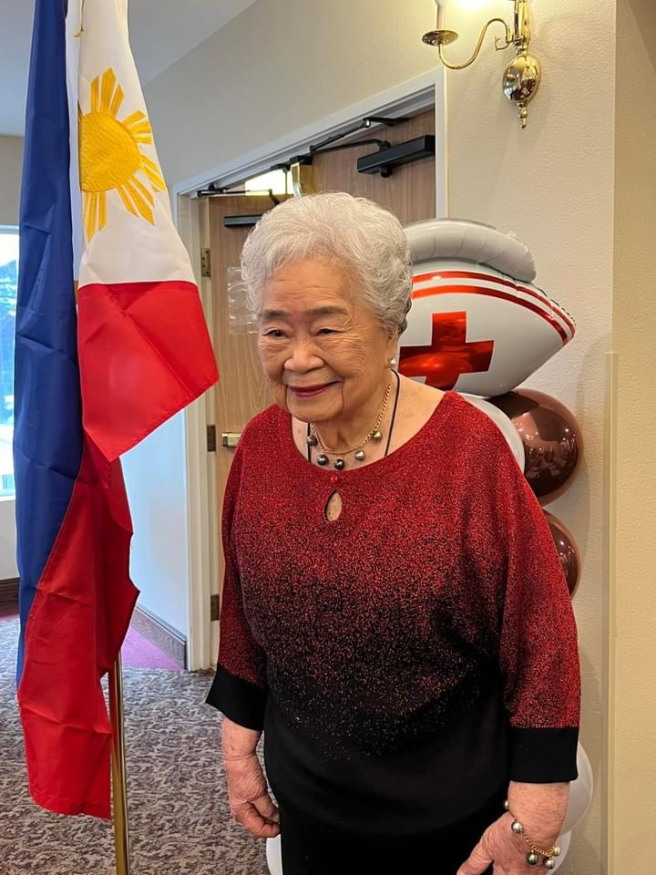
UP ROSE 2024 awarding to
UPNAAI Founder Mrs. Floresinda Sison-Castello
UP ROSE Awardee
Founding President of UPNAAI is presented a Leadership Award , 44th UPNAAI Convention 2023
UP ROSE award presented in person at the Nursing Home Facility of which Ms. Floresinda Sison Castello is a resident
Fondly called Mama Flor, she verbalized how proud of all the Alumni who share their time, talent and expertise as well as their resources to help others.
A short program and luncheon culminated the event. It was an honor to meet the Founding President, 2 other past presidents, Mrs. Lyvia Villegas, Class 1968, and Debbie Butuyan, Class 1989 participated and joined the momentous occasion along with Mama Flor’s family!

Slide 23
Sapphire jubilee celebration 2024: UPNAAI Life membership gifted to 57 upCn 2024 seniors
A Board Resolution was unanimously approved by the Executive Board of Directors last May 2024, after the resounding success of the Balik Turo Program in April, and the exhilarating and enthusiastic response of the UPCN Students to the Balik Turo presentations, to award the UPCN Class of 2024, a total of 57 graduating Seniors, the UPNAAI Life Membership. This is the highlight of this years Sapphire Jubilee celebration. The graduating seniors will be eligible for the UPNAAI Life Membership provided they complete all requirements for graduation and are officially on the graduation roster. Upon completion & submission of the UPNAAI membership application packet, the Membership Chair, Rosemarie Gadioma, will review and approve the application. The Life membership fee of $150 USD for each graduating Senior is sponsored & donated by generous individual Nursing Alumni, Chapter members and Class batches with a total cost of $8550.

Slide 24
Sapphire jubilee life membership donors
Josephine Aparri, Class ‘65 UP-PGHSN; UPCN’66, Med Class ’71
UPNEC Chapter
UPNAA Texas
UPNAA-DelMarva
UPNAA-RMRPS
UPNAA-Florida
UPNAA-California
Abarca Family GN’63
Castello Family GN’50
Osano Family GN’59
Micabalo Family BSN’58
Delmarva, Texas, RMRPS

Slide 25
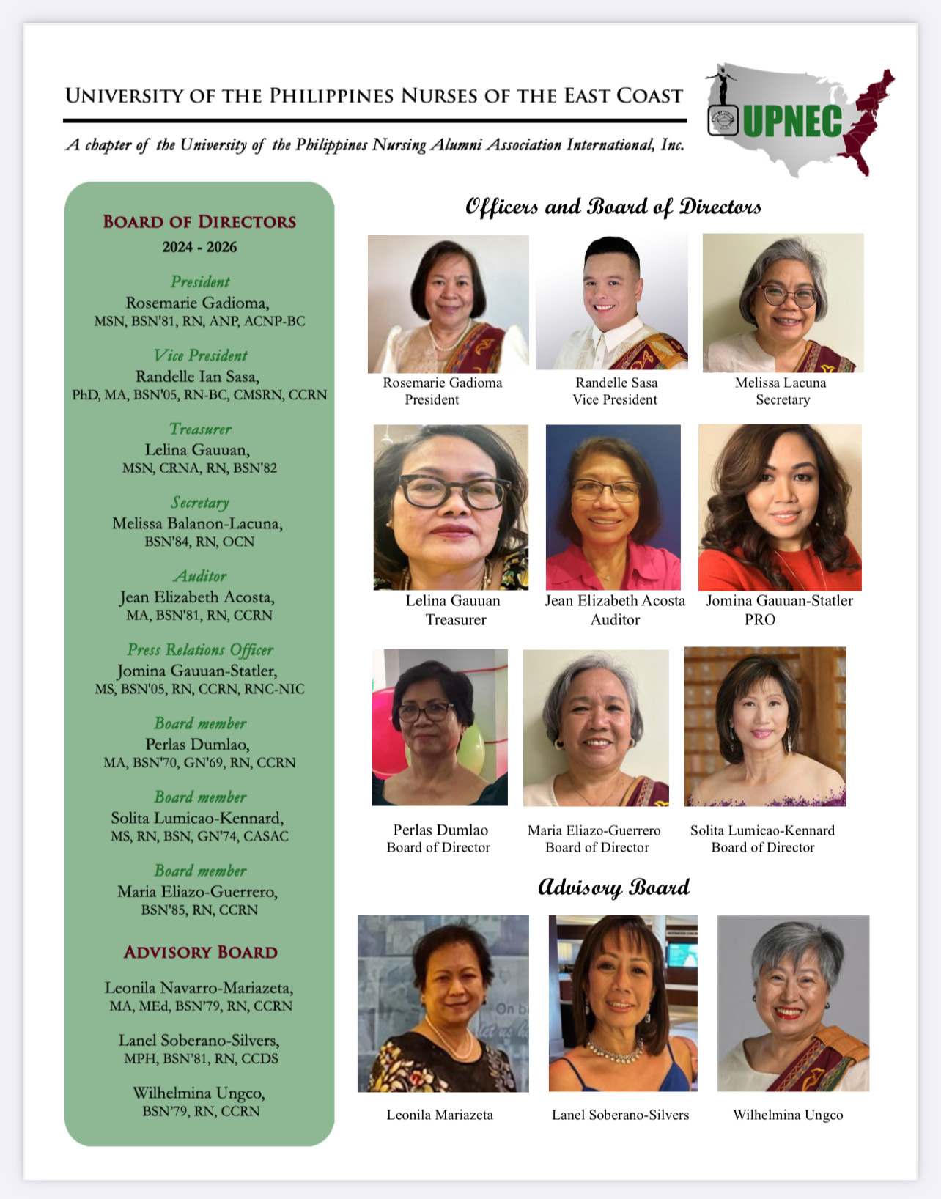
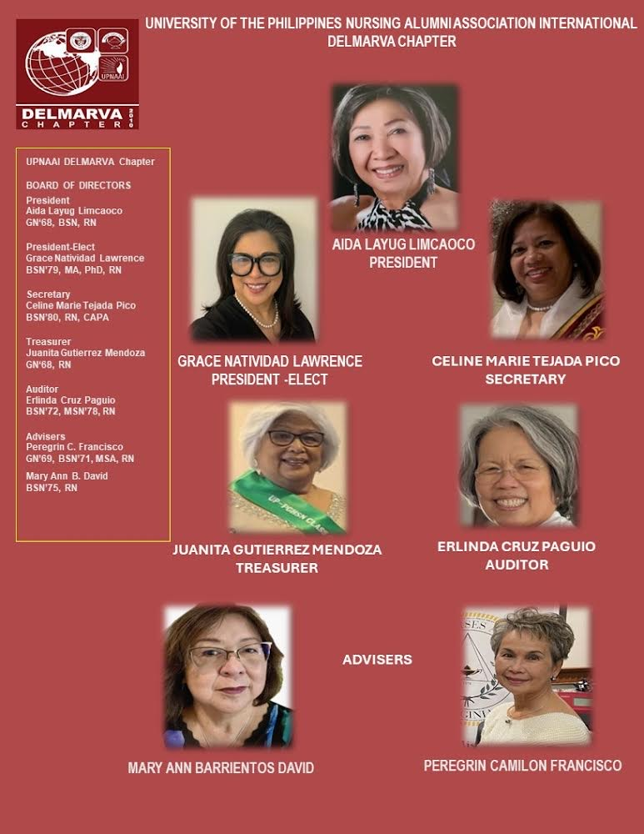
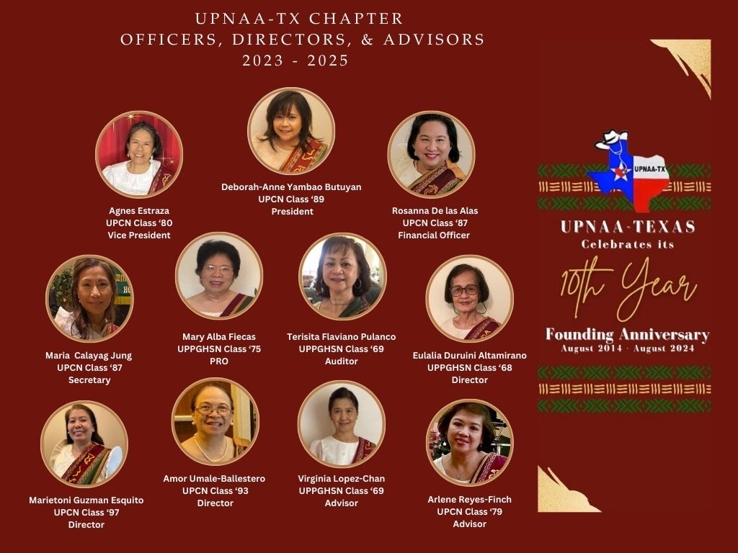
Upnaai, Inc., chapters

Slide 26
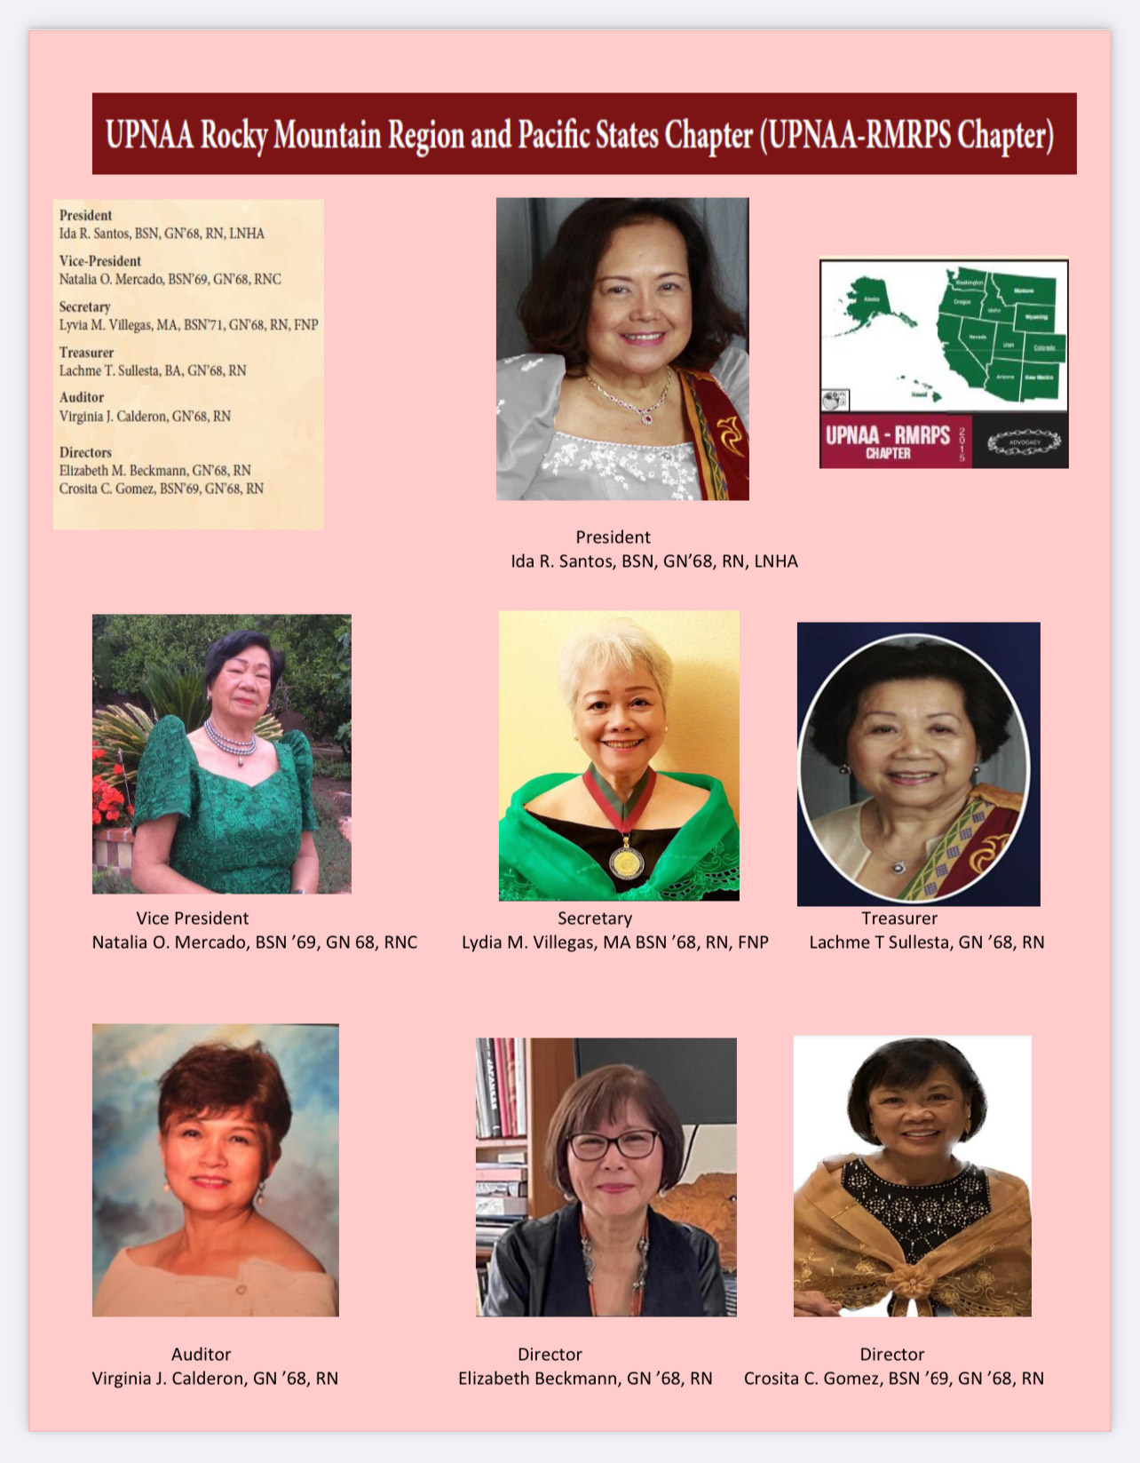

UPNAAI, INC. CHAPTERS

Slide 27
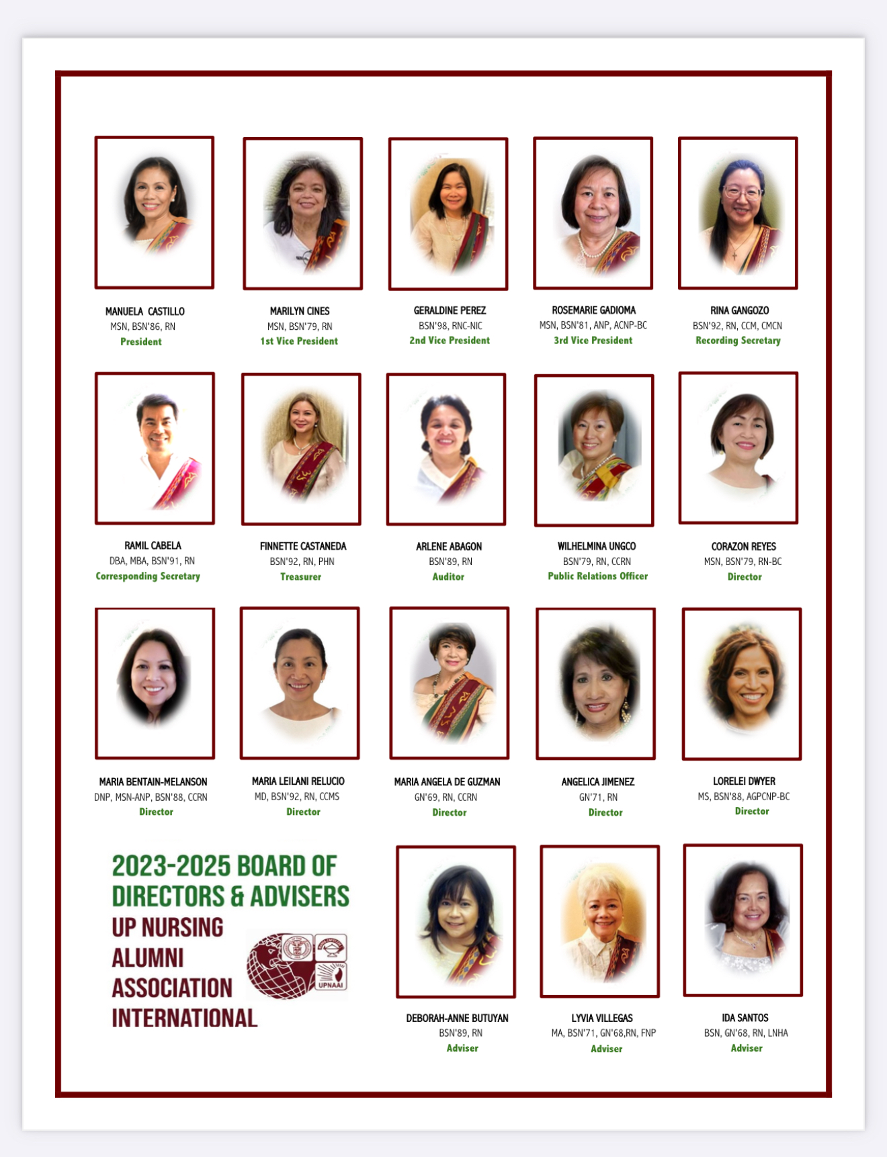
UPNAAI BOD 2023-2025

Slide 28
UPNAAI BOD 2025-2027
The Nominations and Elections Committee (NEC) are pleased to announce the incoming UPNAAI Executive Committee 2025-2027 which includes the Board of Directors and Advisors.
President
President-Elect
1st VP
2ndVP
3rd VP
Recording Secretary
Asst Secretary
Treasurer
Auditor
PRO

Slide 29

Save the date: 47th annual upnaai convention

Slide 30
Chapter Updates
UPNAA-New England Chapter
Restructuring of UPNAA-California
Shout out to Members from California, we are looking for dynamic and innovative leaders to join the Board of Directors, California Chapter
Reach out to Maria Melanson, Chapter Formation and Development Chair
The spirit of volunteerism is alive, the spirit of giving back is instilled in each and everyone of us.
Currently in discussions
New Chapter will include Connecticut, Massachusetts, Rhode Island, New Hampshire and Vermont,
Please nominate potential members that reside in those States
Email the Chair of Chapter Formation & Development if you know someone or would like to nominate them as founding member

Slide 31
THANK YOU

