Slide 1




UNIVERSITY OF THE PHILIPPINES
NURSING ALUMNI ASSOCIATION INTERNATIONAL, Inc.
Beyond the Frontiers of Traditional Nursing:
Artificial Intelligence, Genomics, Simulation, and Hybrid Learning
42nd Annual & 2nd Virtual Convention
August 6th & 7th, 2021

Slide 2
Educational Webinar August 6th, 2021
3:00 Opening Remarks: Wendy Vaughn, BSN’88, MSN, CCRN, OCN, 1st VP and Chair, Education and Research Committee
3:01 National Anthems of the USA and the Philippines: Ramil Cabela, BSN’91, MBA, DBA (Pearl Jubilarian)
3:10 ZOOM Rules and UPNAAI Disclosures: Wendy Vaughn, BSN’88, MSN, CCRN, OCN, 1st VP & Chair, Education & Research Committee
3:15 Invocation: Fe Rosario Antequino, GN’71, President, UPNAA Florida (Gold Jubilarian)
3:20 Welcome Remarks: Wilhelmina Ungco, BSN’79, RN, CCRN, UPNAAI President
3:25 Introduction of JVS Committee Chair-Peregrin Francisco: Wendy Vaughn, BSN’88, MSN, CCRN, OCN
3:35 Introduction of JVSMOH Awardee: Peregrin Francisco, GN’69, BSN’71, MSA (Gold Jubilarian)
Presentation of JVSMOH: Wilhelmina Ungco, BSN’79, RN, CCRN
3:50 Rescuing Nursing Education: From Traditional to Contemporary
Keynote Speaker: Violeta Lopez, GN’71, BSN, MNA, MPET, PhD, RN, JBIC, AFAHSE, FACN, (Gold Jubilarian)
4:30 Q&A
4:40 Break
5:00 Genetic Variations as Determinants of Phenotypic Response to Drugs
Grace Lawrence, BSN’79, PhD
5:40 Q&A
5:50 Online Learning in Nursing Education: Lessons in Resilience in a Time of Pandemic
Elinore Espiritu-Ioan, BSN’81, RN, MSN-FNP, MPA, EdD (Ruby Jubilarian)
6:30 Q&A
6:40 Break
6:50 Resuscitation Quality Improvement
Wendy Vaughn, BSN’88, MSN, CCRN, OCN
7:30 Q&A
7:40 Genetics and Genomics Nursing in the Philippines: Status, Initiatives, and Opportunities
Peter James B. Abad, BSN’10, RN, MSc
8:20 Q&A
8:30 Break
8:40 #1 Poster Presentation- Quality Improvement: Reducing Stress and Anxiety in Filipino Nurses with Less than Five Years of
Nursing Experience in Nevada Through the Implementation of a Mentorship Program
Flora Dado Sayson, DNP, MS, RN
8:55 Q&A
9:05 #2 Poster Presentation: Sepsis Pathway of Treatment Bundle of Awareness
Judy Enriquez Santelices, BSN, RN and Irish Ann B. Florendo, BSN, RN
9:20 Q&A
9:30 Summation By JVSMOH Awardee: Violeta Lopez, GN’71, BSN, MNA, MPET, PhD, RN, JBIC, AFAHSE, FACN (Gold Jubilarian)
9:40 Closing Remarks by 1st VP and ERC Chair: Wendy Vaughn, BSN’88, MSN, CCRN, OCN
9:50 UP Naming Mahal
10:00 Group Picture: Dennis Juanir, BSN’89, RN, Webmaster and Auditor

Slide 3
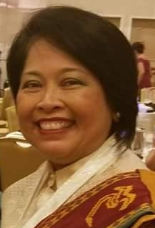
Opening Remarks
42nd Annual & 2nd Virtual Convention
August 6th & 7th, 2021
Wendy Vaughn
1st Vice President
BSN ’88, MSN, CCRN

Slide 4

Philippine National Anthem
By Ramil Cabela, BSN’91, MBA, DBA (Pearl Jubilarian)
42nd Annual & 2nd Virtual Convention
August 6th & 7th, 2021

Slide 5


Slide 6

United States of America National Anthem
By Ramil Cabela, BSN’91, MBA, DBA (Pearl Jubilarian)
42nd Annual & 2nd Virtual Convention
August 6th & 7th, 2021

Slide 8
Zoom Instructions
Your microphone and video will be muted by the host.
Please refrain from multi-tasking.
Choose the speaker view to have a full view of the slides and the speaker.
Type your questions for the speaker at the chat box at the bottom of the screen. The questions will be asked at the end of each presentation.
The chat box at the bottom of the screen is also for any messages you want to send. The message you type on the chat function will be viewable by everyone unless you specify the recipient. Socialization in the chat box is recommended during breaks only.
This is a professional event please wear business casual attire.
If you get logged out, please log back in.
This program will be recorded. You may use a virtual background or mute your video.
At the end of the program, everyone may be unmuted to allow for socialization.

Slide 9
Disclosures
This educational activity awards six(6) contact hours
Attendance to the entire program and completion of the evaluation are
required to receive the e-certificate of attendance and contact hours
UPNAAI is an accredited provider of continuing nursing education by the California Board of Nursing with CEP # 6961
To complete the evaluation click the link provided in the chat box and click submit when you’re done. The evaluation link will be shown on the break slides if you wish to copy it. You will receive an e-certificate in a week’s time after completion and submission of the program evaluation
The speakers have declared no conflict of interest
This educational activity has no commercial support
This educational activity is not a joint provider activity
The content of this educational activity has no connection with any products consumed by or used by patients, so there is no conflict of interest for anyone with the ability to control the content of this activity
This program will be recorded

Slide 10
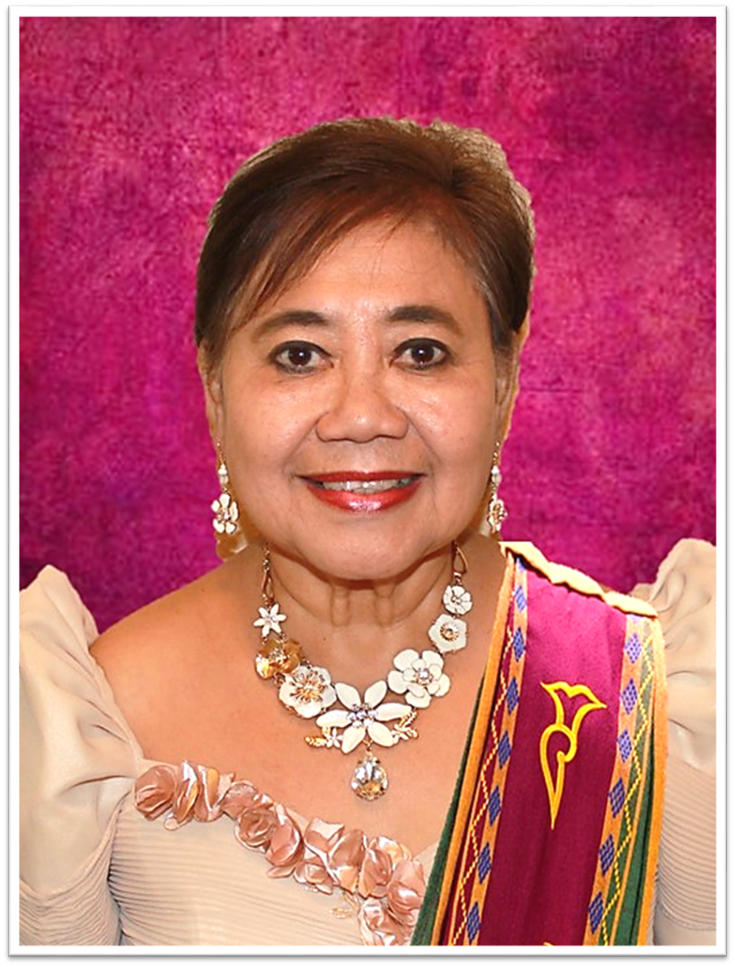
Invocation
42nd Annual & 2nd Virtual Convention
August 6th & 7th, 2021
Fe Rosario Antequino, GN’71
Gold Jubilarian
Notes:
representing PGHSN Class ‘71 and the Founding President of UPNAA Florida.
Before I start, I’d like to acknowledge a nursing colleague, Aga Sta. Romana, who helped me prepare this invocation.
And now, may I ask for some moments of silence to acknowledge God's presence in, among, and around us?
We invoke the spirit of WONDER:
Heavenly Father, in this virtual gathering of mind and spirit pursuing what lies beyond the frontiers of nursing, do awaken in us the true gift of childhood wonder: the spirit of gripping-naïve awe and raw-respectful fear bringing us down to our knees for humble homage and on the lap of your paternal omnipotent omniscience. May the same spirit of WONDER propel us to strengthen the services and programs of UPNAAI to help make it a more robust organization of choice for the UP nursing alumni.
We invoke the spirit of GRATITUDE:
Heavenly Father, in acknowledging and thanking the presence of all attendees on this 42nd Annual Convention and 2nd Virtual Reunion, enkindle in us the spirit of gratitude that will be our trustworthy source of peace and joy and consolation in times of loneliness and despair. May we celebrate every gracious moment of reunion and gathering with the laughter of fond memories to bridge us through the desolate dawning of life we witnessed during this pandemic.
We invoke the spirit of DIALOGUE and FRIENDSHIP:
Heavenly Father, in fostering unity and bond of fellowship by mutual understanding and cooperation among us alumni by the professional and personal development of its members through education, research, support, and collaboration, stir up the spirit of reverential dialogue and genuine friendship grounded and rooted in our love for You and our neighbor as it strengthens the common bond among the seven chapters of UPNAAI and forge a more vital collaboration to promote UPNAAI objectives. May we be courageous and passionate architects of dialogue and friendship, men and women who always hold out a helping hand and may no spaces of enmity remain. (Pope Francis)
We invoke the Spirit of EXCELLENCE:
Heavenly Father, in providing leadership to pursue the ideals of unity, fellowship, academic excellence, leadership, professionalism, and service to country and humanity among nursing graduates of the University of the Philippines residing in the United States and other countries abroad impel and compel our inordinate ambition and blinding pride with the spirit of humble and judicious pursuit of excellence, through which the fruition of all our effort may begin from You and by You be happy ended following Jesus example of being God he deigns to be like us human to save and serve us. May the incarnational and kenotic love of your Son be our example in all our fundraising projects, outreach programs, and politico-social engagements to effect and produce an enduring and effective outcome.
We invoke God’s Power for PROTECTION and BLESSINGS:
Heavenly Father, in aiming to foster UPNAAI members' professional and personal development, protect and empower us with your Magnanimous Sovereignty and bless and grace us with your Paternal Love manifested in your wonderful natural creation. May we respect your natural creation around us and see the wondrous mystery of our unique creativeness and translate the same awe and respect to the external world around us by our resolved commitment for the protection and responsible use of our environment. May our being blessed be a comforting and loving blessing to others around us.
And all of this we ask in Jesus' name. Amen

Slide 11

Welcome Remarks
42nd Annual & 2nd Virtual Convention
August 6th & 7th, 2021
Wilhelmina Ungco, BSN’79, RN, CCRN UPNAAI President
Notes:
Good morning Philippines and Australia. Good afternoon Pacific Coast and British Columbia. Good evening East Coast. We have weathered a health crisis. Some of us succumbed but for many of us we continue the good fight. Here we are again after a tumultuous year of COVID 19 Pandemic, courageous, faithful, and keeping alive the legacy of many UPNAAI trailblazers who went beyond the frontiers of traditional nursing. In this event we will witness the fruition of Dean Julita V. Sotejo’s vision. We will hear from nurse experts that go beyond the basic but equally noble and essential bedside nursing. So without further ado I give back the floor, rather the spotlight , to the Moderator- 1st Vice President and Chair of the Education and research Committee- Wendy Vaugh.

Slide 12
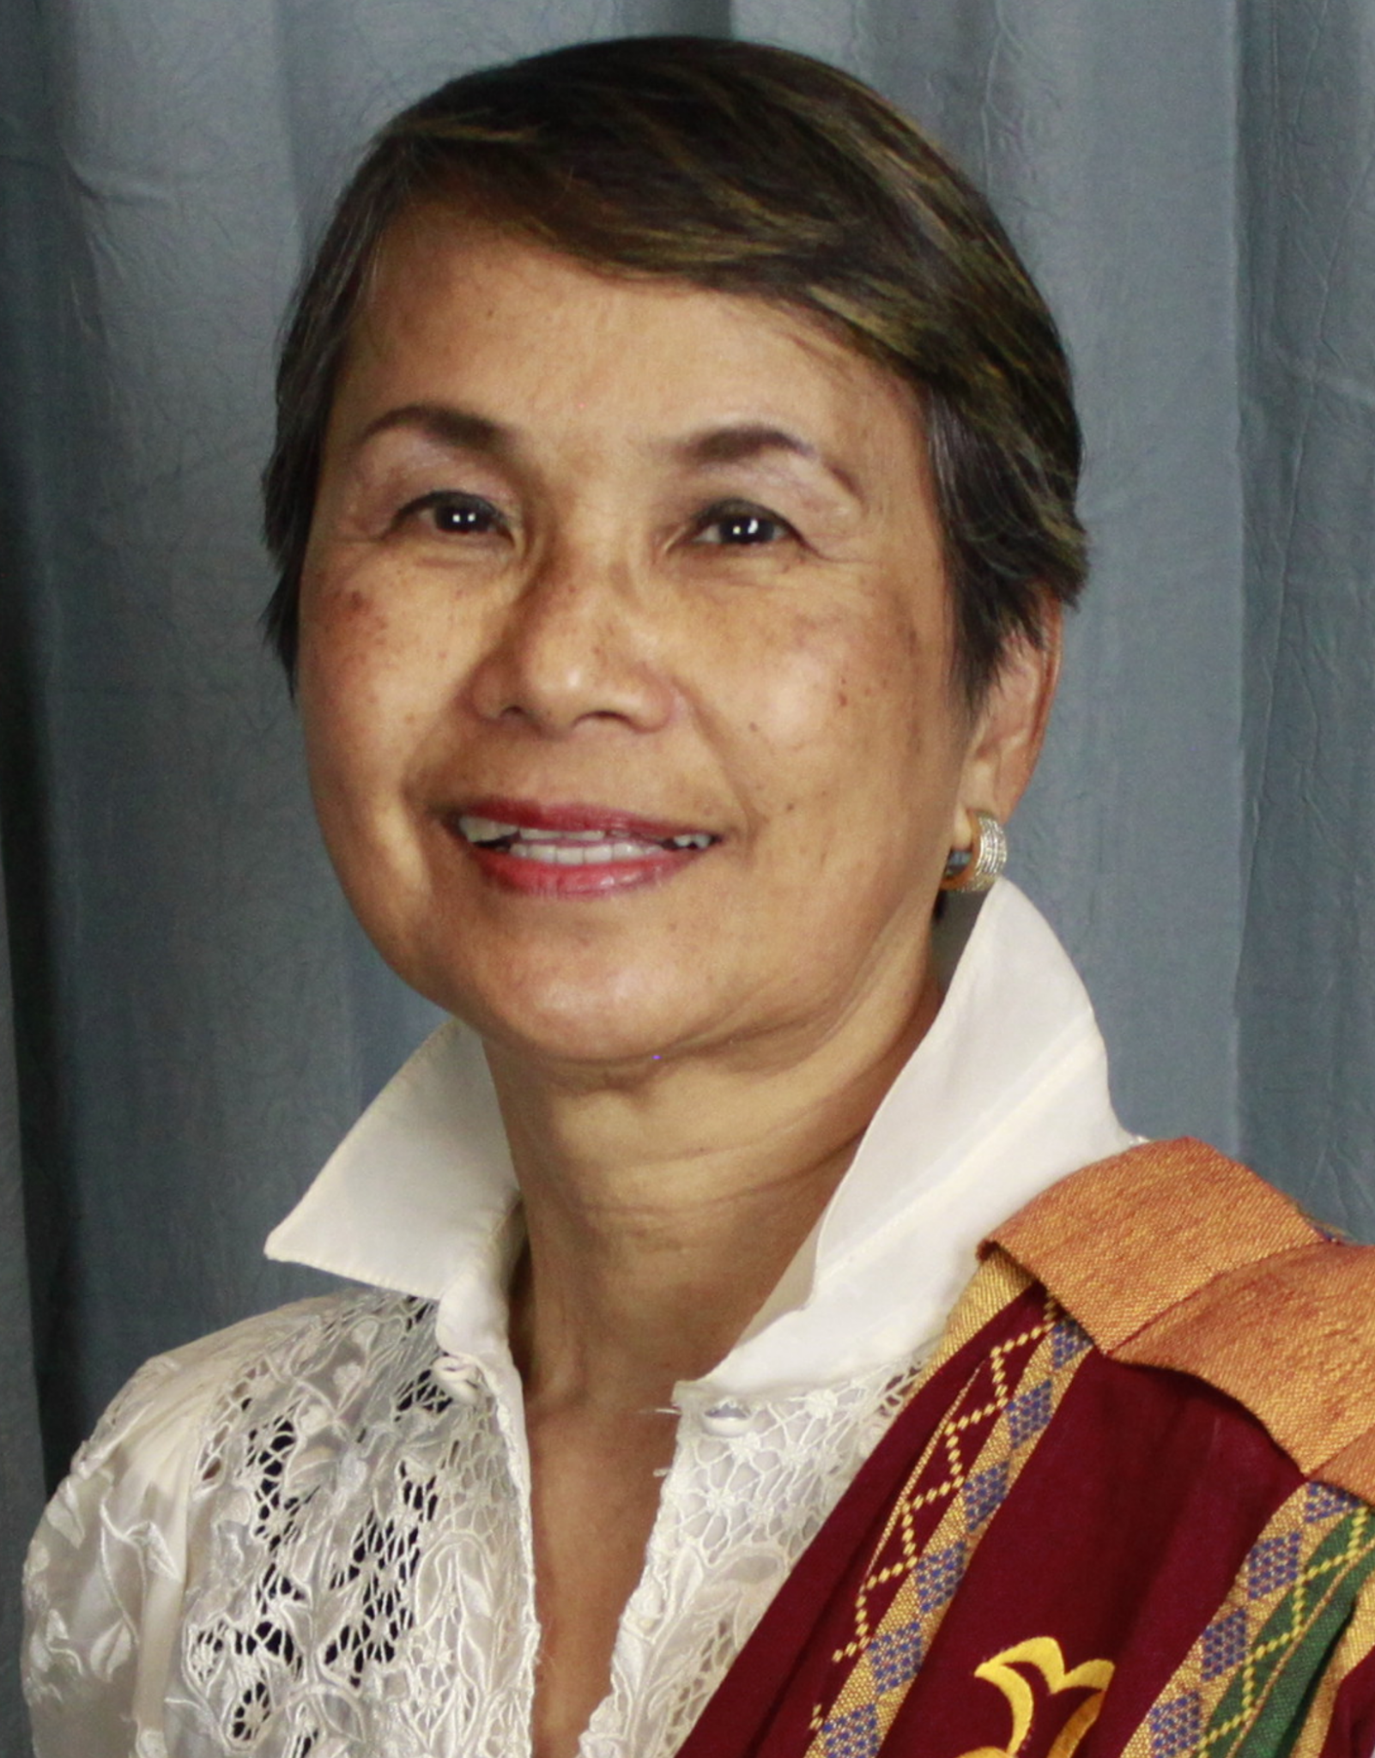
Introduction of JVSMOH Awardee
42nd Annual & 2nd Virtual Convention
August 6th & 7th, 2021
Peregrin Francisco, GN’69, BSN’71, MSA, RN
(Gold Jubilarian)
JVS Commitee Chair
Notes:
Thank you Wendy for your introduction. Greetings from the Commonwealth of Virginia! Welcome all of you to this 2nd virtual University of the Philippines Nursing Alumni Association International Educational Webinar and 42nd Reunion Convention.

Slide 13


Julita V. Sotejo Medallion of Honor
Medallium Honoris Servitium Pro Patriae et Humanitate
Notes:
The Julita V. Sotejo Medallion of Honor was initiated in 1993 by the University of the Philippines Nursing Alumni Association International, Inc. Chosen by peers, the Medallion of Honor is the highest award to recognize alumni who embody the ideals espoused by Dean Sotejo. They must have made a significant, unique and innovative contribution to the nursing profession, must have attained national and possibly international prestige, and have rendered service to country and humanity.
On behalf of the Julita V. Sotejo Medallion of Honor Committee and its members: Rosemarie Gadioma (NY), Aida Limcauco (VA), Erlinda Paguio (VA), Tess Carambas-Santos (WA), and Lyvia Villegas, I am proud to introduce the 2021 JVS Medallion of Honor and the 27th recipient of this award.

Slide 14
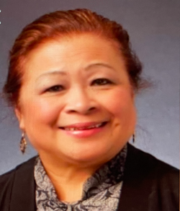
2021 Distinguished JVSMOH Awardee
Violeta Lopez, GN’71, RN, MNA, MPET, PhD, FACN
Notes:
I am deeply honored to introduce and award the 2021 Universsity of the Philippines Nursing Alumni Association International Julita V. Sotejo Medallion of Honor to Dr. Violeta Lopez.
Dr. Violeta Lopez graduated with a Graduate of Nursing Diploma from the University of the Philippines-Philippine General Hospital School pf Nursing in 1971 and completed her Bachelor of Nursing Degree from Far Eastern University in 1973. She completed her Master of Nursing Administration from the University of South Wales, Australia in 1986 and PhD from the University of Sidney, Australia in 1997. She built her nursing career and reputation on Transcultural Nursing and pioneered in nursing research related to Transcultural Nursing in several countries; Australia, Thailand and China to mention a few. Dr. lopez is a Fellow of the Royal College of Nursing in Australia and received multiple awards of Excellence in Nursing Education and Research. She mentored numerous graduate and post-graduate students who made professional nursing contributions in their respective area of specialties and countries.
Dr. Lopez is much-sought after speaker nationally and internationally: as a keynote speaker and a panelist in plenary sessions in South Korea Asia Federation of Critical Area Nurses (Mexico), World Nursing Conference (Singapore), Philippine Embassy Nurses Forum (Australia) and many more.
Dr. Violeta Lopez received a Lifetime Achievement Award from the United States President Barack Obama in 2016, for grateful recognition of her lifelong commitment to building a stronger nation through volunteer service. In 2017, Dr. Lopez was commissioned by the Honorable Order of Kentucky Colonels, by the Governor of Kentucky, for her good deeds, noteworthy accomplishments and outstanding community service. Dr. Lopez was consistent in her pursuit of her community service in underdeveloped countries that won her many awards beyond what I have already mentioned. She continues to share her “intellectual properties” gained from her teaching and mentoring students from many other Asian countries.
I can go on and on, and still not do justice on her 37 page resume and list of accomplishments for this introduction. She met and exceeded the JVSMOH criteria. Please check and read more about Dr. Violeta Lopez in our UPNAAI website and 2021 Yearbook.
As the Chair of the Julita V. Sotejo Medallion of Honor Committee, let us applaud and welcome the 2021 UP Nursing Alumni Association International Julita V. Sotejo Medallion of Honor awardee, Dr. Violeta Lopez.

Slide 15
Presentation of the
2021 Distinguished JVS Medallion of Honor
Awardee
42nd Annual & 2nd Virtual Convention
August 6th & 7th, 2021
Wilhelmina Ungco, BSN’79, RN, CCRN
UPNAAI President

Slide 16
Julita V. Sotejo Medallion of Honor
Medallium Honoris Servitium Pro Patriae et Humanitate
Notes:
The JVS Medallion of Honor is more than a symbol of the ideals and tremendous accomplishments of a great nurse that is Dean Sotejo. This medallion is a living legacy. Its meaning and significance are validated every year as it is bestowed upon the deserving recipient.

Slide 17
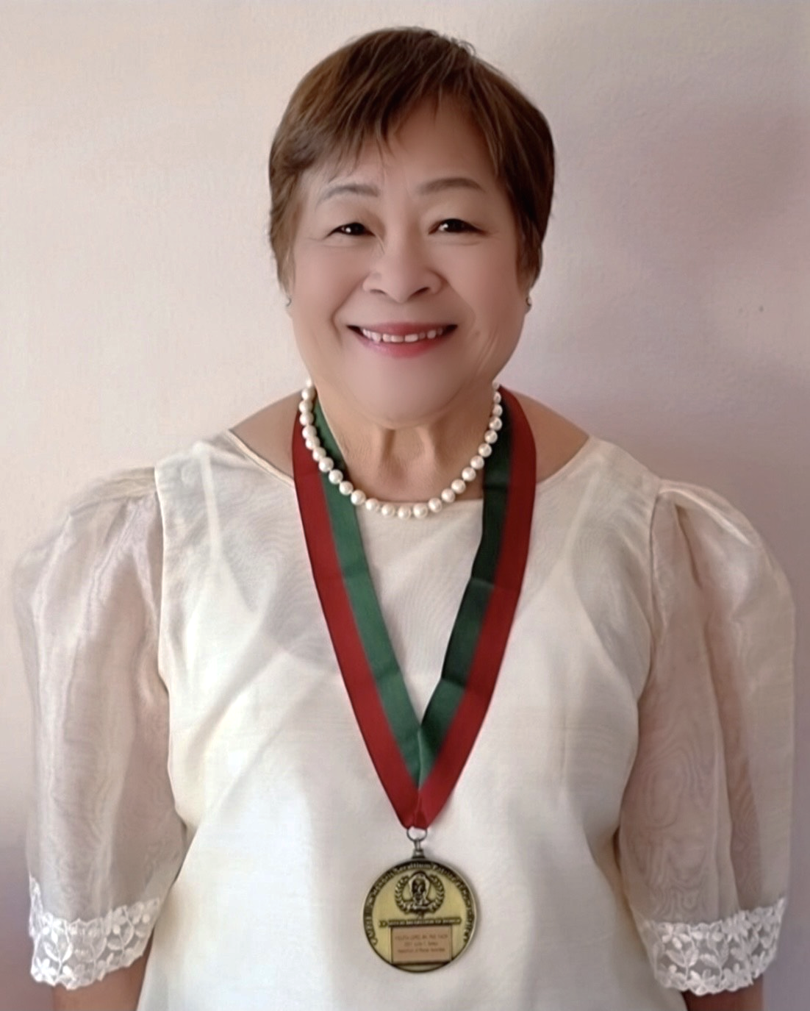
2021 Distinguished JVSMOH Awardee
Medallium Honoris Servitium Pro Patriae et Humanitate
Violeta Lopez, GN’71, RN, MNA, MPET, PhD, FACN
Notes:
Therefore, it is with great pride and honor that I present the 2021 Distinguished JVSMOH Awardee- Dr. Violeta Lopez. Congratulations, Dr. Lopez. And now to deliver the Keynote Address- Dr. Violeta Lopez.

Slide 18

Keynote Speaker Presentation:
Rescuing Nursing Education:
From Traditional to Contemporary
42nd Annual & 2nd Virtual Convention
August 6th & 7th, 2021
Violeta Lopez, GN’71, RN, MNA, MPET, PhD, FACN
2021 Distinguished JVSMOH Awardee
Notes:
Dr. Lopez will give her introduction then when you hear "The topic of my presentation today is.." then go to Dr. Lopez’s first slide

Slide 19


RESCUING NURSING EDUCATION:
Traditional to Contemporary
Professor Violeta Lopez
RN, BSN, MNA, MPET, PhD, FACN
Hubei University of Medicine, School of Nursing
University of Tasmania, School of Nursing
President, Filipino Nursing Diaspora Network
Julita V. Sotejo Medallion of Honor Recipient
Notes:
Rescuing nursing education from the traditional to contemporary.
In this presentation, I will review the past and now of nursing education and what the future of nursing will look line
Wat are the changes need to move forward and cross the gap especially during this unpresedented COVID-19 pandemic.
The rules of the game from the past to future

Slide 20

Rules of the game
Notes:
Of nursing education means that there are many hurdles that we need to meet but there are certain rules of the game within the nursing profession that we should overcome throughout our journey to meet our goals for the future.
In the past

Slide 21


Nursing education: Problems of the past
INSTRUCTIONAL PARADIGM
This Photo by Unknown Author is licensed under CC BY
Notes:
The problem in nursing education was that it used the instructional paradigm. The reasons for this were many because of the low-level of educational preparation for student nurses mainly hospital-based provided by nursing educators with also low level of teaching preparation.
There much focused on teacher-centered pedagogy., content saturation where students required memorization, excessive readings and assignments and content processing. Nowadays

Slide 22


LEARNING PARADIGM
Notes:
There is much focus on learning paradigm and student-centered pedagogy. Nursing education moved to colleges and university settings. Some have used teaching technologies and simulations to provide teaching and more have focused on transition from theory to practice.
In the future

Slide 23

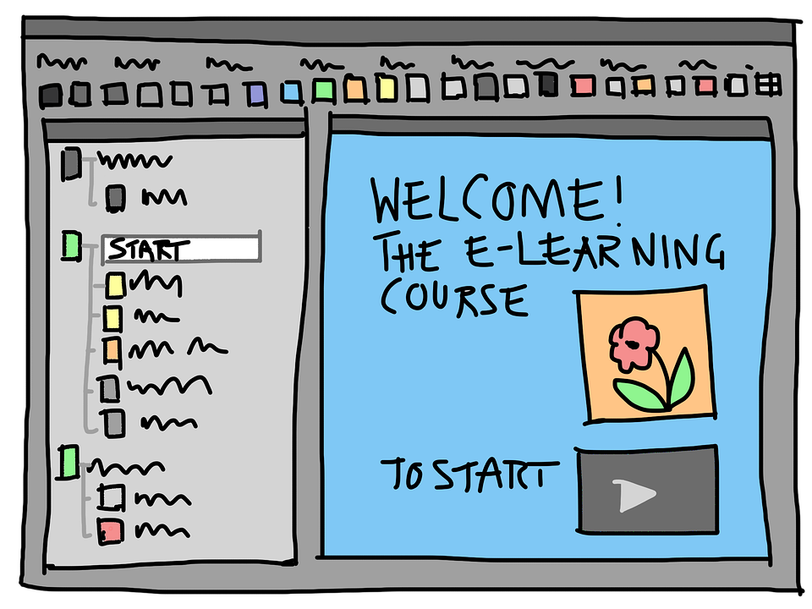
E-LEARNING
Notes:
Nursing education will change dramatically using fully utilised teaching and learning technologies. Nursing education will continue to be university-based with PhD-prepared nursing academics and researchers. There will be more focus on interdisciplinary teaching and learning approaches and changes in accreditation policies.
How do we then bridge the gap?

Slide 24

Bridging the Gap
Period of transition
Notes:
There is still a long way to go. The past has provided us with information why we need to change to meet the future needs of our clients and the healthcare system.
In so doing, wee need to revisit the report of the Institute of Medicine – The future of Nursing

Slide 25


Bridging the Gap
National Academies of Sciences, Engineering, and Medicine. 2021. The Future of Nursing 2020-2030: Charting a Path toAchieve Health Equity. Washington, DC: The National Academies Press. https://doi.org/10.17226/25982.
Institute of Medicine. (2010). The future of nursing. Available from URL: http://doi: 10.17226/12956
Notes:
Although these reports were provided in 2010 and the 2020, I believe that the key messages in these reported have much relevance to guide us in the future.
The first key message

Slide 26
KEY MESSAGE - 1
Nurses should practice to the full extent of their
education and training
Institute of Medicine. (2010). The future of nursing. Available from URL: http://www.IOM.edu
Notes:
Is that nurses should practice to the full extent of their education and training

Slide 27

Nurse
Consultant
Nurse
Researcher
Nurse
Educator
Nurse
Administrator
Nurse
specialist
Nurse
practitioner
This Photo by Unknown Author is licensed under CC BY-NC-ND
Notes:
This recommendation pertains to needed changes at the federal, state, and local levels to facilitate the uniform independent practice including prescriptive authority of advanced practice nurses (nurse practitioners, nurse-midwives, clinical nurse specialists, and nurse anesthetists).
The second key message is

Slide 28
KEY MESSAGE - 2
Nurses should achieve higher levels of education and
training through an improved education system that
promotes seamless academic progression
Institute of Medicine. (2010). The future of nursing. Available from URL: http://www.IOM.edu

Slide 29
MOVING FORWARD
Expert
Proficient
APNAPN
Competent
APN
Advanced
Beginners
Specialist
nurses
Masters
PhD
Novice
3rd year RNs
Newly
Postgraduate
Masters
2nd year RNs
Degree
Newly
Graduate RNs
Degree
Certificate
Degree
Notes:
There is critical recommendation calls for the collaboration of academic nurse leaders across the range of educational programs and the related stakeholders of accrediting bodies, public funders, and employers.
This essential recommendation calls on academic in private and public agencies, leaders and related bodies to double in 10 years the number of nurses prepared at the doctoral level to add to the cadre of nurse faculty and researchers, also with an emphasis on increased diversity among nurses. The 3rd key message is

Slide 30
KEY MESSAGE - 3
Nurses should be full partners, with physicians and other
Health professionals, in redesigning health care
Institute of Medicine. (2010). The future of nursing. Available from URL: http://www.IOM.edu

Slide 31

MOVING FORWARD
Planned
  Coherent and progressive
Created
  Delivered
Understood
  Received
Notes:
interprofessional collaboration is the practice of approaching patient care from a team-based perspective - the focus is on the patient as a whole rather than a specific diagnosis or treatment.”
Interprofessional education provides a practical framework for learning and clinical practice that has a singular focus on the patients’ needs above all else. Interprofessional approach facilitates vital sharing of expertise and encourages all practitioners to focus on the common goal of restoring or maintaining optimal patient health. It is a movement fueled by the greater complexity of patient needs and the clear recognition that no one profession alone can respond adequately to the multiplicity of problems that many patients have.
Benefits include: improve patient care outcomes, reduce medical errors, start treatment faster, reduce inefficiencies and healthcare costs and improve staff relationships and job satisfaction
The 4th key message is

Slide 32
KEY MESSAGE - 4
Effective workforce planning and policy making require
better data collection and an improved information
infrastructure
Institute of Medicine. (2010). The future of nursing. Available from URL: http://www.IOM.edu

Slide 33



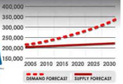
MOVING FORWARD
Open forum
WHO/ICN/GOV Reports
Opinion leaders
Surveys
Notes:
A shortage of Registered Nurses is expected to intensify as the Baby Boomer population ages. The nursing shortage has only intensified due to the COVID-19 pandemic as hospitals and other health care environments struggle under unprecedented patient loads.
Even pre-COVID, the Bureau of Labor Statistics had projected Registered Nursing to be one of the top occupations for job growth through 2028. It is expected to grow by 12% and reported that more than 400 thousand new RN jobs will be needed by 2028. Nursing remains a female-dominated profession, but slowly that is beginning to change.
Since 1960, there has been a clear trend toward increasing numbers of male nurses. The share of nurses who are male went up from 2.2% in 1960 to 12% in 2019. As stigma fades and more men realize the benefits of a career in nursing, we expect the proportion of male nurses to increase. From these four key messages, Why do our teaching and learning need to change?

Slide 34
TEACHING AND LEARNING – WHY THE CHANGE
MELLINEALS
NET GENERATION
OLDER
WITH PAST DEGREES
EMPLOYED
OTHER OPPORTUNITES
WHY THE CHANGE
Notes:
Who are our future nursing students? They are the mellineals, net generations, older, with past degrees, employed and with other opportunities. Students are:
Multitaskers
Like to be entertained and stimulated
Get bored easily
Goal oriented
Likes to try new things
Knows what they want
Motivated to succeed
Grade focused
Teaching that is fast, relative, succinct
Need immediate feedback
What about medical technologies?

Slide 35

TEACHING AND LEARNING – WHY THE CHANGE
In the future we will be looking at people who might be
“half human” and “half machine” challenging the existence
of the human race…
Notes:
Medical technologies continue to expand.
In the future, we will be looking at people who might be half human and half machine challenging the existence of the human race.
What is happening to other healthcare technologies?

Slide 36

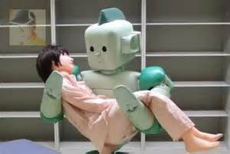
TEACHING AND LEARNING – WHY THE CHANGE
the human healthcare
workforce in the provision
of “care”
Versus
provision of “cure” that the
technological healthcare
workforce provides
Notes:
Even with AI automating many spheres of life now and in the future, human beings capable of empathising with others will have valued qualities.
Nursing differs from medicine in that it is based on those intrinsic nursing values centred on human understanding and caring for patients with a holistic view that cannot be substituted by machines.
How then do we rescue nursing education?

Slide 37

Rescuing the nursing education
  caring domains PLUS competencies in
  bio-engineering and
  computer science
Notes:
Given the crucial role of nurses with respect to the quality, accessibility, and value of care, the nursing profession itself must undergo a fundamental transformation if the committee’s vision for health care is to be realized. The ways in which nurses were educated and practiced during the 20th century are no longer adequate for dealing with the realities of health care in the 21st century. Outdated regulations, attitudes, policies, and habits continue to restrict the innovations the nursing profession can bring to health care at a time of tremendous complexity and change.
The way forward from 2020

Slide 38
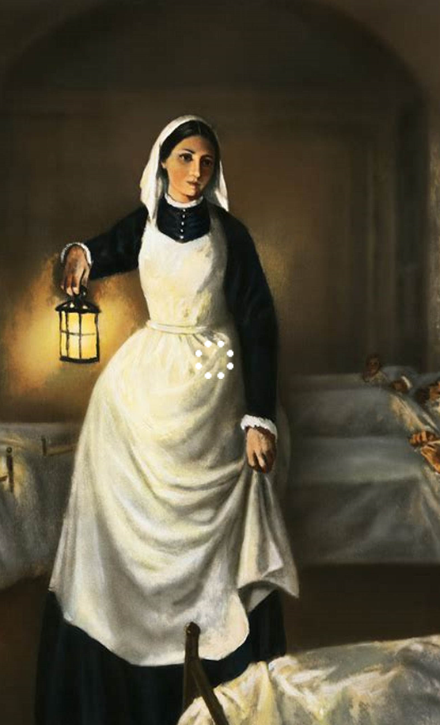
2020 and Way Forward
200th anniversary of
Florence Nightingale
Notes:
Although a great honour to celebrate the unique contributions of nurses and midwives, what then will this mean to nurses in the years to come considering the everchanging landscape of the aging population and shortage of nurses?
Recognising the work of nurses in different setting not only in acute care settings but also in ambulatory, community, nursing homes, schools and at home require a coordinated and multidisciplinary approach.
Transitioning nurses from the classroom to practice setting is an important preparation throughout the students’ as well as nurses’ life-long education.
To take on more complex tasks, participate as partners on healthcare team making critical decisions, nurses should be prepared to lead change to advance health.
What then should be our nursing goals?

Slide 39
Nursing Education Goals
Improvement in education, professional development,
standards, regulations
Clear progress in elimination global shortage of
9 million nurses
Improve dissemination of effective and innovative nursing
practice
Involvement of nurses in national policies on health and
health care
More nurses in leadership positions and opportunities for
development at all levels
Notes:
What should the nursing curriculum looks like?

Slide 40
The way forward
Product-based
Relevant
Interprofessional
Shorter and smaller
Multisite
Symbiotic Curriculum
Notes:
In rescuing the nursing education to be contemporary, a symbiotic curriculum is needed.
What is needed in the new curriculum content?

Slide 41
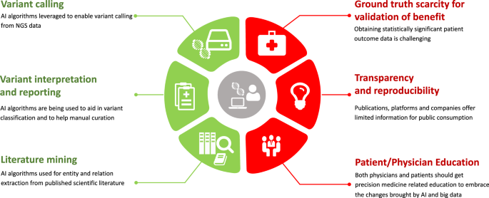
NEW CURRICULUM CONTENT - GENOMICS
This Photo by Unknown Author is licensed under CC BY
Notes:
The integration of genomics across health care provides nurses with leadership opportunities. Nurses could “accept the changes brought to healthcare by genomics as passive agents or they can be proactive in shaping and informing the transformation in their areas of practice.”
Genetics/genomics nursing practice and care focuses on the actual and potential impact of genetic and genomic influences on health. What are the aims of the curriculum content?

Slide 42
NEW CURRICULUM CONTENT - GENOMICS
GENOMICS
Integrate across nursing education
Mobilise information, resources and strategies to benefits
patients and families
Support nurses to integrate genomics across nursing
practice to improve healthcare for all.
Global Genomics Nursing Alliance
Notes:
The overarching intent of this genomic knowledge mobilization is to optimize resource accessibility and reduce duplication of efforts through leadership, collaboration and sharing. These nurses advise and educate clients and families on such influences that might impact their health, identify and manage physiologic responses. The goals of their nursing interventions: to optimize health, reduce health risks, treat disease, and promote wellness What do the International Society of nurses in genetics stand for?

Slide 43

WHAT IS A GENETICS NURSE?
Notes:
A genetics nurse is a licensed professional nurse with special education and training in genetics. Genetics nurses help people at risk for or affected by diseases with a genetic component achieve and maintain health. Genetics nurses perform risk assessment, analyze the genetic contribution to disease risk, and discuss the impact of risk on health care management for individuals and families.
They also provide specialty clinics where gene-based diagnoses and therapies in prenatal and reproductive technology centers
cancer centers, primary health care settings, pediatric clinics,
industrial health, school health, research centers
biotech and insurance industries
What are the other changes in nursing education?

Slide 44
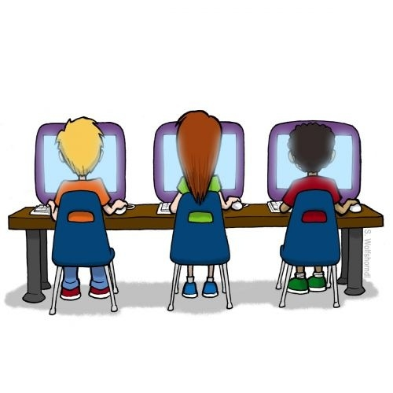
ONLINE NURSING EDUCATION is here to stay
This Photo by Unknown Author is licensed under CC BY-SA-NC
Notes:
Over the last two decades, nursing not only has been a leader in online education, but the online environment has become a staple. Online learning has matured from a basic discussion board in 1997 to virtual classrooms and simulations It has grown in enrolment and acceptance and especially appealing to nursing students who otherwise might be unable to pursue their education because of family and work demands, or because they live too far from a school to attend classes. Nurses worldwide have taken advantage of the flexible scheduling and variety of nursing specializations available via online educational programs.^{2, 3}
Students across the globe can actively engage in a virtual learning environment of classroom, lab and clinical settings — all rich in diverse perspectives and ideas.
What about online simulations?

Slide 45

Virtual Classrooms
and
Clinical Simulations
This Photo by Unknown Author is licensed under CC BY-SA
Notes:
Nursing faculty immersed themselves in this new learning culture, navigating the online landscape, learning new technologies and teaching methods and adapting the clinical education arena to online simulations. The technology allows students to actively engage with peers and faculty to changes in science and technology, patient-care needs and student preferences. As a result, online simulation learning helps equip students with skills, because the rapid growth of technology in clinical care means that the nurse of the future must be a health technology expert who provides safe, high quality, technology-infused patient care and is capable of accessing accurate, current information at the point of care.^{8n} With the changes to move forward, what are some of the questions we need to ask?

Slide 46

1. What are the challenges of the e-learning ?
How do nurse educators address the challenges and pedagogy in the e-learning environment?
3. What learning opportunities does e-learning modality afford, which are not available face-to-face?
This Photo by Unknown Author is licensed under CC BY
Notes:
What are the challenges we need to be aware of?

Slide 47

Online
delivery
methods
Assessments of
eLearning
Tools
CHALLENGES
Core
Clinical courses
Student
Technical abilities
This Photo by Unknown Author is licensed under CC BY-SA
Content
Notes:
There are many challenges that we need to overcome.
We a need an effective and efficient delivery methods
The tools we use should be user friendly
We need to ensure nursing students have the technical abilities to use the online delivery methods and tools.
The content of each course must be relevant in today’s context
We need to ensure that core clinical content matches the theoretical input
There should be a clear and authentic assessment strategies of e-Leaning
Based on the roadmap for global integration across nursing

Slide 48
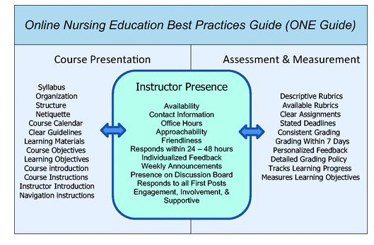
Tonkin, et al (2020) A roadmap for global acceleration of genomics integration across nursing. Jou Nur Schol, 52:3,329-338.
Notes:
We can use this roadmap in our nursing curriculum. Technological advances have brought new opportunities for clinical application of nursing, one of the core trends shaping the future of healthcare. The sheer size of the global workforce and the diversity of the professional role and settings in which nurses practice make them ideally placed to deliver health care, from novice to advanced practice levels.
Best evidence indicates that it is important for the online learner to have several ways to contact the instructor including email, video chat, telephone, or web conferencing. Instructors also should state availability times and create an environment that is comfortable for students to contact them . A positive, encouraging environment impacts learner motivation directly (Kuo et al., 2014). The online nursing education
best practice

Slide 49
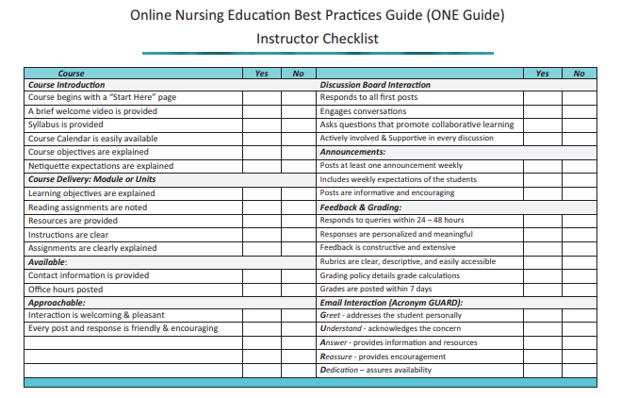
Tonkin, et al (2020) A roadmap for global acceleration of genomics integration across nursing. Jou Nur Schol, 52:3,329-338.
Notes:
Although the best practice instructor checklist was developed for genomic integration in the curriculum, I believe that it could be useful for any nursing courses to ensure that online teaching and learning are of high standard.
What are some online teaching tips

Slide 50





Online teaching tips
Provide clear directions
Engage students
Give immediate feedback
Stress organization
Notes:
Instructor presence is a pivotal component of online learning. Instructor presence encourages student engagement and connections with other students. Instructors should pay attention in how they provide constructive feedback to students’ work and accomplishment. They should also offer technological support when needed and stress the importance of being organised in what they need to learn using the information provided online.
We should also be mindful of the educational principles

Slide 51

Respect
for
autonomy
Relevance
to learners
EDUCATIONAL PRINCIPLES
Critical reflection
Context
based
Learning
and
assessment
relationship
Notes:
These educational principles are provided by the National League of Nurses.
These principles are important for successful teaching and learning today and in the future.
We need to learn what the past nursing education provided us to plan the path for what i9s to come.
Although the educational paradigm have changes so do teaching and learning among nursing students and educators have changed.
Rescuing nursing education to be contemporary is a continuous process and we always need to be proactive to meet the challenges to come before us.
I want to leave you with the following key messages

Slide 52

Be proactive
Pursue excellence
Do not be afraid to change
MESSAGES
Collaborate
Consider alternatives
Notes:
The five key messages I want to leave you are
Be proactive in making the changes needed to make the nursing curriculum contemporary
Do not be afraid to change any aspects of the nursing curriculum
Consider alternatives that will facilitate nursing students’ learning needs
Continue to collaborate with other health disciplines and mostly clinical nurses
Always pursue excellence in uplifting nursing profession
Thank you for listening to my presentation.

Slide 53

THANK YOU
Email: hccasyd@gmail.com

Slide 54
REFERENCES
Braithwaite, J., Mannion, R., Matsuyama, Y., Shekelle, P., Whittaker, S., Al-Adawi, S., Hughes, C. (2018). The future of health systems to 2030: A roadmap for global progress and sustainability. International Journal for Quality in Health Care, 30(10), 823–831.
Callaway, M. V., Connor, S. R., & Foley, K. (2018). World Health Organization public health model: A roadmap for palliative care development. Journal of Pain & Symptom Management, 55, S6– S13.
Calzone KA, et al., 2011 Establishment of the genetic/genomic competency center for education. J. Nurs. Scholarsh 43 (4), 351–358.
Jenkins J, Calzone KA, 2014 Genomics nursing Faculty Champion initiative. Nurse Educ. 39 (1), 8–13.
Read CY, Ward LD, 2016 Faculty performance on the genomic nursing concept inventory. J. Nurs. Scholarsh 48 (1), 5–13.
Rehm HL, 2017 Evolving health care through personal genomics. Nat. Rev. Genet 18(4), 259–267.
Seven M, et al., 2015 Nurses’ knowledge and educational needs regarding genetics. Nurse Educ. Today 35 (3), 444–4
Tonkin E, et al., 2011 Genomic education resources for nursing faculty. J. Nurs. Scholarsh 43 (4), 330–340.
Williams JK, et al., 2017 Implementation science, genomic precision medicine, and improved health: a new path
forward? Nurs. Outlook 65 (1), 36–40.

Slide 55
Keynote Speaker Presentation:
Rescuing Nursing Education:
From Traditional to Contemporary
Violeta Lopez, GN’71, RN, MNA, MPET, PhD, FACN
2021 Distinguished JVSMOH Awardee
Notes:
Dr. Lopez will give her introduction then when you hear "The topic of my presentation today is.." then go to Dr. Lopez’s first slide

Slide 56
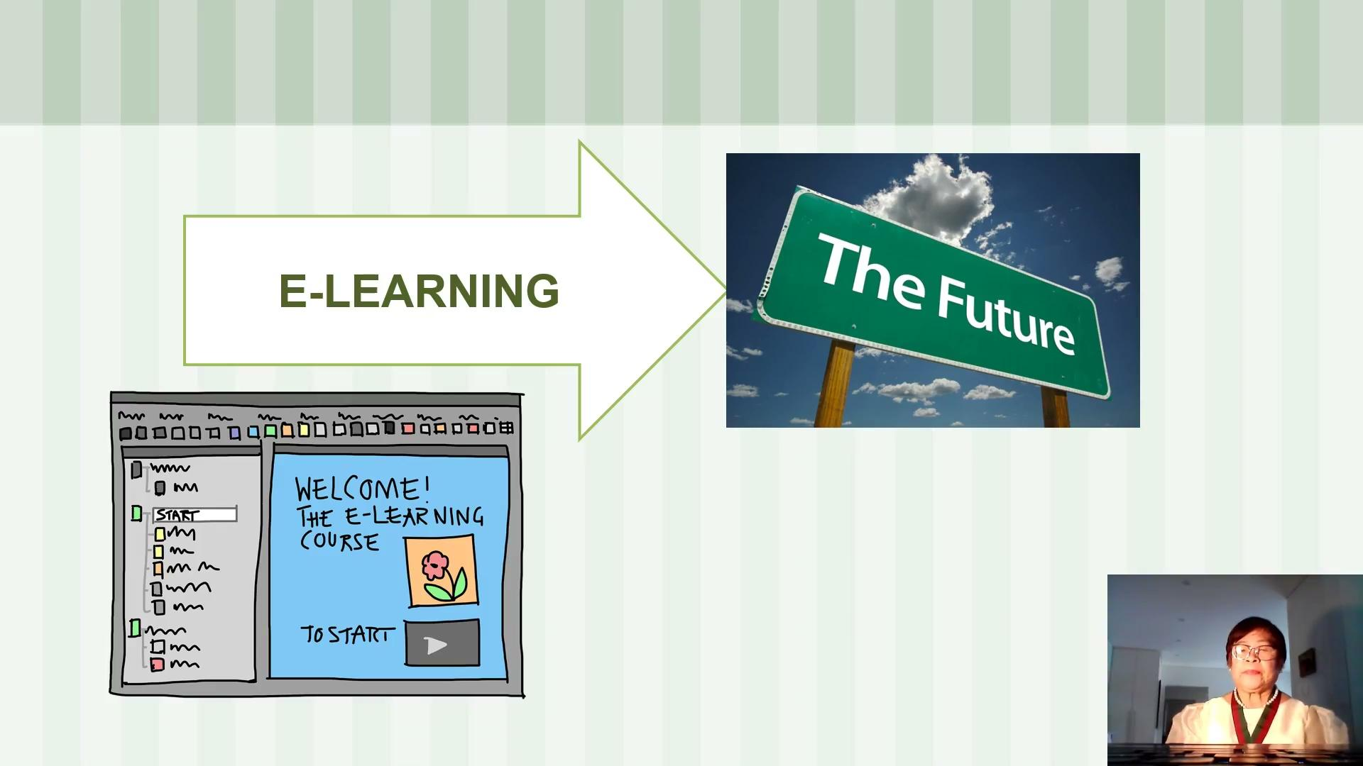
Notes:
Dr. Lopez will give her introduction then when you hear "The topic of my presentation today is.." then go to Dr. Lopez’s first slide

Slide 57


Q & A
Minnie Corpuz-Castillo, BSN’86, RN
Chair, Sustainability & Viability Committee
Rosemarie Gadioma, BSN’81, MSN, ANP,ACNP-BC
Chapter President, UPN-EC
Member, Awards and Citations Committee

Slide 58
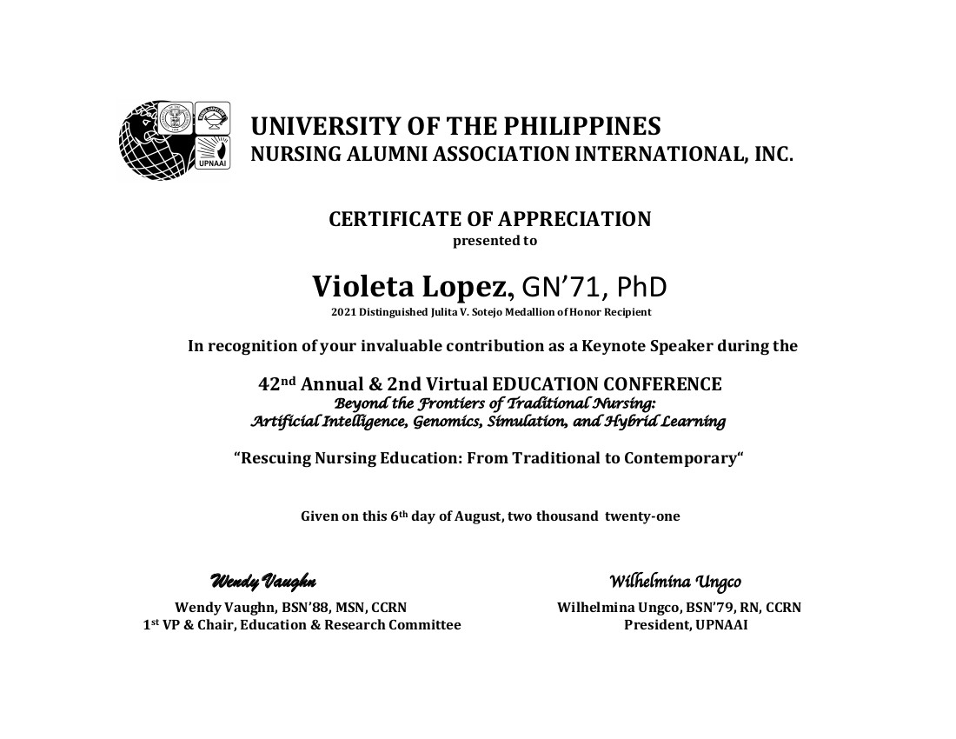

Slide 59
BREAK
Resumes in 10 minutes
Link to Evaluation:
https://forms.gle/coysdwffcciUmR2J7
42nd Annual & 2nd Virtual Convention
August 6th & 7th, 2021

Slide 60
42nd Annual & 2nd Virtual Convention
August 6th & 7th, 2021

Slide 61

Genetic Variations as Determinant of Phenotypic Response to Drugs
42nd Annual & 2nd Virtual Convention
August 6th & 7th, 2021
Grace Lawrence, BSN ’79, PhD

Slide 62

Zoom Poll
How many prescriptions were dispensed in the US in 2019?
  1.5 billion
  2 billion
  3.5 billion
  4.2 billion

Slide 63
Prescription Drug Use in the US
Among U.S. adults aged 40–79,
69.0% used at least one prescription drug in the past 30 days and
22.4% used five or more.
Hales CM, Servais J, Martin CB, Kohen D. Prescription drug use among adults aged 40–79 in the United States and Canada. NCHS Data Brief, no 347. Hyattsville, MD: National Center for Health Statistics. 2019.
Source: NHANES survey 2015-2016

Slide 64
Adverse Drug Events
In 2013-2014 - about 4 ED visits per 1000 individuals were for adverse drug events
27.3% of the ED visits for adverse drug events resulted in hospitalization
Source: Shehab N, Lovegrove MC, Geller AI, Rose KO, Weidle NJ, Budnitz DS. US Emergency Department Visits for Outpatient Adverse Drug Events, 2013-2014. JAMA. 2016 Nov 22;316(20):2115-2125.

Slide 65
All patients with same diagnosis
Responders and
Patients not Experiencing
Severe Toxicity
Non-Responders and Patients Experiencing Severe Toxicity
  Ramaswamy Iyer, PhD, FACMG 25 March 2016

Slide 66
Sources of Variability in Drug Response
Drug Specific:
Dose & Schedule
Form of Dosage
Morphometric:
Body Size
Body Composition
Genetics:
Variations in
metabolic enzymes,
Transporters, receptors etc
Demographic:
Age
Race/Ethnicity
Sex
Variability
Physiologic:
Disease
Hepatic Function
Renal Function
Environment:
Drug-drug interactions
Drug-CAM interactions
Drug-formulation interactions
Drug-food constituent interactions
  Ramaswamy Iyer, PhD, FACMG 25 March 2016

Slide 67
GENETIC VARIATIONS AS DETERMINANTS OF PHENOTYPIC RESPONSE TO DRUGS
Grace N. Lawrence, PhD, RN

Slide 68
Objectives
Define relevant pharmacogenomic language
Describe the clinical utility of pharmacogenetic testing

Slide 69
Definition of Common Terms
Pharmacogenetics - the study of genes (DNA sequence) and their influence on drug response, typically one or only a few genes involved
Pharmacogenomics - The study of variations of DNA and RNA characteristics as related to drug response
'PGx' represents both terms
https://www.genome.gov/glossary/index.cfm?id=90
https://www.fda.gov/media/71389/download

Slide 70
Question
The human genome has 6 billion nucleotide bases represented by the letters A, C, T, G. The letter “T” stands for:
  Tyrosine
  Thymine
  Toluene
  D. Thiamine

Slide 71
PGx
Adenine-Cytosine-Thymine-Guanine sequences
Encodes 2 (often NOT identical) copies of ~25,000 genes
  68 clinically important pharmacogenes
Source: Gabor Matyas Pharmacogenomics (2021) 22(3), 177–190 ISSN 1462-2416 177 Perspective

Slide 72
68 Pharmacogenes
Encodes for:
  Drug metabolizing enzymes (e.g., Cytochrome P 450)
  Transporters
  Drug targets
  Oncogenes
  Immune system

Slide 73
Genetic Variation
POLYMORPHISM
Gene variation that occurs at a frequency of >1% of heterozygous individuals in a given population (kind of) implies that it is benign
MUTATION
Gene variation present in <1% of the given population
  Could be benign or not

Slide 74
Genetic Variations
Sequence Variations
  SNPs – Single Nucleotide Polymorphisms
  Indels – Insertions and deletions of one or few nucleotides
  Larger deletions and insertions
  CNVs – Copy Number Variations
  Repetitive DNA sequences

Slide 75
Genotype
Allele
An allele is one of two or more versions of a gene.
An individual inherits two alleles for each gene, one from each parent.
If the two alleles are the same, the individual is homozygous for that gene.
If the alleles are different, the individual is heterozygous.
https://www.genome.gov/glossary/index.cfm?id=4

Slide 76
Genotype
Most detected functional variants are primarily described using the star (*) allele nomenclature

Slide 77
Genotype - *ALLELES
 | GENE | ALLELES TESTED
Encode for metabolizing enzymes | CYP2C9 | *2, *3, *4, *5, *6, *7, *8, *9, *10, *11, *13, *15, *16 *27
 | CYP2C19 | *2, *3, *4, *4b, *5, *6, *7, *8, *9, *10, *17
 | CYP2D6 | *2, *3, *4, *4M, *6, *7, *8, *9, *10, *11, *12, *14A, *14B *15, *17, *20, *29, *35, *41, *5 (gene deletion), XN (gene duplication)
 | CYP3A5 | *1D, *2, *3,*3B, *3C, *3K, *6, *7, *8, *9
 | TPMT | *2, *3A, *3B, *3C, *4
Encodes a transporter | SLCO1B1 | 388A>G, 521 T>C
Encodes a target | VKORC1 | -1639G>A, 1542G>C, 2255C>T, 3730G>A, 5808T>G, 1173C>T

Slide 78
PGx
  The study of variations in DNA sequence (Genotype) as related to drug response (Phenotype)
              Pharmacokinetics – how does the body affect the drug?
                Absorbtion
                Distribution
                Metabolism
                Excretion
              Pharmacodynamics - how does the drug affect the body?
              The relationship between the drug concentration & its therapeutic effect; the likelihood of an adverse effect
  Source: http://www.fda.gov/downloads/drugs/guidancecomplianceregulatoryinformation/guidances/ucm073162.pdf

Slide 79
PGx Phenotype
Refers to drug metabolizer status
Four Groups
  Ultra (UM)
  Extensive/Normal (EM)
  Intermediate (IM)
  Poor (PM)

Slide 80
PGx testing models
Reactive
versus
Preemptive

Slide 81
PGx of Cytochrome P450
Superfamily of enzymes (> 55 genes)
CYP2C9, CYP2C19, CYP2D6, and CYP3A4
Gene nomenclature:
[Human] CYP2D6*5
Isoform
Family
Allele
Species
Superfamily
Subfamily

Slide 82
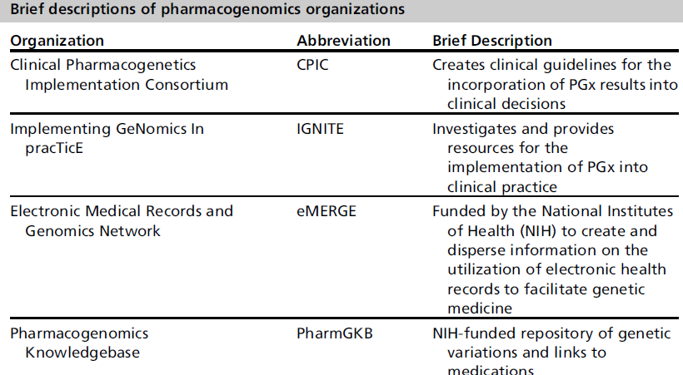
Source: Wake DT, Ilbawi N, Dunnenberger HM, Hulick PJ. Pharmacogenomics: Prescribing Precisely. Med Clin North Am. 2019 Nov;103(6):977-990. doi: 10.1016/j.mcna.2019.07.002. Epub 2019 Aug 24. PMID: 31582008.

Slide 83
CYP2D6 and CODEINE
Genotype: *4/*4

Slide 84
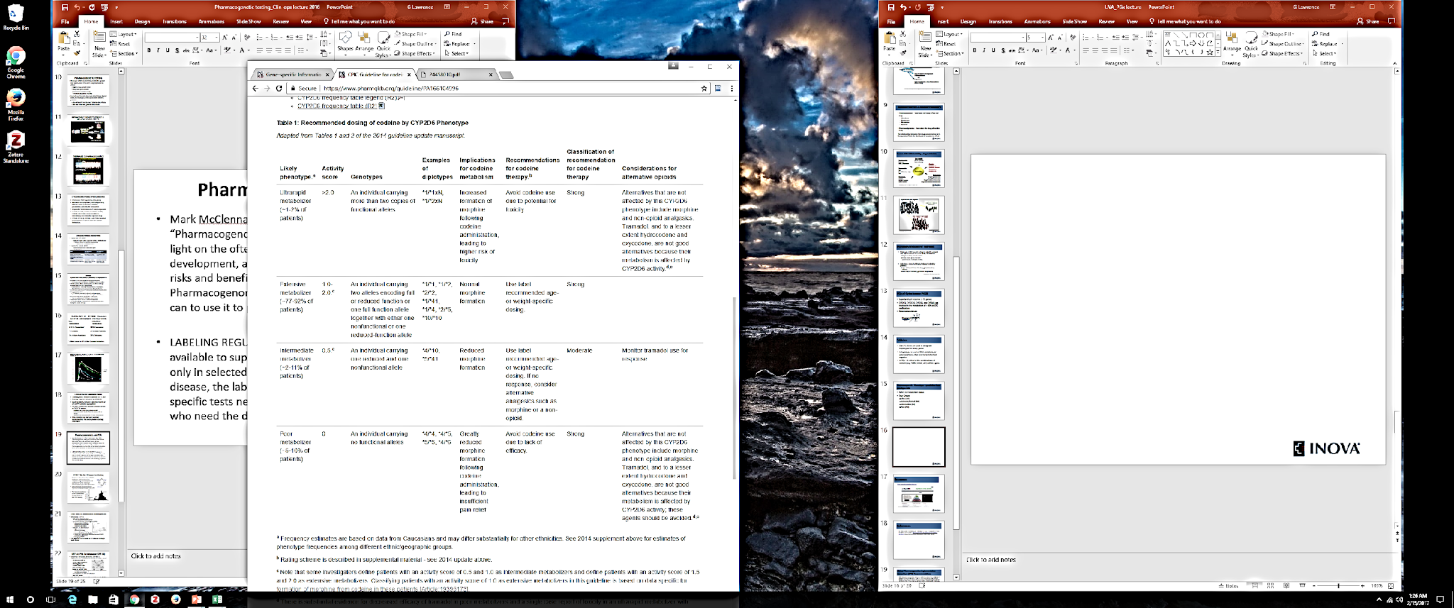

Slide 85
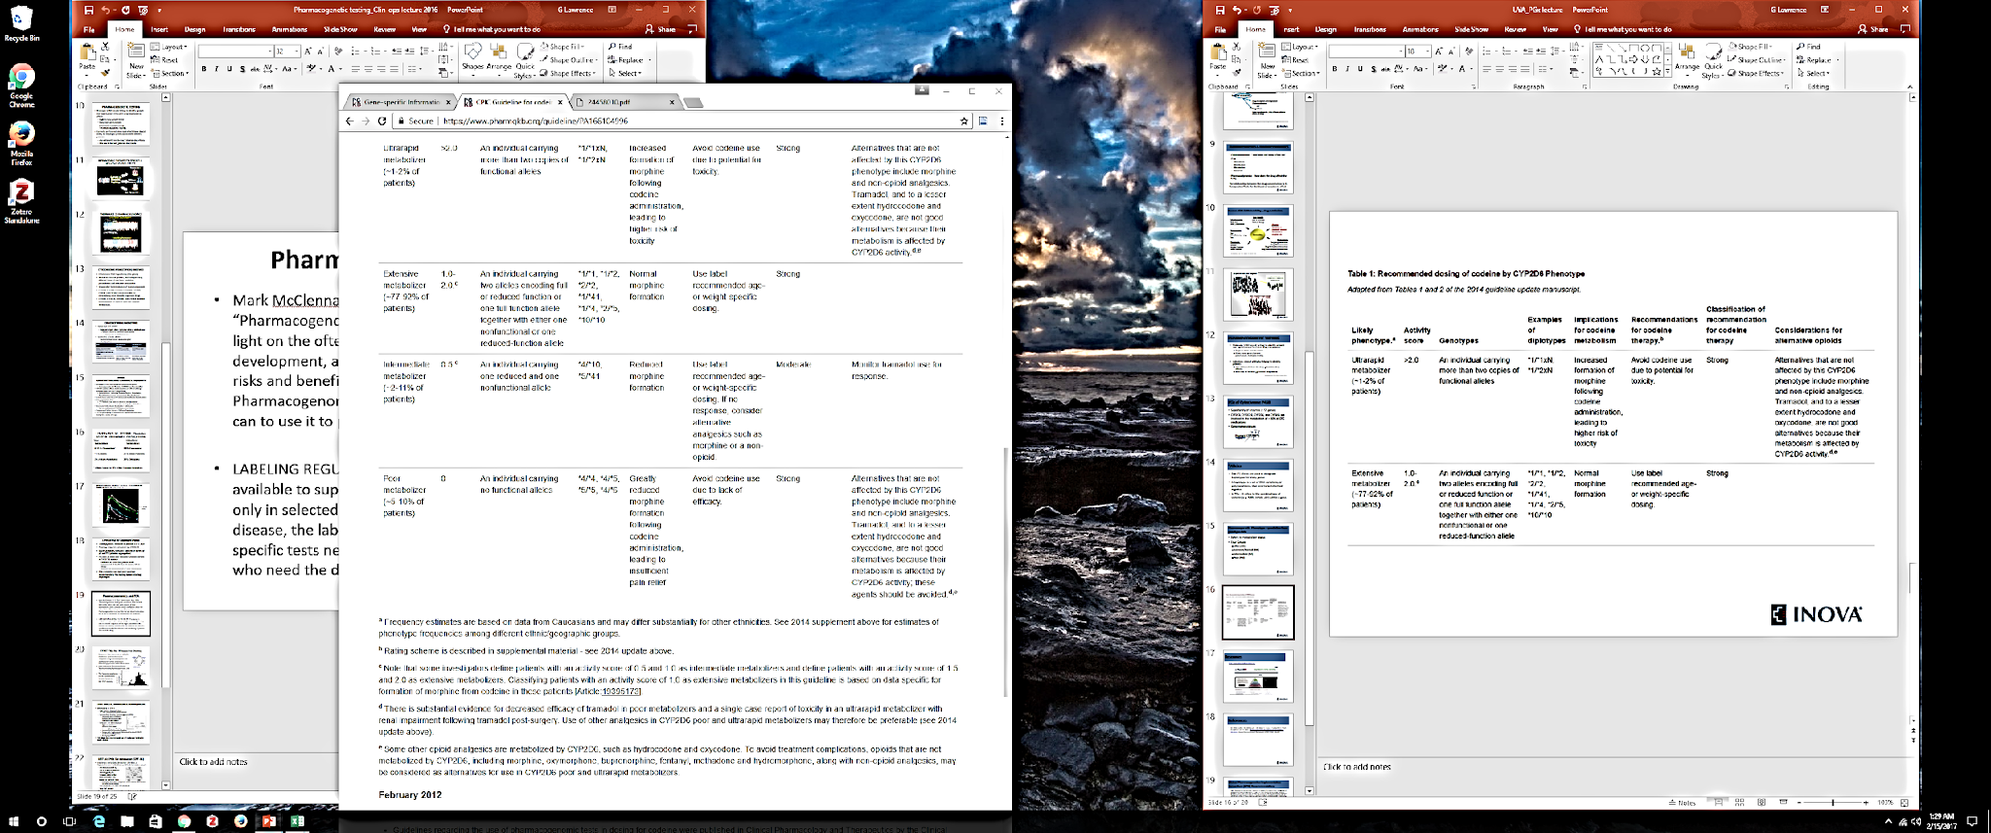
https://www.pharmgkb.org/guideline/PA166104996

Slide 86
CYP2C19 AND CLOPIDOGREL (PLAVIX)

Slide 87
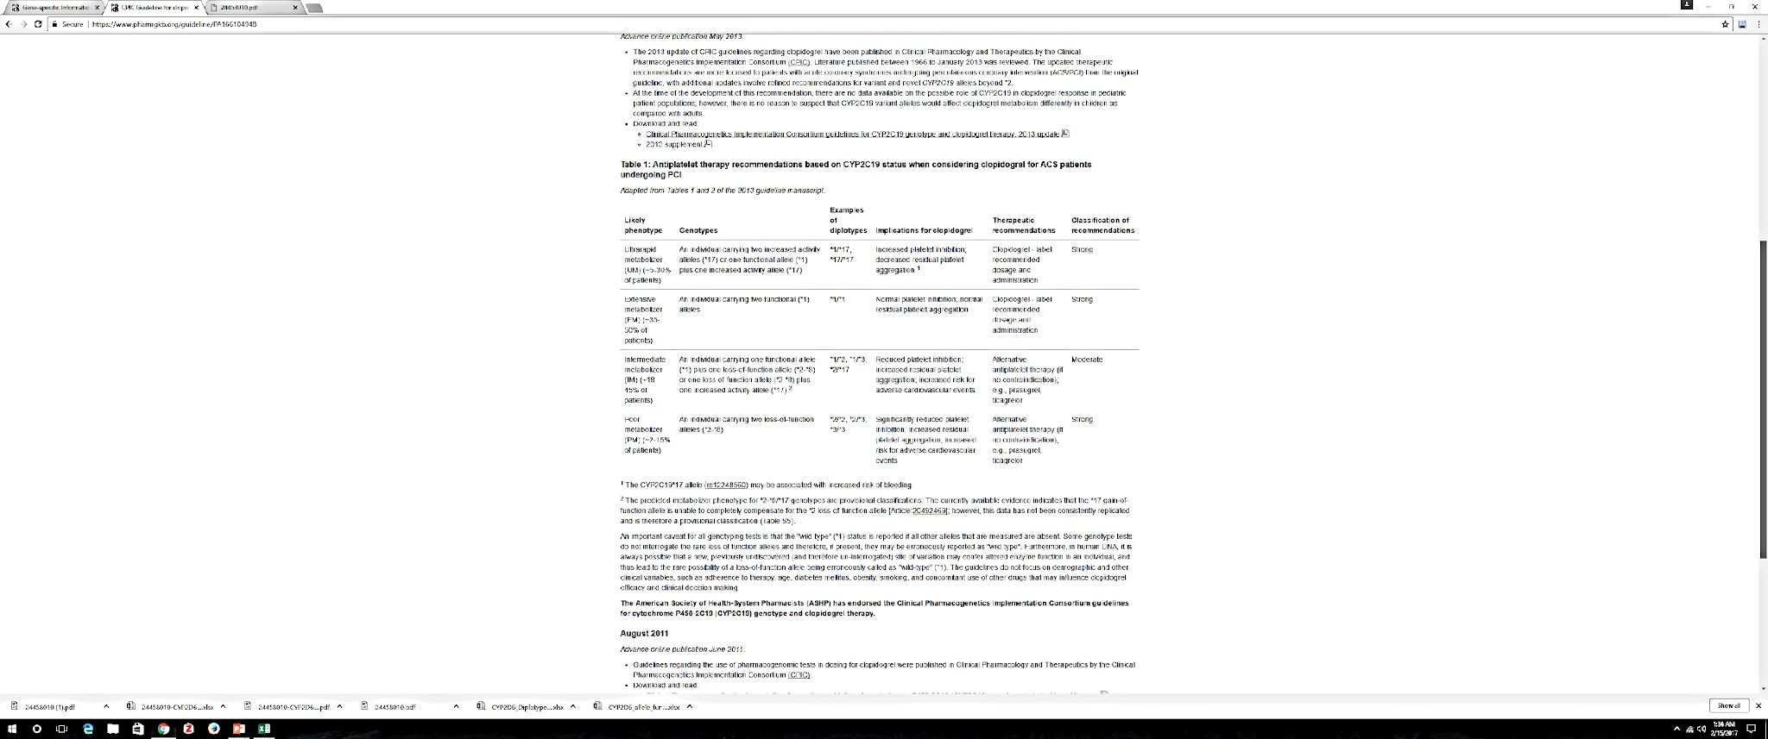

Slide 88
https://www.pharmgkb.org/guideline/PA166104948

Slide 89
Genetic Variation And Drug Phenotype Data For 4647 Newborns That Completed Pharmacogenetic Testing

Slide 90
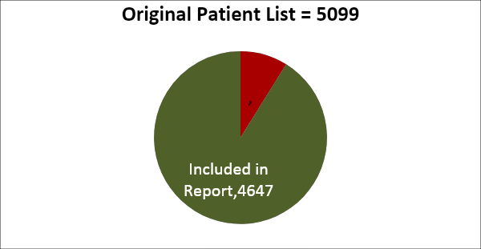
METHOD
Pulled patient list from June 1, 2016 – June 30, 2017
Eliminated those that answered “NO” to publishing their de-identified test results
Total number of patients in this report n= 4647

Slide 91
METHODS
Pharmacogenes
Rx Medications
  Encode drug metabolizing enzymes
    CYP2C9
    CYP2C19
    CYP2D6
    CYP3A5
    TPMT
  Encodes a target
    6. VKORC1
  Encodes a transporter
    7. SLCO1B1
Anti-cancer | mercaptopurine | (Purinethol)
 | thioguanine | (Tabloid)
Cardiovascular | clopidogrel | (Plavix)
 | simvastatin | (Zocor)
 | warfarin | (Coumadin)
Pain | codeine | (Codeine)
Immunologic | azathioprine | (Imuran)
 | tacrolimus | (Prograf)
Psychotropic | amitryptyline | (Elavil)
 | citalopram | (Celexa)
 | clomipramine | (Anafranil)
 | desipramine | (Norpramin)
 | doxepin | (Sinequan)
 | escitalopram | (Lexapro)
 | fluvoxamine | (Luvox)
 | imipramine | (Tofranil)
 | nortriptylene | (Pamelor)
 | paroxetine | (Paxil, Brisdelle)
 | phenytoin | (Dilantin)
 | sertraline | (Zoloft)
 | trimipramine | (Surmontil)

Slide 92
DRUGS AND FREQUENCY OF GENOTYPE-GUIDED DRUG RECOMMENDATIONS

Slide 93
CYP2C9
 |  |  | Green | Yellow | Red
Psychotropic | phenytoin | (Dilantin) | 72% | 28% | 0%

Slide 94
CYP2C19
 |  |  | Green | Yellow | Red
Cardiovascular | clopidogrel | (Plavix) | 45% | 24% | 31%
Psychotropic | amitryptyline | (Elavil) | 64% | 18% | 18%
 | clomipramine | (Anafranil) | 64% | 18% | 18%
 | citalopram | (Celexa) | 53% | 35% | 12%
 | doxepin | (Sinequan) | 64% | 18% | 18%
 | escitalopram (Lexapro) |  | 73% | 4% | 23%
 | imipramine | (Tofranil) | 64% | 18% | 18%
 | sertraline | (Zoloft) | 73% | 27% | 0%

Slide 95
CYP2D6
 |  |  | Green | Yellow | Red
Pain | codeine | (Codeine) | 83% | 5% | 12%
Psychotropic | amitriptyline | (Elavil)* | 64% | 18% | 18%
 | clomipramine | (Anafranil)* | 64% | 18% | 18%
 | desipramine | (Norpramin) | 83% | 5% | 12%
 | doxepin | (Sinequan)* | 64% | 18% | 18%
 | fluvoxamine | (Luvox) | 88% | 12% | 0%
 | imipramine | (Tofranil)* | 64% | 18% | 18%
 | nortriptylene | (Pamelor) | 83% | 5% | 12%
 | paroxetine | (Paxil, Brisdelle) | 88% | 0% | 12%
 | trimipramine | (Surmontil)* | 64% | 18% | 18%
* drugs metabolized by more than one gene

Slide 96
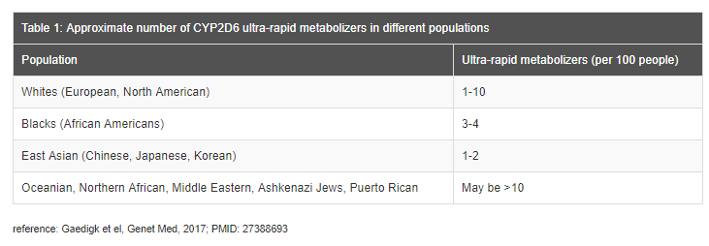
Ultra Rapid Metabolizers by Population

Slide 97
SLCO1B1
 |  |  | Green | Yellow | Red
Cardiovascular | simvastatin | (Zocor) | 84% | 3% | 13%

Slide 98
VKORC1 and CYP2C9
 |  |  | Green | Yellow | Red
Cardiovascular | warfarin | (Coumadin) | 25% | 75% | 0%

Slide 99
Key Points
PGx is a field of genetics that studies the effect of gene variation on individual drug response
There are data driven guidelines that translate genotyping data into phenotypes; accompanied by clinically meaningful recommendations
PGx is a powerful tool for personalized health but does not solely account for individual variability in drug response.
The use of PGx does not preclude the need for astute clinical assessments and judgment

Slide 100
Poll
We use PGx in our practice/facility
Yes
No
Not sure

Slide 101
Poll
I believe PGx testing will help me and my health care provider with my medications now and in the future.
I agree
I disagree
I need more data

Slide 102

Rural Health Nursing - Bay, Laguna

Slide 103

Graduation Day 1979

Slide 104


Graduation Ball – Top 10 UPCN ‘79 Graduates

Slide 105
UPNAAI 2021

Slide 106
Genetic Variations as Determinant of Phenotypic Response to Drugs
Grace Lawrence, BSN ’79, PhD

Slide 107
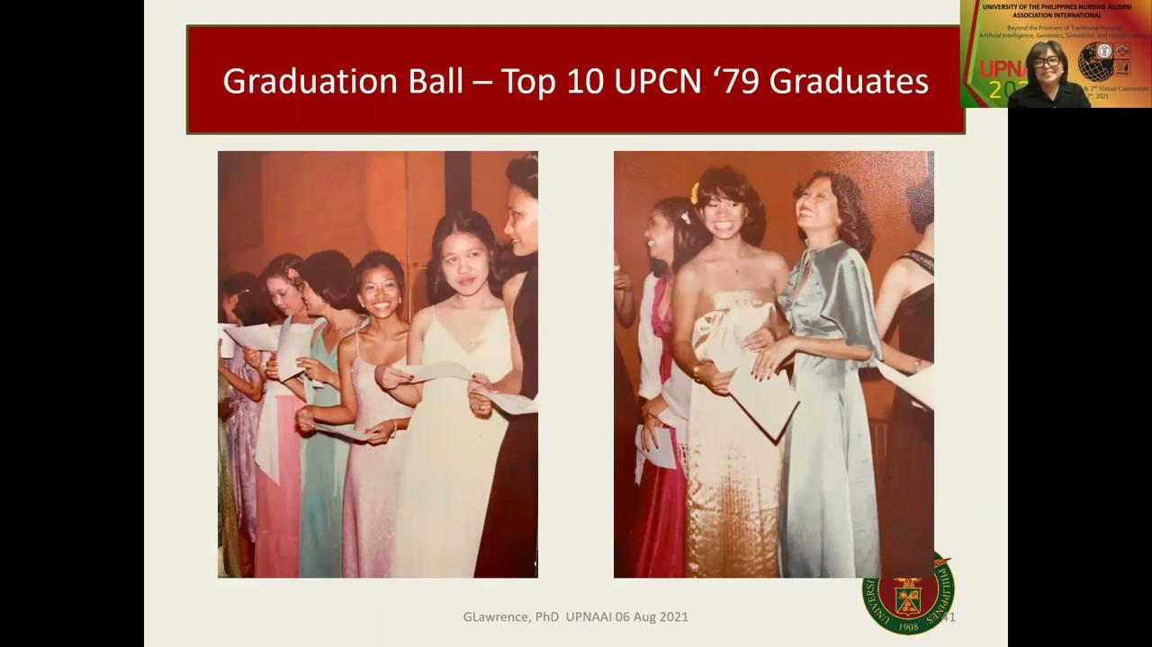

Slide 108
Q & A
Minnie Corpuz-Castillo, BSN’86, RN
Chair, Sustainability & Viability Committee
Rosemarie Gadioma, BSN’81, MSN, ANP,ACNP-BC
Chapter President, UPN-EC
Member, Awards and Citations Committee

Slide 109
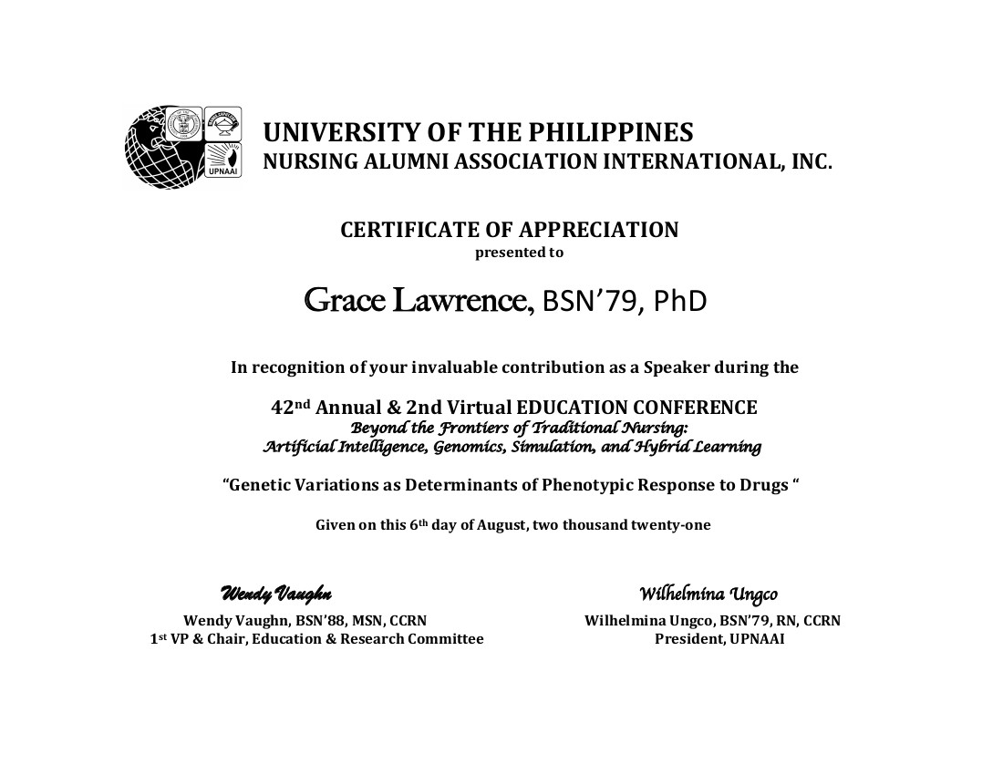

Slide 110
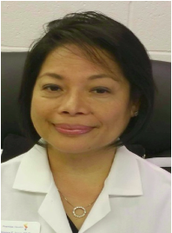
Online Learning in Nursing Education: Lessons in Resilience in a Time of Pandemic
42nd Annual & 2nd Virtual Convention
August 6th & 7th, 2021
Elinore Espiritu-Ioan, BSN’81, RN, MSN-FNP, MPA, EdD Ruby Jubilarian

Slide 111
Online Learning in Nursing Education:
Lessons in Resilience and Sustainability in a Time of Pandemic
Elinore Espiritu-Ioan
BSN’81, EdD, RN, MSN/FNP, MPA

Slide 112
OBJECTIVES
At the end of this presentation, the audience will be able to:
1. describe the nature of online learning in nursing education within the historical background of the pre- and current SARS-COV-2 pandemic;
2. discuss the various impacts of the SARS-COV-2 pandemic on global and nursing education
3. identify and discuss resilience responses related to online learning in nursing education during the COVID-19 pandemic, and,
4. evaluate and analyze possible repercussions of the SARS-COV-2 pandemic to the future of nursing education, specifically to online learning and sustainable education.

Slide 113
PART I
THE BASICS OF ONLINE LEARNING
Notes:
Objectives:

Slide 114


TERMINOLOGIES
Distance Education
  Distance Learning
    Online Learning
    E-Learning (“Blended Learning”)
    Technology Learning
    Mediated Learning
    Online Collaborative Learning
    Virtual Learning
    Web-based Learning
      Online Learning Environments

Slide 115

TERMINOLOGIES
Distance Education
  Learning Environments
    Learning Management Systems (LMS)
    Course Management System (CMS)
    Virtual Learning Environment (VLE)
    Knowledge Management System (KMS)

Slide 116

TERMINOLOGIES
Distance Education
  Online Learning Environment (OLE)
  (webinar, online lecture, virtual meeting)
    Self-paced Learning (Asynchronous)
    Self- directed Learning (Independent)
    Instructor-led Learning

Slide 117
THE HISTORICAL EVOLUTION OF DISTANCE EDUCATION
1700s: “Correspondence Education”
1800s: University of London; International Correspondence Schools, USA; Home Studies
1900s: Use of technology (radio, TV, computer), Learning from home, Full online and full web-based learning, virtual learning
Today and Beyond
ONLINE LEARNING
MOOCs (Massive Online Open Courses)
CHALLENGES:
One-way communication
Lack of technology to facility learning

Slide 118
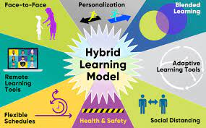
HYBRID LEARNING

Slide 119
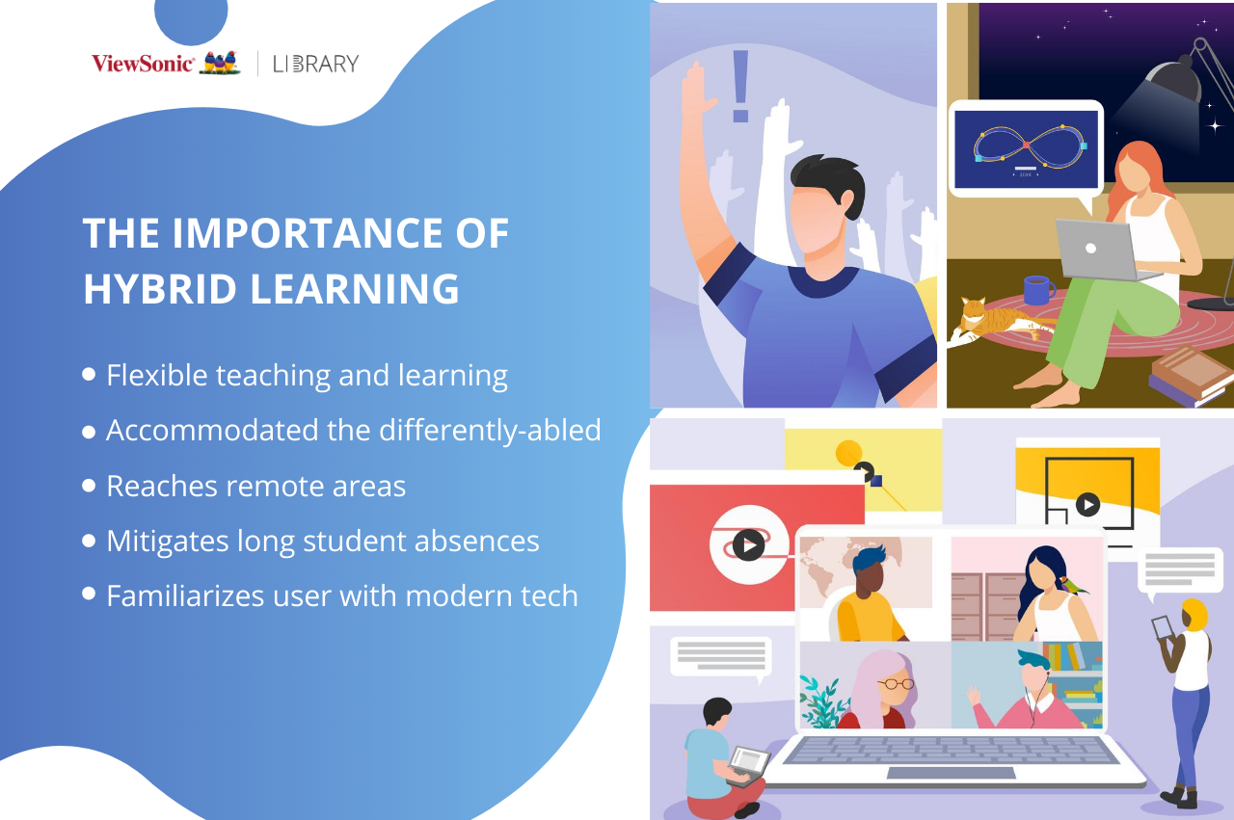

Slide 120
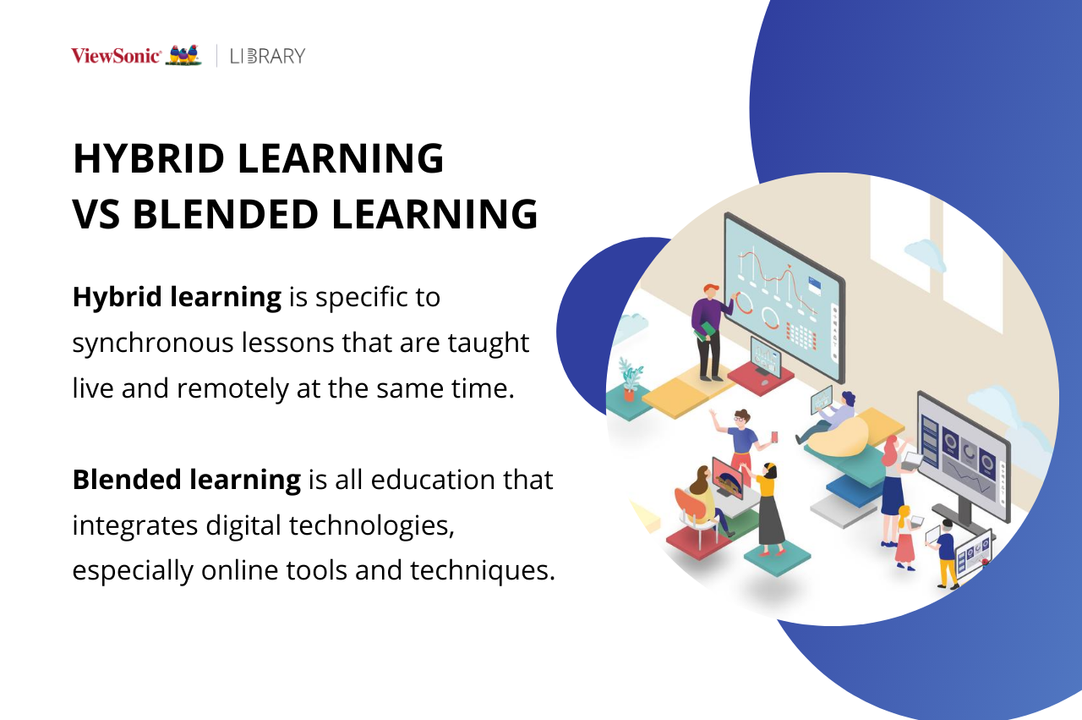

Slide 121
ONLINE LEARNING
Evolution
1995: WebCT and LMS > Blackboard
e-learning, blended learning, online education, online courses, etc.
Delineate domain & concepts
Important to Review
Definitions
Overlapping concepts
Common Elements
Usage of Key Elements
  Challenges

Slide 122
ONLINE LEARNING
DEFINITIONS
(2002): “the use of the internet in some way to enhance the interaction between teacher and student”.
  Asynchronous and synchronous interaction, classroom-based instruction and as well as distance education modes
  Other terms synonymous with online learning are ‘web-based education’ and ‘e-learning’. (Curtain, 2002)
(2017): “the bridging of the space between the teacher and the student through the use of web-based technologies” (Lee, 2017; Moore et al., 2011; Ryan et al.,2016).(2016)
CONCEPTS
Connectivity, Flexibility, Accessibility, Interactivity

Slide 123
ONLINE LEARNING
COMMON ELEMENTS
Technology
Time
Interactivity
Physical Distance
Educational Context

Slide 124
ONLINE LEARNING
USAGE OF KEY ELEMENTS
Challenges:
  Concept of Learning itself
    Student engagement, cognition, awareness, retention
    Learning Techniques, Outcomes
  Domain
  Evolving definitions based on evolving technologies

Slide 125
MAJOR ISSUES RELATED TO ONLINE EDUCATION
Students
Participation/Engagement
Expectations
Readiness
Time & Technology
Major
Issues
Curriculum
Content Development
Delivery, Instructional Strategy
Others
Educators
Roles, Interest & Preparation
Time and Technology
Communication

Slide 126
PART II
ONLINE LEARNING AND THE SARS-COV-2 PANDEMIC

Slide 127
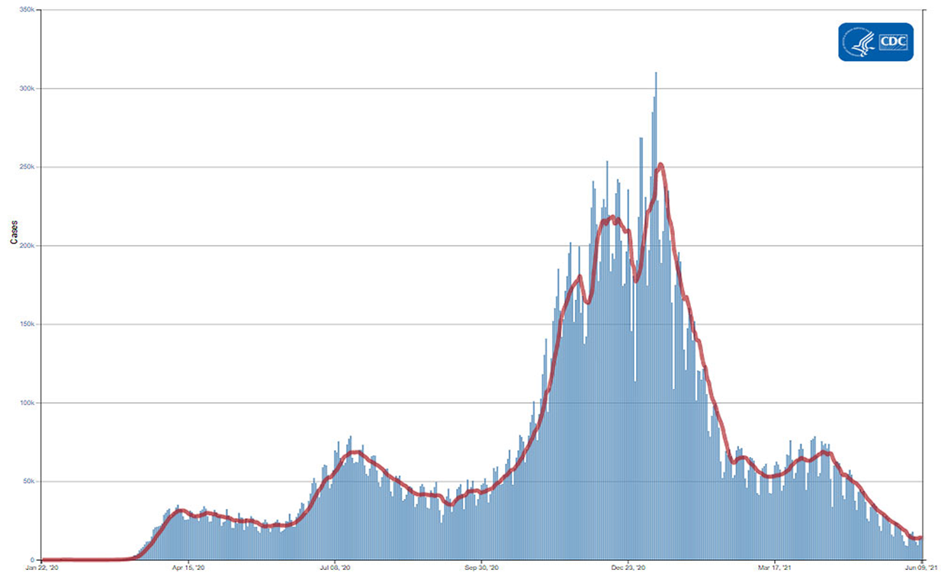
THE IMPACT OF THE SARS-COV-2 PANDEMIC WORLDWIDE

Slide 128

THE IMPACT OF THE SARS-COV-2 PANDEMIC WORLDWIDE
Public Health Emergency of International Concern (January 30, 2020)
A Pandemic (March 11, 2020)
Significant Impacts
  Health Impact
  Social Impact
  Economic Impact
  Psychological (Mental and Emotional) Impact

Slide 129
THE IMPACT OF THE SARS-COV-2 PANDEMIC WORLDWIDE (cont)
Significant health, economic, and social impacts
  Health Impacts
  Economic Impacts
  Social Impacts
    Social distancing and quarantine
  Psychological Impacts (Mental & Emotional)
    Anxiety, Depression, Deep sadness, Fatigue
    Sense of Isolation, Loss of control
    Moral distress

Slide 130
THE IMPACT OF THE SARS-COV-2 PANDEMIC ON GLOBAL EDUCATION
90%
World Student Population
1.25B
Learners
Worldwide
60.3M
Teachers

Slide 131
THE IMPACT OF THE SARS-COV-2 PANDEMIC ON GLOBAL EDUCATION
PHILIPPPINES
  School Lockdown (Full School Closures since March 16, 2020) under the ECQ (Enhanced Community Quarantine)
    Department of Education (DOE) offered fast track online/digital learning
    Identified and supported students without technological capability
  Higher Education Institutions (HEIs)
    Revised and adapted course syllabi and requirements towards alternative or remote teaching modalities (synchronous and asynchronous)
      Use of LMS (Canvas, Moodle, Blackboard
      Use of applications (Google, Hangouts, Zoom, Skype)
      Smartphones: text messaging, email, Facebook, Messenger, Twitter
    Suspended online or remote classes: SES and psychological impacts
    Full opening of schools will face challenges: vaccination, evaluation of COVID educational experiences, adaptation to “new normal”

Slide 132

THE IMPACT OF THE
SARS-CoV-2 PANDEMIC ON
NURSING EDUCATION

Slide 133
THE IMPACT OF THE SARS-COV-2 PANDEMIC ON NURSING EDUCATION
Disruptions to Nursing Education Worldwide (ICN, 2021, Apr)
Concerns
  About completion of program requirements and delays in graduation (57%)
  About learning modifications affecting learning trajectory.
  Delays in nursing research
  Risk of delaying or restricting nursing workforce supply leading to shortages.
https://www.youtube.com/watch?v=LZTkaiZw8_U
  Switch from traditional teaching to online learning
  (≈ Mar, 2020)
  Halted clinical placements to conserve PPEs and limit direct patient care (46%) or with restrictions (41%)
Outcomes
Positive
Negative

Slide 134

THE IMPACTOF THE SARS-COV-2 PANDEMIC ON NURSING EDUCATION
Impact on Student Learning
  Traditional vs Virtual Teaching
  Student Experiences:
    Student - Faculty interactions
    Time and technology management skills
    Self-direction/Navigation
    Psychological/emotional repercussions
      Safety
      Social connections
      Losses

Slide 135
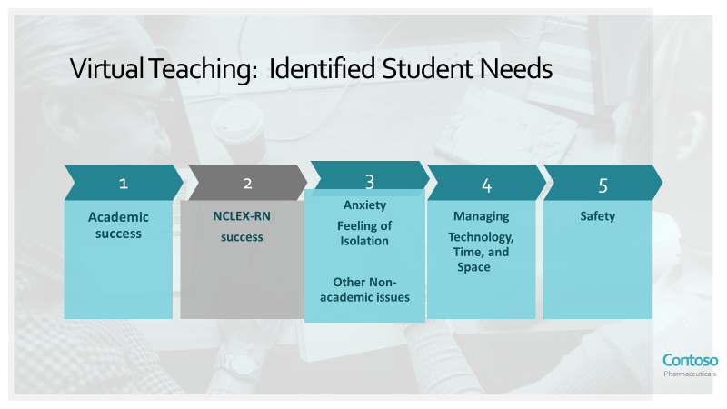
THE IMPACT OF THE SARS-COV-2 PANDEMIC ON NURSING EDUCATION
XX
  XX
    XX

Slide 136

THE IMPACT OF THE SARS-COV-2 PANDEMIC ON NURSING EDUCATION
Impact on Nurse Educators and Pedagogy
  Traditional vs Virtual Teaching
  Faculty Experiences:
    Reconceptualization of faculty role
    Instructional design, faculty - student interactions/communication
    Time and technology management skills
    Psychological/emotional repercussions
      Safety
      Social connections and support
      Losses

Slide 137
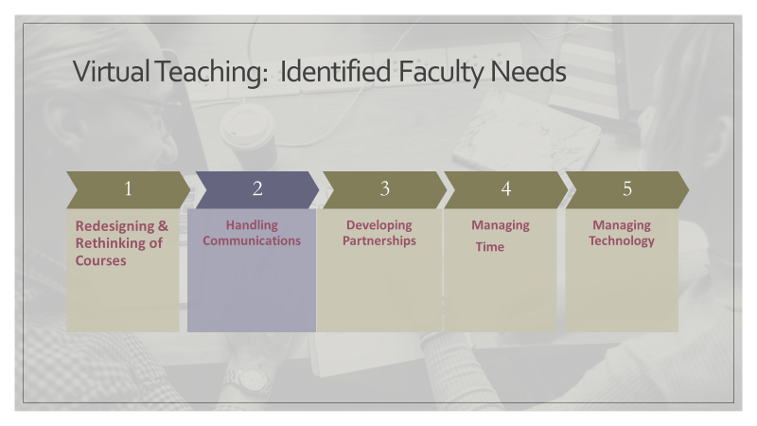
THE IMPACT OF THE SARS-COV-2 PANDEMIC ON NURSING EDUCATION

Slide 138
PSYCHOLOGICAL IMPACT OF THE SARS-COV-2 PANDEMIC ON NURSE EDUCATORS
  Urgent Issues Needed to Address Faculty “Distress”
  Burnout : “the loss of the ability to care” (Schwenk, 2018) .. “resulting from chronic work stress unsuccessfully managed” (WHO) 2019)
  Compassion Fatigue: emotional and physical exhaustion leading to a diminished ability to empathize or feel compassion for others
  Moral Distress: emotional state felt when the ethically correct action to take is different from expected task
  Literature Regarding Self Care to Address Faculty “Distress”
  Stages of Grief: Kubler-Ross’ stages of grief as a framework for coping interventions.
  Self Care (WHO) : “the ability … to promote health, prevent disease, maintain health, and to cope with illness and disability with or without the support of a healthcare provider”.

Slide 139
The UP COLLEGE of NURSING (UPCN) EXPERIENCE
PARADIGM OF LIFELONG LEARNING

Slide 140
HISTORICAL BACKGROUND OF ONLINE LEARNING AT UPCN
DESIGNING FLEXIBLE LEARNING IN NURSING (DFLN)
Existed pre- COV SARS-2 pandemic
Response to natural disasters and calamities
Curriculum change from competency to outcome-based since 2018

Slide 141
ONLINE LEARNING AT UPCN
DURING THE COV-SARS-2 PANDEMIC
CHED COVID Advisory No. 7 (May 24, 2020)
Program Redesign
  Program Implementation: Course Sequencing, Course Scheduling, Student Load, Faculty Load
  Course Delivery: Team Teaching, Peer Mentoring
Course Redesign
  Designing Flexible Learning Course
  DLFN Course: Planning, Designing, Assessment
Course Pack

Slide 142
ONLINE LEARNING AT UPCN
DURING THE COV-SARS-2 PANDEMIC
LESSONS LEARNED
Online is effective
Compassionate Learning
Equity and access
Design and values
LOOKING FORWARD…
Faculty and student roles
Technical and Technology
OERS and MOOCS
Self care, resilience

Slide 143
PART III
RESILIENCE, QUALITY OF LIFE, AND EDUCATION SUSTAINABILITY
Notes:
Objectives:

Slide 144
RESILIENCE, QoL, COMPASSIONATE TEACHING
Resilience: “the ability of an individual to adjust to adversity, maintain equilibrium, retain some sense of control over their environment, and continue to move on in a positive manner” (Jackson et al., 2007).
Empathy: ability to ‘feel with’ others when we are exposed to others' experiences whilst recognizing that those feelings belong to another (Singer and Klimecki, 2014).
  Affective/Emotional, Cognitive , Empathic Concern = Compassion
Emotion Regulation Vs. Compassion Fatigue
Resilience and Quality of Life (QoL)
Compassionate Teaching: Faculty awareness/sensitivity of student suffering, having feeling of sympathetic concern, and findings ways to help relieve that suffering.

Slide 145
RESILIENCE AND COMPASSIONATE TEACHING:STRATEGIES
Effective
Communication
Managing
Relationships
Developing
Leaderships
Developing
Institutional
Empathy

Slide 146
ENGAGEMENT AND RESILIENCE
Engagement: a measure of absorption, dedication, and rigor of participation, retention, and application of learning (knowledge) into practice (clinical). (Ghasemi et al, 2020; Hudson & Carrasco, 2017; Fernandez-Pena et al., 2017)
Evidence-based (EBP) and EB decision making (EBDM) > Quality Care
Sociocentric networks
Student Engagement During the Pandemic

Slide 147
EDUCATION FOR SUSTAINABLE DEVELOPMENT (ESD)
ESD: Practice of integrating sustainability teaching and learning into education (education tech used in design and pedagogy)
  Sustainable Development (SD): socioeconomic and ecological development that meet the needs of the present without compromising the needs of future generations” (Our Common Future, 1987) through lifestyle choices and attitudes.
    Approach: human rights, poverty reduction, sustainable livelihoods, peace and protection, health, democracy climate change, gender equality, protection of indigenous cultures
    Aims: integrate into lifelong methods that empower individuals, communities > informed decisions > QOL
    Pedagogy: Ecopedagogy for sustainability, collectivism, globalism, and social issues
Pre-COVID Barriers
Realizations During COVID Pandemic
  Sustainability and Climate Change teaching; simulation of learning environments; field projects (clinical rotations & experiences)
UN , Sustainable Development Goals (SDGs) (SDG-Education 2030 2020)
  (Targets 4.3, 4.5)

Slide 148
SUSTAINABLE EDUCATION FOR NURSING
Self-transformation of teaching/learning institutions
  Aim: To equip learners and teachers with sustainability competencies.
    Review nursing curricula, re-design learning activities
Collaborations between Students, Faculty, Researchers, Practitioners
  Aim: To co-create knowledge and skills to promote SD
    Re-design learning activities
Student Advocates
Green Resources for Nursing
  Aim: To develop multiliteracies for multicultural, multilingual, technological adaptation
    Use of gaming, simulation, role playing, role modelling
Green Design for Nursing
  Aim: To revisit traditional instructional design vs authentic problem solving, meaningful engagement and collaboration with a variety of discourse modes (Scarmadali & Bereiter, 1994).
    Use of student personal contexts & background knowledge on authentic problem solving
    Use of Asynchronous and synchronous communication and interactivities for reflection & peer commentary
    Use of expertise (other than teacher) on sustainable development

Slide 149
SUSTAINABLE EDUCATION FOR NURSING (cont)
Priorities for Practice
  Review pre and pandemic competencies (skills, attitudes, knowledge)
  Develop relational skills (motivation, introspection, communication, mindfulness)
Priorities for Policy
  Review curricula to include ethics , moral distress/resilience
  Review educational institutional and college policies
  Review accrediting & regulating bodies re: policies and professional associations
Priorities for Nursing Research
  Research on resilience studies, educator satisfaction, moral and ethical issues
  Research on incorporation of these to Sustainable Education for Nursing
Notes:
Executive Summary: Transforming Moral Distress into Moral Resilience in Nursing Experts recommend strategies to develop moral resilience and support ethical practice. Rushton, Cynda Hylton PhD, RN, FAAN Schoonover-Shoffner, Kathy PhD, RN Kennedy, Maureen Shawn MA, RN, FAAN
The full report is available online at http://journals.lww.com/ajnonline/Pages/Moral-Distress-Supplement.aspx.
Priorities for practice.
Implement a work environment that fosters reflection and communication and rewards staff for raising ethical questions.
• Provide resources designed to address morally challenging issues and include consultants who can facilitate ethics-related conversations.
Promote collaboration among all members of the health care team to develop an ethical practice environment.
Develop strategies with interprofessional colleagues to identify and address the root causes of moral distress in the clinical setting.
Priorities for policy.
Encourage accreditation bodies to mandate that curricula for all health care professions include content addressing ethics, moral distress, and moral resilience.
Priorities for Nursing Research

Slide 150


Slide 151

A Tribute to All Pilipino Nurses:
Sa iyong mga kamay, puso, at espiritu nakasalalay ang tunay na kahulugan ng pagmamalasakit at pagkalinga sa mga nangangailangan.
PAGPALAIN KA, PINOY NARS!!

Slide 152
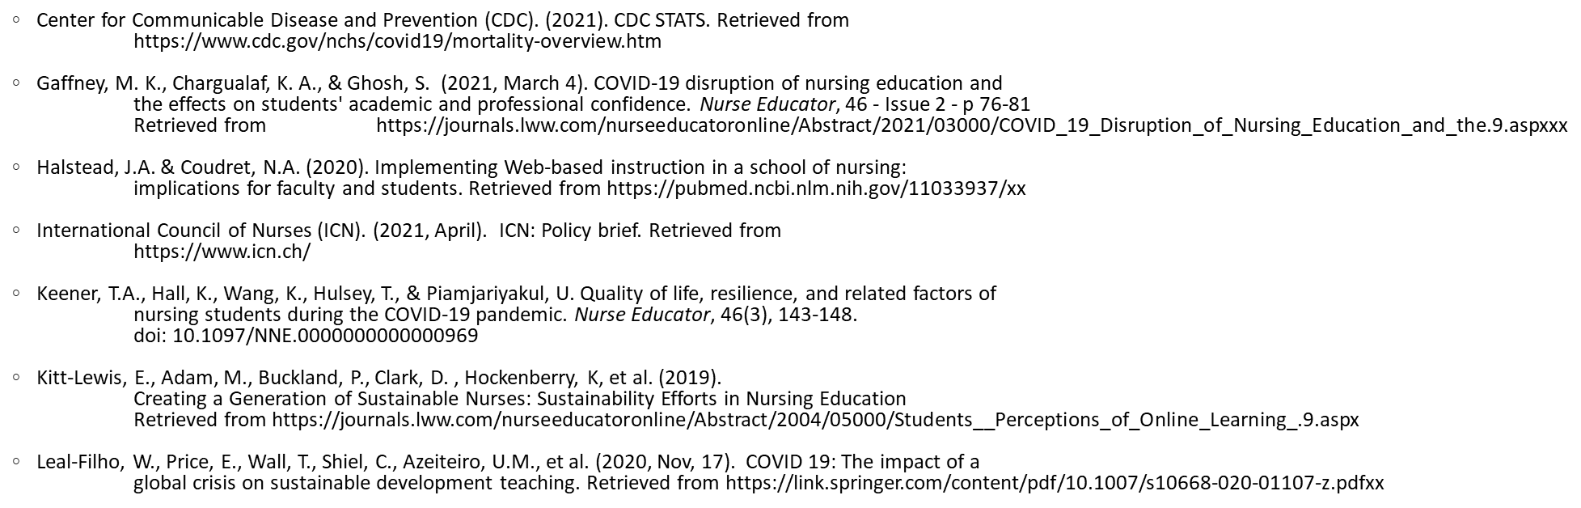
REFERENCES

Slide 153
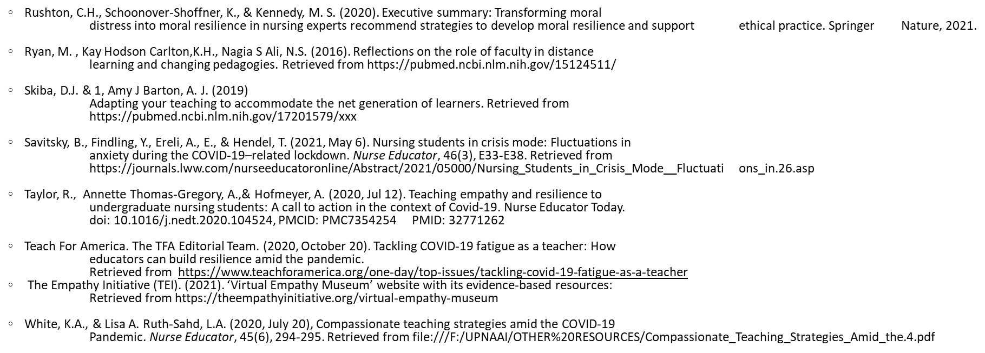
REFERENCES

Slide 154
MARAMING SALAMAT!!
MAY I ANSWER YOUR QUESTIONS?
Notes:
Objectives:

Slide 155
Online Learning in Nursing Education: Lessons in Resilience in a Time of Pandemic
Elinore Espiritu-Ioan, BSN’81, RN, MSN-FNP, MPA, EdD Ruby Jubilarian

Slide 157
Q & A
Minnie Corpuz-Castillo, BSN’86, RN
Chair, Sustainability & Viability Committee
Rosemarie Gadioma, BSN’81, MSN, ANP,ACNP-BC
Chapter President, UPN-EC
Member, Awards and Citations Committee

Slide 158
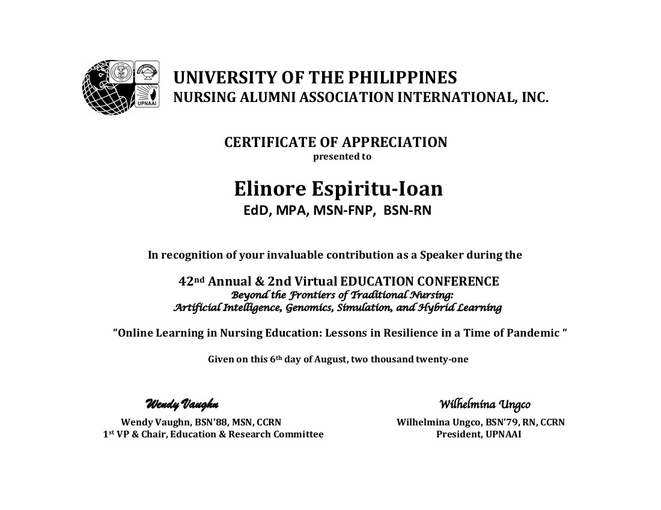

Slide 159
BREAK
Resumes in 10 minutes
Link to Evaluation:
https://forms.gle/coysdwffcciUmR2J7
42nd Annual & 2nd Virtual Convention
August 6th & 7th, 2021

Slide 160

42nd Annual & 2nd Virtual Convention
August 6th & 7th, 2021

Slide 161
Resuscitation Quality Improvement
42nd Annual & 2nd Virtual Convention
August 6th & 7th, 2021
Wendy Vaughn
1 st Vice President
BSN ’88, MSN, CCRN

Slide 162


Slide 163
Resuscitation Quality Improvement:
My Own Journey

Slide 164
Novice to Expert

Slide 165
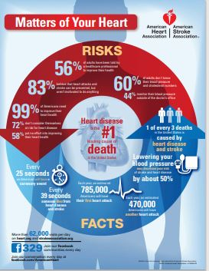
Heart Health By The Numbers
Every 25 seconds an American will have a coronary event
Every 39 seconds someone dies from heart disease and stroke
Each year 785,000 Americans will have their 1st heart attac
Each year 470,000 will have their 2nd heart attack

Slide 166
Heart Health By The Numbers
60% of adults DO NOT know their BPs and Cholesterol levels
72 % DO NOT consider themselves at risk for heart disease
58% put NO effort into improving their heart health
83% are NOT motivated to prevent heart attacks and stroke
99% of Americans need to improve their heart health

Slide 167
Resuscitation FAQs
Skill EROSION
“Rescuers in the workplace should practice every 4 to 6 weeks, if at all possible”
- Mary Fran Hazinski
Senior Science Editor for the Emergency Cardiovascular Care for the AHA

Slide 168
Resuscitation FAQs
Skill EROSION:
Infrequent training intervals

Slide 169
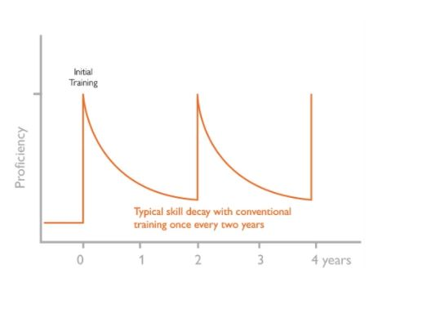
Typical skill decay with training every 2 years

Slide 170
Resuscitation FAQs
Skill EROSION:
Healthcare provider’s skill retention
Declines after 3 months of training

Slide 171
Resuscitation FAQs
Skill EROSION:
Most healthcare providers DO NOT get the experience they need to maintain skills

Slide 172
Resuscitation Quality Improvement FAQs
Allows healthcare providers to training in short, frequent intervals
“Low dose High-frequency intervals”

Slide 173
So WHY IQR?
Definition: Interquartile Range
        It is the middle 50% of values from lowest to highest
        Also referred to as the midpoint range
        It is a platform like Healthstream
        Low Dose – High Frequency Training

Slide 174
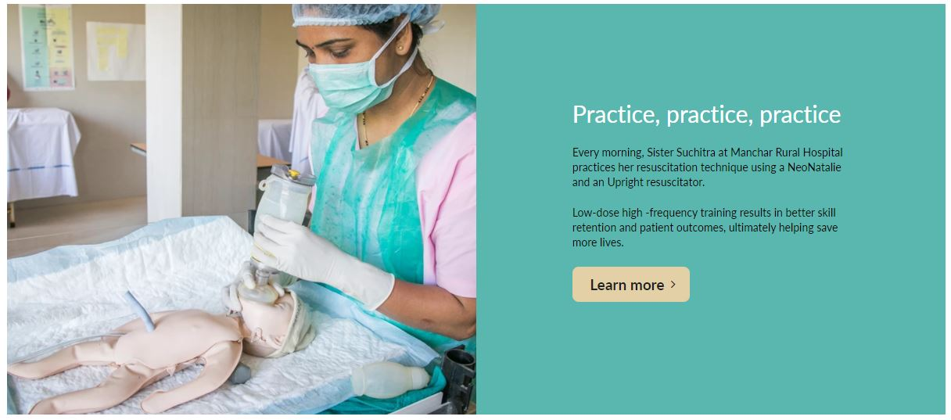

Slide 175

SIMULATION AND TRAINING

Slide 176


Slide 177
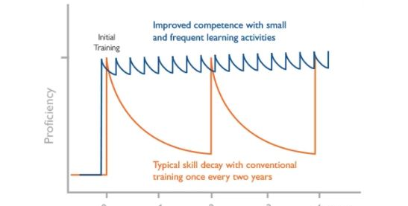

Slide 178
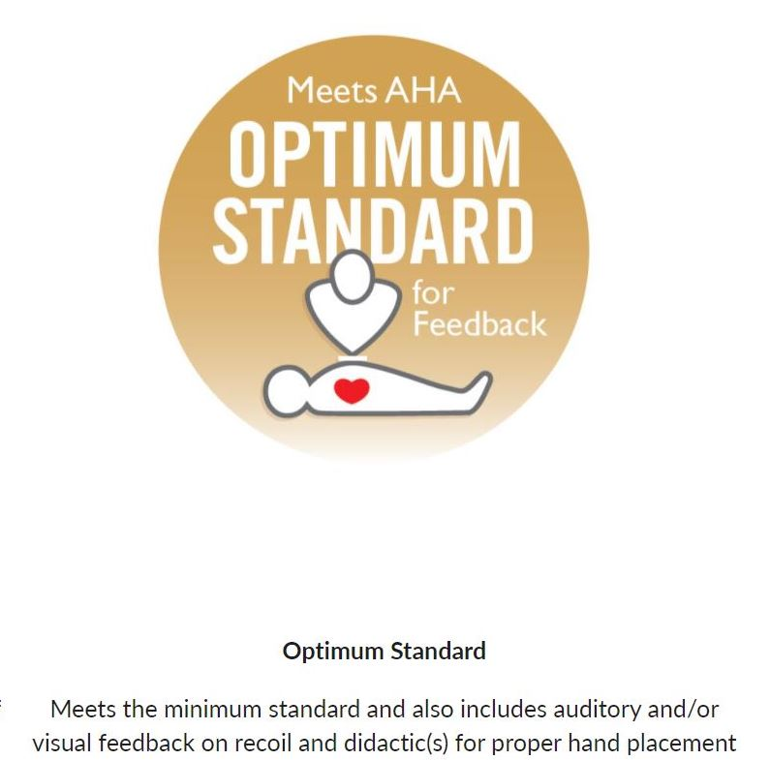
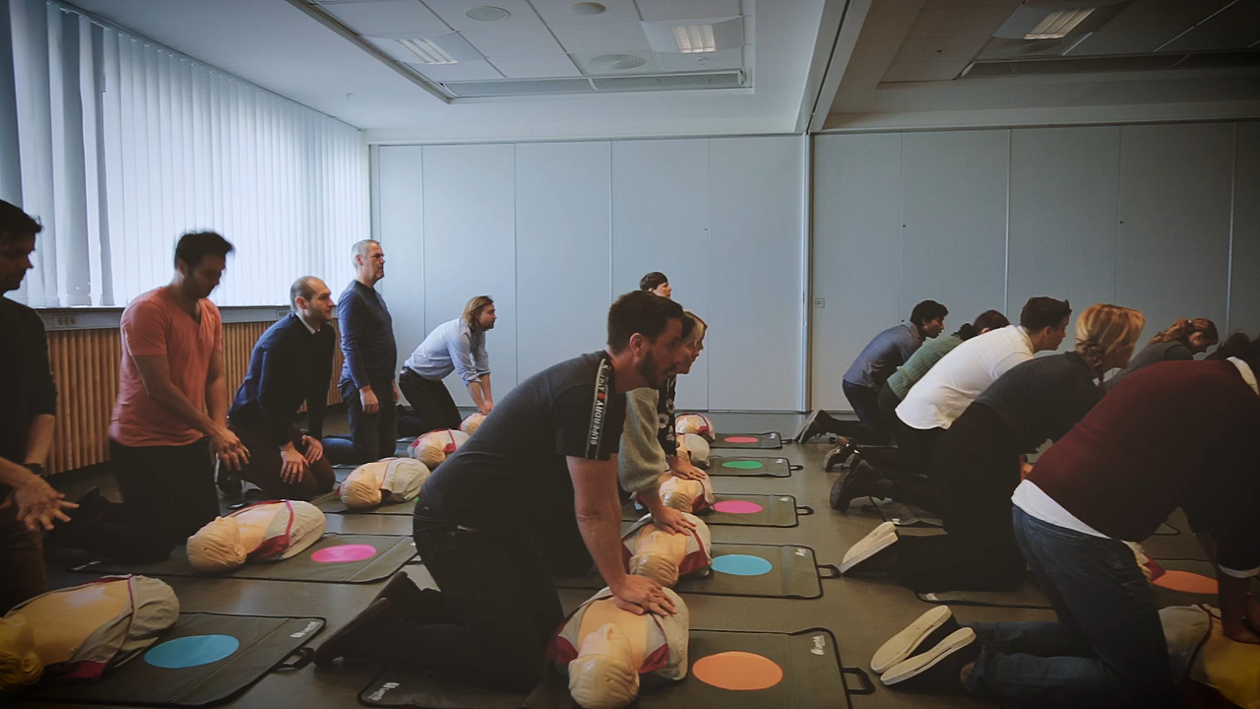

Slide 179
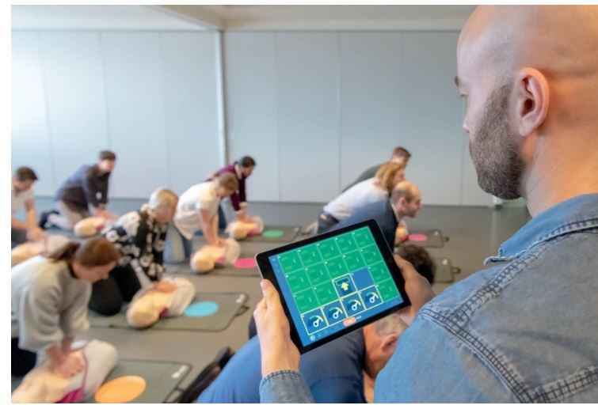
QCPR Classroom

Slide 180
Conclusion
70% of Out of Hospital Cardiac Arrests occurs at home! Followed by public settings and then Nursing Homes.
Practice makes perfect!
Skill mastery is acquired as you:
  “See one , Do one, Teach One!”

Slide 181
References:
Low-dose High Frequency Training. Available at Improving competence and confidence | Laerdal Medical
QCPR Classroom. Available at URL QCPR Classroom (laerdal.com)
Simulation and Training. Available at URL Simulation & Training | Laerdal Medical

Slide 182
Q & A
Minnie Corpuz-Castillo, BSN’86, RN
Chair, Sustainability & Viability Committee
Rosemarie Gadioma, BSN’81, MSN, ANP,ACNP-BC
Chapter President, UPN-EC
Member, Awards and Citations Committee

Slide 183


Slide 184

Genetics and Genomics Nursing in the Philippines: Status, Initiatives, and Opportunities
42nd Annual & 2nd Virtual Convention
August 6th & 7th, 2021
Peter James Abad, BSN’10, MSc, RN

Slide 185
Genetics and Genomics Nursing in the Philippines:
Status, Initiatives, and Opportunities
Peter James B. Abad, RN, MSc
College of Nursing
University of the Philippines Manila

Slide 186
Learning outcomes
Discuss developments and advancements in genetics and genomics in the Philippines
Recognize the importance of integrating genetics and genomics in nursing
Identify initiatives and opportunities for nurses to improve their practice in the era of genetics and precision medicine.

Slide 187
Outline of Presentation
Developments in Genetics and Genomics in the Philippines
Opportunities in Nursing Practice
Initiatives in Nursing Education
Issues and Challenges

Slide 188
Developments in Medical Genetics and Genomics in the Philippines

Slide 189


UP Manila NIH – Institute of Human Genetics
Offers the most comprehensive medical genetics and genomics services in the country
  Newborn Screening Center – NIH
  Molecular Genetics Laboratory
  Cytogenetics Laboratory
  Clinical Genetics and Research
  Biochemical Genetics Laboratory
  Microarray Core Laboratory
  Hemoglobinopathy Reference Unit

Slide 190

Clinical Genetics and Research Unit
Provides comprehensive genetic health care to individuals with or at high-risk to development inherited conditions.
Only such clinic in the Philippines
Caters to dysmorphology and inherited metabolic conditions including those requiring enzyme replacement therapy.
Conducts research and clinical trials on rare disease.

Slide 191
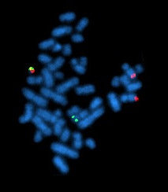
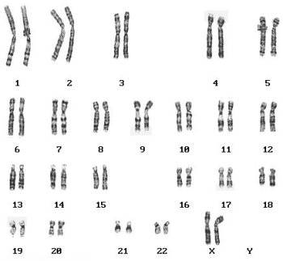
Cytogenetics Laboratory
Perform routing karyotyping services to detect chromosomal aneuploidies
It conducts fluorescence in situ hybridization (FISH) for chromosomal disorders and cancer

Slide 192
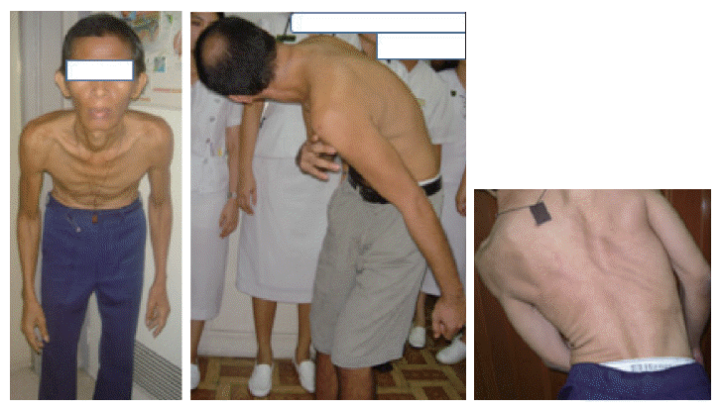
Molecular Genetics Laboratory
Conducts research on the molecular etiology of monogenic and complex conditions affecting the Filipino population.
  X-linked Dystonia Parkinsonism,
  Maple Syrup Urine Disease,
  Phenylketonuria,
  G6PD deficiency,
  thalassemia.

Slide 193

Biochemical Genetics Laboratory
Offers biochemical tests that assists in the diagnostic confirmation of inherited metabolic conditions.

Slide 194
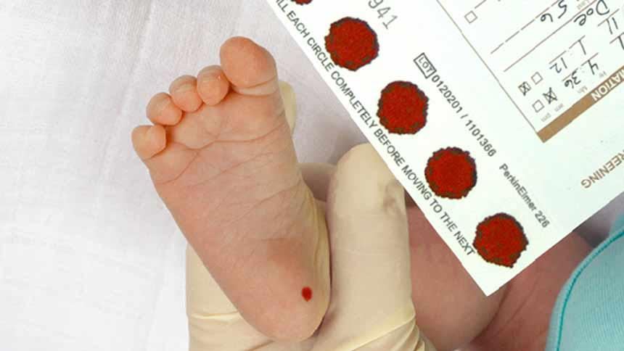
Newborn Screening Program in the Philippines
Population-based genetics program to detect inborn errors of metabolism allowing for management and treatment.
Introduced in 1996 as a research initiative
Enacted into law in 2004 (Republic Act 9228)

Slide 195

Newborn Screening in the Philippines – expanded in 2014
Congenital Adrenal Hyperplasia
Congenital Hypothyroidism
Galactosemia
G6PD deficiency
Phenylketonuria
Maple Syrup Urine Disease
3-Methylcrotnyl CoA Carboxylase Def
Beta Ketothiolase Def
Biotinadase Def
Carnitine Palmitoyl Transferase Type 1 and 2
Fatty acid disorders
Glutaric academia type 1 and 2
Homocystinuria fatty acid disorders
Methionine adenosime transferase def
Multiple carboxylase def
Organic acidurias
Thalassemias
Hemoglobinopathies
Tyrosinemia
Urea cycle defects
Source: Newborn Screening Reference Center

Slide 196
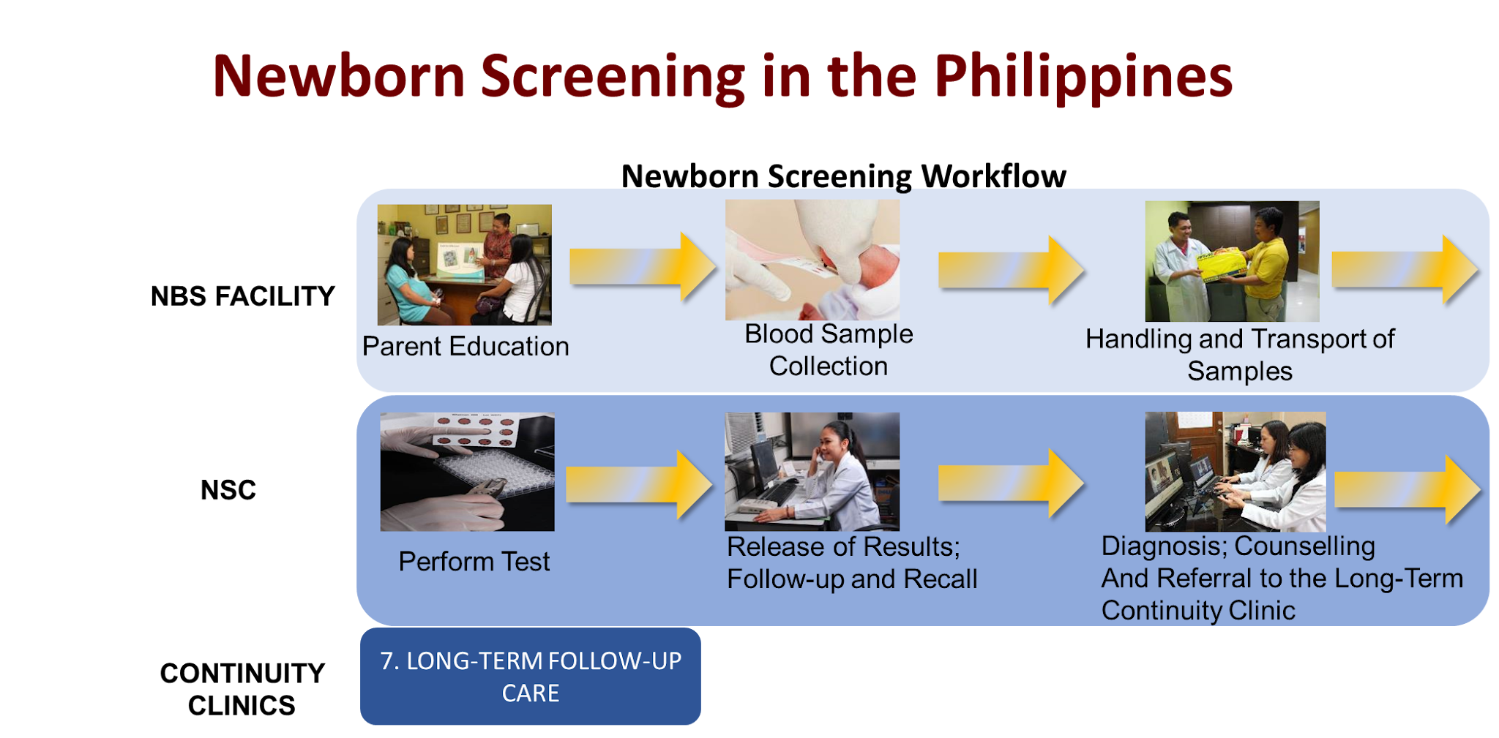

Slide 197
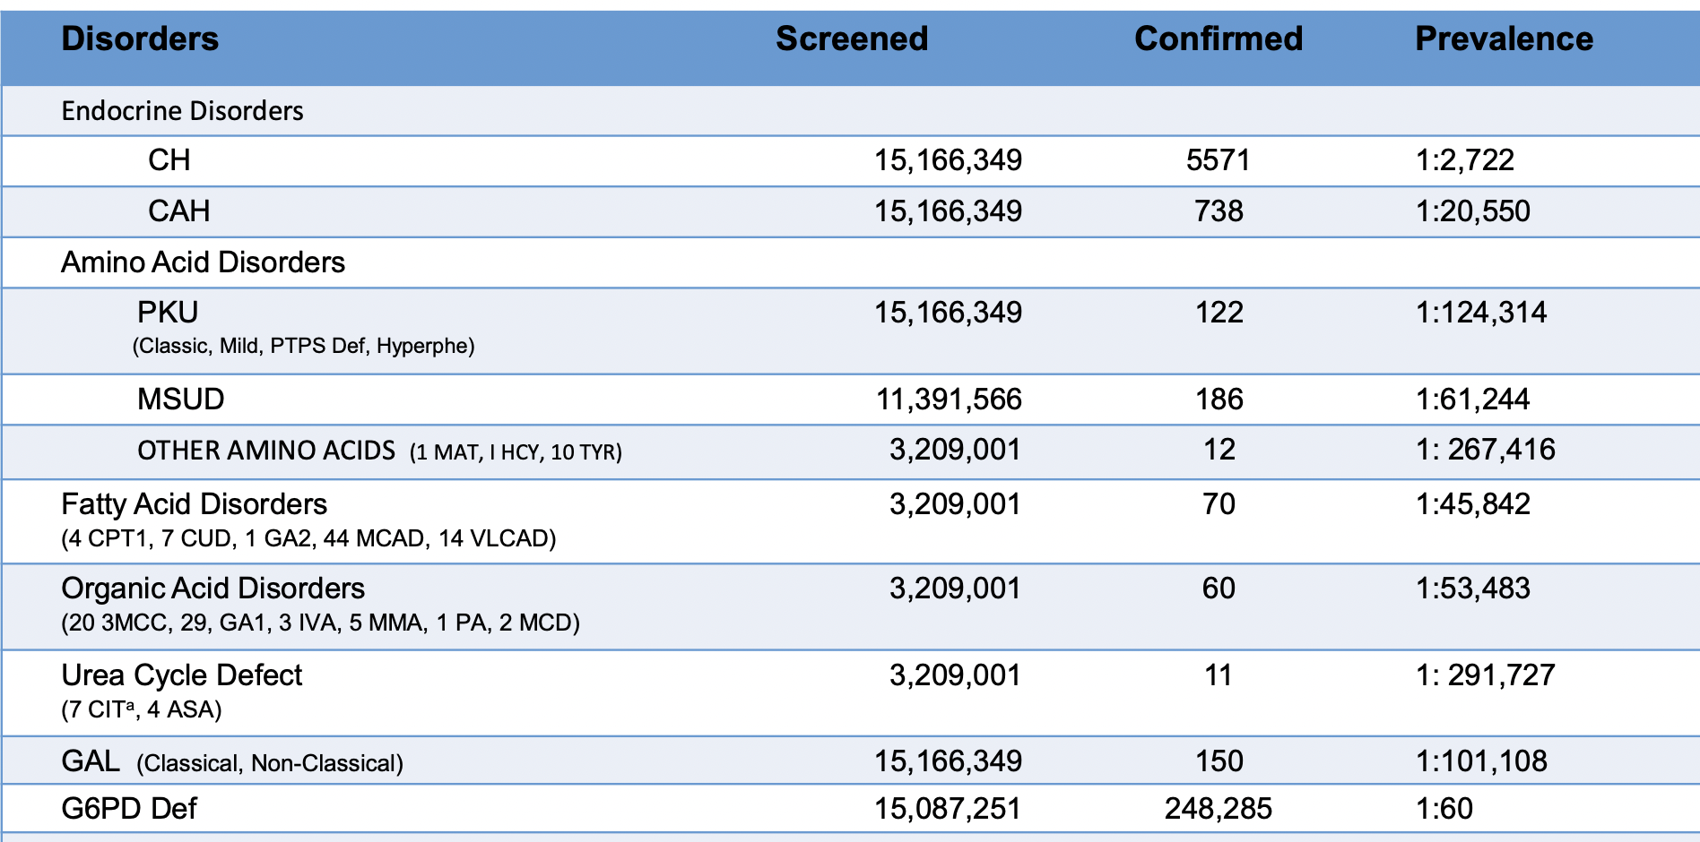
Newborn Screening in the Philippines – Prevalence of Disorders (2020)
Source: Newborn Screening Reference Center

Slide 198
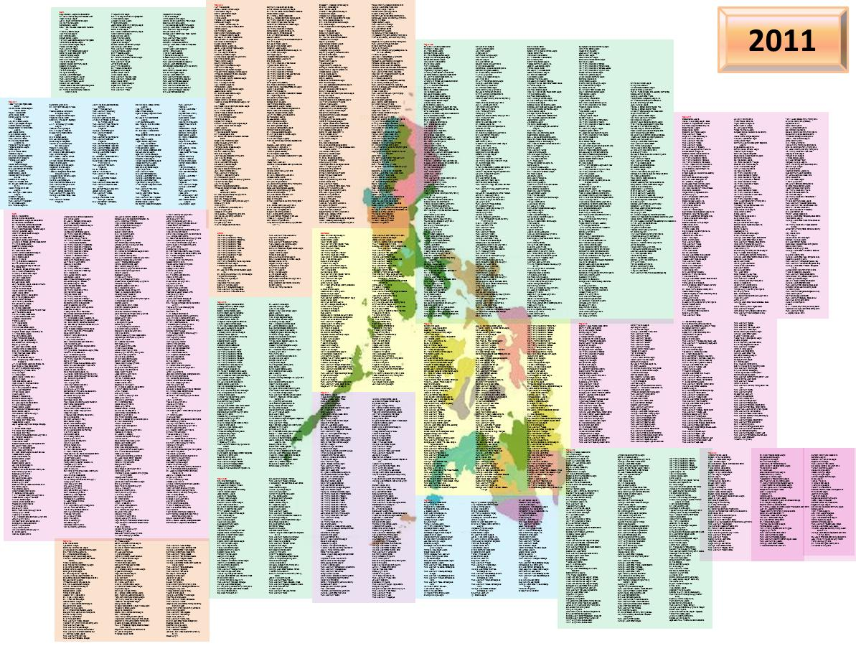
Newborn Screening Facilities
7100+
facilities
Health facilities where blood spot samples are collected
Hospitals, health centers, lying-in clinics
June 2020

Slide 199
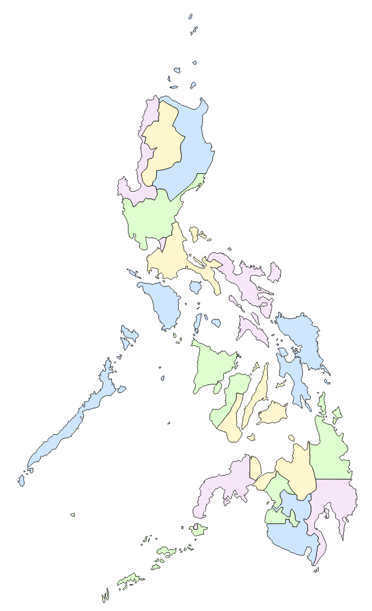

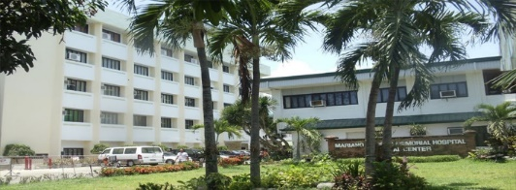




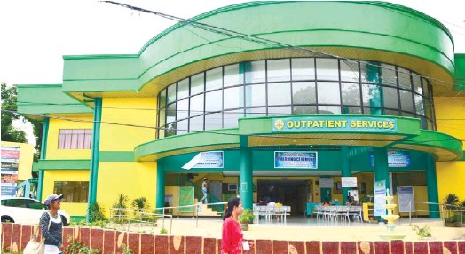

Newborn Screening Centers
NSC - NORTHERN LUZON
Mariano Marcos Memorial Hospital and Medical Center
NSC – SOUTHERN LUZON
Daniel Mercado Medical Center
NSC - CENTRAL LUZON
Angeles University Foundation Medical Center
NSC – Visayas
West Visayas State University Medical Center
NSC – NIH
UP Manila
NSC – CENTRAL VISAYAS
Eversley Childs Sanitarium and General Hospital
Future NSCs

Slide 200
Establishment of Continuity Clinics
Short-Term Follow-up
Long-Term Follow-up
Newborn Screening Centers
Newborn Screening Continuity Clinics

Slide 201

NBS Continuity Clinics
Ilocos Training and Regional Medical Center, Region 1
Cagayan Valley Medical Center, Region 2
Jose B. Lingad Memorial Regional Hospital, Region 3
Baguio General Hospital and Medical Center, CAR
Philippine General Hospital, NCR
Gen. Emilio Aguinaldo Memorial Hospital, CALABARZON
Bicol Regional Training and Teaching Hospital, Region 5
West Visayas State University Medical Center, Region 6
Vicente Sotto Memorial Medical Center, Region 7
Eastern Visayas Regional Medical Center, Region 8
Zamboanga City Medical Center, Region 9
Northern Mindanao Medical Center, Region 10
Southern Philippines Medical Center, Region 11
Cotabato Regional Medical Center, Region 12
Long Term
Follow-up
CAGAYAN
BAGUIO
LA UNION
PAMPANGA
MANILA
CAVITE
14 Continuity Clinics in operation
ALBAY
ILOILO
LEYTE
CEBU
CAGAYAN DE ORO
Mimaropa region is being handled by PGH NCR
Caraga region is being handled by SPMC Region 11
ARMM is being handled by CRMC Region 12
ZAMBOANGA
DAVAO
COTABATO

Slide 202

Newborn Screening Coverage 2020
Source: Newborn Screening Reference Center

Slide 203


Philippine Genome Center
Established in 2009
Accelerated genomics research allowing for the development of health diagnostics and therapeutics among others

Slide 204


Research on Precision Medicine
Application of precision medicine on
  Diabetes,
  Hypertension,
  Coronary artery disease,
  Hyperlipidemia, and
  Colorectal cancer

Slide 205

National Integrated Cancer Control Act 2019
Emphasis on
  cancer prevention including screening and early detection through genetic testing and counseling,
  treatment including targeted therapy, and
  survivorship by strengthening essential program along the cancer care continuum

Slide 206


Direct-to-consumer tests are also available
DTC tests offered include:
  Ancestry testing
  Health and wellness
  Disease susceptibility

Slide 207
Opportunities in Nursing Practice

Slide 208
Newborn Screening is an opportunity to integrate genetics
The Newborn Screening Act of 2004 (Republic Act 9288) provided for training of nurses to assume important roles in newborn screening implementation such as advocacy, sample collection, and short- and long-term management of patients

Slide 209

Exemplars
Philippine General Hospital (PGH) NBS Nurses Core Group
Newborn Screening Continuity Clinics

Slide 210
PGH NBS Nurses Core Group
The nurses provide pre-screening information and support
Providing pre-screening information is important as this increases adherence for confirmatory testing in case of positive screening results (Abad et al., 2019; Potter et al., 2015).
In results disclosure, they provide information about the disorder and instructions for confirmatory testing, as well as psychosocial support
The PGH NBS nurses core group serves as model for other hospitals and other NBS facilities nationwide.

Slide 211


NBS Continuity Clinics
Nurses have key roles in addressing the supportive care needs of patients and families guiding them through the life course ensuring continuity of care.
They provide basic genetics information about the conditions.
They help patients and families to self-advocate by encouraging them to participate in support groups

Slide 212
Nurses at the PGH Clinical Genetics Clinic
They provide comprehensive nursing care to patients referred to the clinic from assessment, management, and evaluation of care.
They also take part in enzyme replacement therapy, clinical trials, and research on rare diseases.
They serve as resource persons in capability building activities of the Newborn Screening Reference Center (NSRC) and in organizing patient support groups.

Slide 213

Nurse - Genetic Counselors
Among the 14 genetic counselors in the Philippines, 11 are nurses.
They provide genetic counseling in various capacities in strategic locations in the country.
Manila (4)
1 – Assistant Professor (College of Nursing)
1 – Clinical Assistant Professor (College of Medicine)
1- Research Associate, Cancer Clinical Trials
1 – Clinical Manager, CGGCS
Roxas City, Capiz (2)
Clinical In-house Genetic Counselors, Collaborative Center for XDP
Iloilo City (1)
Genetic counselor, NSC-Visayas
Davao City (3)
Genetic Counselor, NSC Mindanao
Zamboanga City (1)
Family Service and Training Coordinator, Commission on Population

Slide 214



Nurse– Genetic Counselors expand provision of genetics and genetic counseling services
Telegenetic Counseling in Newborn Screening
Genetic counseling session for Thalassemia
Genetic counseling session for X-linked Dystonia Parkinsonism

Slide 215
Initiatives in Nursing Education

Slide 216

Training Workshop in Genetics for Nurses
Lectures on
  Basic genetics concepts,
  Family history and risk assessment,
  Specific application of genetics in various medical specialties,
  Ethical, legal, and sociocultural implications
Workshop on
  Drawing and interpreting family histories
  Applying the nursing process in caring for individuals with inherited conditions given hypothetical situation

Slide 217


Conferences that include genetics and genomics content
There are yearly Newborn Screening Convention to update health care providers on the program.
The Philippine Oncology Nurses Association has been including genetics content in its yearly conferences

Slide 218



Webinars on genetics and genomics are also available

Slide 219
The MS Genetic Counseling program as a formal training in genetics and counseling
It is a two-year program that is key in implementing and expanding genetic counseling services in the country.
Many of its graduates are nurses
There are currently very few clinical geneticists in the country and the graduates of the MSGC program are crucial to meet the increasing patient and healthcare provider demands.

Slide 220





MS Genetic Counseling
To date, there are 72 students in the Philippines. It is the 11th year of offering; 14 have graduated
Notes:
The University of the Philippines Manila opened a two-year degree program in 2011 that will prepare students to become competent genetic counselors to serve a vital role in the access, delivery, and expansion of clinical medical genetics in the Philippines and in the Southeast Asia region. Five students already graduated from the program and 44 students currently enrolled. These prospective graduates are expected to respond to the counseling need of the patients and their families who will be identified positive by the program.
The Newborn Screening Reference Center (NSRC) also continues to offer fellowship grants for pediatric endocrinologists and clinical geneticists to ensure the availability of qualified health personnel in the country who could be tapped in the follow-up treatment, monitoring and management of newborns with positive screens.

Slide 221
MS Genetic Counseling
To date, there are 72 students in the Philippines. It is the 11th year of offering; 14 have graduated
Notes:
The University of the Philippines Manila opened a two-year degree program in 2011 that will prepare students to become competent genetic counselors to serve a vital role in the access, delivery, and expansion of clinical medical genetics in the Philippines and in the Southeast Asia region. Five students already graduated from the program and 44 students currently enrolled. These prospective graduates are expected to respond to the counseling need of the patients and their families who will be identified positive by the program.
The Newborn Screening Reference Center (NSRC) also continues to offer fellowship grants for pediatric endocrinologists and clinical geneticists to ensure the availability of qualified health personnel in the country who could be tapped in the follow-up treatment, monitoring and management of newborns with positive screens.

Slide 222
Issues and Challenges

Slide 223
Issues and challenges mirrors the obstacles in genomics medicine in developing countries
There is less priority given to genetics and genomics by the government despite the potential contributions of “omics” technologies in the prevention and control of the current disease burden.
There is a need to capacitate the current health workforce in integrating genetics and genomics in health service delivery.
Locally relevant practice guidelines in genetics and genomics are much needed.
Absence of an organization that advocates for the professional development and certification of nurses involved in genetics.

Slide 224
Conclusion

Slide 225
Conclusion
Despite being a developing country, the Philippines has, in the past years, harnessed the use of genetics and genomics to address population needs.
Genetics services in other specialty areas such as in oncology are also slowly being developed and integrated.
The nursing workforce needs to keep abreast with these developments and continuously look for opportunities and initiate strategies to ensure that nurses are prepared to integrate genetics and genomics in their practice.
There are several issues and challenges, but these can be addressed strategically.

Slide 226
Thank you!

Slide 227

Genetics and Genomics Nursing in the Philippines: Status, Initiatives, and Opportunities
Peter James Abad, BSN’10, MSc, RN

Slide 229
Q & A
Minnie Corpuz-Castillo, BSN’86, RN
Chair, Sustainability & Viability Committee
Rosemarie Gadioma, BSN’81, MSN, ANP,ACNP-BC
Chapter President, UPN-EC
Member, Awards and Citations Committee

Slide 230


Slide 231
BREAK
Resumes in 10 minutes
Link to Evaluation:
https://forms.gle/coysdwffcciUmR2J7
42nd Annual & 2nd Virtual Convention
August 6th & 7th, 2021

Slide 232


Slide 233

Quality Improvement: Reducing Stress and Anxiety in Filipino Nurses with Less Than Five Years of Nursing Experience in Nevada Through the Implementation of a Mentorship Program
42nd Annual & 2nd Virtual Convention
August 6th & 7th, 2021
Flora Dado Sayson, DNP, MSN, RN

Slide 234



Slide 235
Objectives
Determine the efficacy of the web-based mentorship program.
Determine if the mentees have reduced stress and anxiety after the mentorship program.
Describe the strategies utilized in the mentorship program.

Slide 236
Abstract
The DNP project showed that a Filipino nurse with less than five years of nursing experience in Nevada reduced stress and anxiety through the implementation of a web-based mentorship program.
The web-based mentorship program was guided by Jean Watson's theory of human caring utilizing the Ten Caritas Processes®.
The participants' recruitment went through an email and a flyer posted on the community partner's website, the Philippine Nurses Association of Nevada, pnanv.org.
A pre and post questionnaire survey was conducted using the Perceived Stress Scale by Mind Garden, Inc. The results were analyzed using Paired Sample T-Test that showed a reduction in the mentees' stress and anxiety after the intervention using a web-based mentorship program.

Slide 237

PROBLEM
NURSE STAFFING PROBLEM (AMERICAN NURSES ASSOCIATION,2017)
FOREIGN GRADUATE NURSES (JAUREGUI &, 2010)
CHALLENGES IN ASSIMILATION, LANGUAGE BARRIERS AND DISCRIMINATION ARE CAUSING STRESS & ANXIETY (CONNOR, 2016)
.
Notes:
According to the American Nurses Association in 2017 there was nurse staffing problem, hospitals and healthcare facilities recruited foreign graduate nurses and among those are Filipino nurse who faced challenges in assimilation, language barriers and discrimination that caused stress and anxiety.

Slide 238

BACKGROUND
INSTITUTE OF MEDICINE, AS OF 2018, THERE ARE AN ADDITIONAL 32 MILLION AMERICANS
3.8 MILLION REGISTERED NURSES NATIONWIDE, BUT ONLY 84.5% ARE EMPLOYED IN NURSING (AACN, 2019)
PREVENTIVE CARE, GROWING RATES OF CHRONIC CONDITIONS SUCH AS DIABETES AND OBESITY AND DEMAND FOR HEALTHCARE SERVICES FROM THE BABY-BOOM POPULATION (AACN,2019)
Notes:
…and nurses are needed for preventive care because there are growing rates of chronic conditions….

Slide 239

BACKGROUND
INSTITUTE OF MEDICINE, AS OF 2018, THERE ARE AN ADDITIONAL 32 MILLION AMERICANS
3.8 MILLION REGISTERED NURSES NATIONWIDE, BUT ONLY 84.5% ARE EMPLOYED IN NURSING (AACN, 2019)
PREVENTIVE CARE, GROWING RATES OF CHRONIC CONDITIONS SUCH AS DIABETES AND OBESITY AND DEMAND FOR HEALTHCARE SERVICES FROM THE BABY-BOOM POPULATION (AACN,2019)
Notes:
brought about by cost-cutting decisions, aging population, increased patient complexity and aging workforce that added stress on working conditions, caused nurses to leave the workplace
The recruitment of Foreign Educated Nurses was beneficial to the hospitals because it kept hiring costs down over the long run.
Among those recruited were Filipino nurses.

Slide 240



CLINICAL QUESTION
WILL THE FILIPINO NURSE, WITH LESS THAN FIVE YEARS OF NURSING EXPERIENCE IN A NEVADA HEALTHCARE SETTING WHO AVAILED A MENTORSHIP PROGRAM FOR TEN WEEKS, EXPERIENCE A REDUCTION IN STRESS AND ANXIETY COMPARED TO THOSE WHO DID NOT?
P-FILIPINO NURSE WITH LESS THAN FIVE YEARS OF NURSING EXPERIENCE (MENTEE) AND FILIPINO NURSE WITH SEVEN YEARS OR MORE NURSING EXPERIENCE (MENTOR) IN NEVADA HEALTHCARE SETTING.
I-WEB-BASED MENTORSHIP PROGRAM, TEN CARITAS PROCESSES® OF JEAN WATSON'S HUMAN CARING THEORY
C- SURVEY THE PARTICIPANTS BEFORE AND AFTER AVAILING OF THE WEB-BASED MENTORSHIP PROGRAM
O-PARTICIPANTS WILL REDUCE STRESS AND ANXIETY
T-TEN WEEKS

Slide 241
LITERATURE REVIEW
The advancement of technology brought an increased usage of the internet and digital platform that paved the way to web-based interventions (Yang 2019), and that brought virtual mentoring program into the society (Welch 2017).
According to Brannagan & Oriol (2014), Rand & Pajarillo (2015), virtual mentoring in nursing education improved virtual connections, relationships, and program outcomes.
As stated by Lewis & Flannery (2016) - virtual mentors could provide a tremendous boost to the mentee's professional network, which can prove invaluable to professional development

Slide 242
LITERATURE REVIEW
Garringer et al. (2019) stated that, E-mentoring has grown in popularity since different platforms allow a mentor and a mentee to communicate in a space completely dedicated to their mentoring interaction, such as emails, texting, chatting using a messenger program or social media, and video conferencing.
The American Nurses Association (2020) – conducted virtual mentorship in 2015 to prevent the high turnover rates, especially young nurses.

Slide 243

LITERATURE REVIEW
AS EVIDENCED BY THE LITERATURES REVIEWED, WEB-BASED MENTORSHIP PROGRAM CAN LEAD TO POSITIVE OUTCOMES AS WE NOW HAVE A PARADIGM SHIFT THAT INVOLVES UTILIZATION OF TECHNOLOGY.
Notes:
There can be drawbacks: developing trust, lack of verbal cues, the increased likelihood of miscommunication, the possibility of a reduced mentor-mentee relationship progression, unique privacy concerns, unpredictability of modes of communication, and lack of technical skills, any of which could create communication gaps between the mentor and mentee (Leck & Wood, 2013; Rogers, 2019).

Slide 244


GUIDING THEORY: JEAN WATSON’S HUMAN CARING THEORY
CARING SCIENCE EMBRACES THE WHOLE PERSON, THE UNITY OF MINDBODYSPIRIT AS ONE IN RELATION WITH ENVIRONMENT AT ALL LEVELS.
BRING MEANING AND FOCUS TO NURSING AS DISTINCT HEALTH PROFESSION WITH ITS OWN UNIQUE VALUES, KNOWLEDGE AND PRACTICES, WITH ITS OWN ETHIC AND MISSION TO SOCIETY.
SUBJECTIVE INNER HEALING PROCESSES AND THE LIFE WORLD OF THE EXPERIENCING PERSON, REQUIRING UNIQUE CARING-HEALING ARTS AND A FRAMEWORK CALLED "CARATIVE FACTORS.“
THE CARING MODEL OR THEORY CAN ALSO BE CONSIDERED A PHILOSOPHICAL AND MORAL/ETHICAL FOUNDATION FOR PROFESSIONAL NURSING, ONE HAS TO PERSONALLY EXPERIENCE IT; THUS THE MODEL IS BOTH AN INVITATION AND AN OPPORTUNITY TO INTERACT WITH THE IDEAS, EXPERIMENT WITH AND GROW WITHIN THE PHILOSOPHY, AND LIVING IT OUT IN ONE’S PERSONAL/PROFESSIONAL LIFE.
      (WATSON, 1979, 1985, 1999,2006, 2008)
Notes:
The Conceptual framework used was Jean Watson’s Human Caring theory. According to Jean Watson…

Slide 245

Notes:
According to Watson’s Human Caring Theory, caring process includes Ten Carative Factors that evolve to Ten Caritas Processes

Slide 246

Notes:
These are the Ten Carative Factors that the mentee reflect on during the meeting with the mentors, each meeting the mentees and mentors watched a video recording from Jean Watson.

Slide 247

METHOD
QUALITY IMPROVEMENT THAT WILL UTILIZE FADE METHOD:
  FOCUS – AIMS TO REDUCE THE STRESS AND ANXIETY OF THE FILIPINO NURSE WHO HAS LESS THAN FIVE YEARS OF NURSING EXPERIENCE IN NEVADA.
  ANALYZE - PRE AND POST QUESTIONNAIRE WILL UTILIZE THE PERCEIVED STRESS SCALE FROM MIND GARDEN, INC., TO DETERMINE THE PARTICIPANTS' STRESS AND ANXIETY LEVEL.
  DEVELOP - WEB-BASED MENTORSHIP PROGRAM VIA ZOOM MEETING PLATFORM
  EXECUTE – RECRUITMENT OF PARTICIPANTS WILL START WITH AN EMAIL INVITATION AND A FLIER, CONSENT, DEMOGRAPHIC SURVEY AND REGISTRATION AT THE PNANV.ORG WEBSITE. SEPTEMBER 7 TO NOVEMBER 9, 2020, MENTOR AND MENTEE WILL MEET THIRTY TO SIXTY MINUTES EACH WEEK FOR TEN WEEKS. EACH MEETING WILL ENTAIL A REFLECTIVE DISCUSSION OF EACH OF THE 10 CARITAS PROCESSES®
  EVALUATE - THE PROGRAM'S EFFECTIVENESS WILL BE EVALUATED WITH THE POST QUESTIONNAIRE USING THE PERCEIVED STRESS SCALE BY MIND GARDEN, INC. AN EVALUATION FORM WILL ALSO BE COMPLETED
  (MORAN & CONRAD, 2014)
Notes:
The Method used was based on FADE method by Moran and Conrad… FOCUS…ANALYZE were pre and post questionnaire using the Perceived Stress Scale by Mind Garden Inc. to determine the level of stress and anxiety that the mentees experienced before and after the implementation of mentorship program.
DEVELOP the web-based mentorship program…EXECUTE started with recruitment via email invitation, flier, consent and demographic survey were conducted once the particpants registered in the pnanv.org website. The mentees chose an applicable time with their mentors and the start of the program commenced on the week of September 7th until the week of November 16th. EVALUATE …

Slide 248

Descriptive Statistics
 | N | Minimum | Maximum | Mean | Std. Deviation
Age | 10 | 22.00 | 32.00 | 25.7000 | 3.19896
Years as RN | 10 | .00 | 2.00 | .5000 | .84984
EdLevel | 10 | 1.00 | 2.00 | 1.8000 | .42164
Valid N (listwise) | 10
MENTEES
*
PARTICIPANTS
Descriptive Statistics
 | N | Minimum | Maximum | Mean | Std. Deviation
Age | 10 | 43.00 | 62.00 | 51.3000 | 6.01941
Years as RN | 10 | 8.00 | 31.00 | 18.0000 | 8.21922
EdLevel | 10 | 1.00 | 4.00 | 2.9000 | 1.10050
Valid N (listwise) | 10
MENTORS
*
* 1-Associate, 2-Bachelors, 3-Masters, 4-Doctoral

Slide 249
Data Analysis
The demographic survey showed; that the age of mentees who participated ranged from 22 to 32 years old. The years of nursing experience of the mentees varied between less than a year to 2 years. Meanwhile, the mentors were between 43 to 62 years old. The years of nursing experience of the mentors were from 8 years to 31 years.
Among the 10 mentees, there were 2 with associate degrees and 8 with bachelors’ degrees. Among the 10 mentors, 1 had an associate degree, 3 with bachelors’ degrees, 2 with masters’ degrees, and 4 with doctoral degrees.

Slide 250


EFFECT OF
WEB-BASED
MENTORSHIP
ON THE
10
MENTEES
SIGNIFICANT
CHANGE ON
THE
MENTEES

Slide 251

EFFECT OF
WEB-BASED
MENTORSHIP
ON THE
10
MENTEES

Slide 252


Slide 253
Implications for Nursing Practice
The web-based mentorship program was effective in reducing stress and anxiety of the Filipino Nurse with less than five years of nursing experience in Nevada.
“The program is a great tool for new nurses.”
Developed strategies to reduce stress and anxiety.
Encouraged confidence, efficiency and effectiveness. Therefore, quality nursing care and excellent patient care outcomes will ensue.
Professional advancement and encouraged retention.

Slide 254
Limitations
The focus of the project was on the Filipino nurse (mentee) with less than five years of nursing experience in Nevada health care setting. In the future the Filipino nurse (mentor) with more than seven years of nursing experience will also become part of the web-based mentorship program experiencing the Ten Caritas Processes of Jean Watson.
There was small number of participants. The community partner, the Philippine Nurses Association of Nevada will adopt the program and will open it to all members.

Slide 255
CONCLUSION
The web-based mentorship program was effective in reducing the stress and anxiety of the Filipino nurses with less than five years of nursing experience in Nevada as indicated in the results of the Perceived Stress Scale survey by Mind Garden, Inc. which was measured before and after the program.

Slide 256

THANK YOU

Slide 257
REFERENCES
AMERICAN ASSOCIATION OF COLLEGES OF NURSING. (2019). NURSING FACT SHEET. RETRIEVED FROM HTTPS://WWW.AACNNURSING.ORG/NEWS-INFORMATION/FACT-SHEETS/NURSING-FACT-SHEET
AMERICAN NURSES ASSOCIATION. (2017). NURSE STAFFING CRISIS. RETRIEVED FROM HTTPS://WWW.NURSINGWORLD.ORG/PRACTICE-POLICY/NURSE-STAFFING/NURSE-STAFFING- CRISIS/
BORINES, Z. G. (2018). IMPLEMENTATION OF THE MENTORSHIP PROGRAM IN THE EMERGENCY DEPARTMENT HTTPS://WWW.DOCTORSOFNURSINGPRACTICE.ORG/WP- CONTENT/UPLOADS/PROJECT_FORM/COMPLETE_250218114436.PDF
HAYASHI, T. L. (2018). EXPLORING THE DEVELOPMENTAL INFLUENCE OF MENTORING ON THE POSITIVE CAREER OUTCOMES OF ASIAN PACIFIC ISLANDER PROFESSIONALS. PROQUEST DISSERTATIONS & THESES GLOBAL. HTTP://DX.DOI.ORG/10828478
CONNOR, J. B. (2016). CULTURAL INFLUENCE ON COPING STRATEGIES OF FILIPINO IMMIGRANT NURSES. SAGE, 64(5), 1-7. HTTP://DX.DOI.ORG/ 10.1177/2165079916630553

Slide 258
REFERENCES
INSTITUTE OF MEDICINE. (2011). THE FUTURE OF NURSING: LEADING CHANGE, ADVANCING HEALTH. RETRIEVED FROM DOI: HTTPS://DOI.ORG/10.17226/12956
JAUREGUI, A. B., & XU, Y. (2010). TRANSITION INTO PRACTICE: EXPERIENCES OF FILIPINO PHYSICIAN-TURNED NURSE PRACTITIONERS. JOURNAL OF TRANSCULTURAL NURSING, 21(3), 257-264. HTTP://DX.DOI.ORG/ 10.1177/1043659609358787
LECK, J. D., & WOOD, P. M. (2013). FORMING TRUST IN E-MENTORING: A RESEARCH AGENDA. AMERICAN JOURNAL OF INDUSTRIAL AND BUSINESS MANAGEMENT, 3(1), 101-109. HTTP://DX.DOI.ORG/10.4236/AJIBM.2013.31013
MORAN, K., BURSON, R., & CONRAD, D. (2014). THE DOCTOR OF NURSING PRACTICE SCHOLARLY PROJECT A FRAMEWORK FOR SUCCESS. BURLINGTON, MA: JONES & BARTLETT LEARNING

Slide 259
REFERENCES
NEVADA STATE BOARD OF NURSING ANNUAL REPORT FISCAL YEAR 2018/2019. (). HTTPS://NEVADANURSINGBOARD.ORG/WP-CONTENT/UPLOADS/2019/12/18.19-ANNUAL- REPORT.PDF
PITTMAN, P., FOLSOM, A., & BASS, E. (2010). U.S.-BASED RECRUITMENT OF FOREIGN- EDUCATED NURSES: IMPLICATIONS OF AN EMERGING INDUSTRY. AM.J. NURS, 110(6), 38-48. RETRIEVED FROM HTTPS://HSRC.HIMMELFARB.GWU.EDU/SPHHS_POLICY_FACPUBS/1340
ROGERS, D. F. (2020). A CORRELATIONAL STUDY: E-MENTORING, PERCEPTIONS OF E-MENTORING AND THE ACTUAL CAREER ADVANCEMENT OF WOMEN IN EDUCATIONAL LEADERSHIP. PROQUEST DISSERTATIONS PUBLISHING. RETRIEVED FROM HTTPS://SEARCH-PROQUEST- COM.UNR.IDM.OCLC.ORG/DOCVIEW/2390191805?ACCOUNTID=452&PQ-ORIGSITE=SUMMON
WEI, H., & WATSON, J. (2019, JAN 10). HEALTHCARE INTERPROFESSIONAL TEAM MEMBERS’ PERSPECTIVES ON HUMAN CARING: A DIRECTED CONTENT ANALYSIS STUDY. INT J NURS SCI, 6(1), 17-23. HTTP://DX.DOI.ORG/DOI: 10.1016/J.IJNSS.2018.12.001

Slide 260
REFERENCES
WELCH, S. (2017, JANUARY 24). VIRTUAL MENTORING PROGRAM WITHIN AN ONLINE DOCTORAL NURSING EDUCATION PROGRAM: A PHENOMENOLOGICAL STUDY. INTERNATIONAL J JOURNAL OF NURSING EDUCATION SCHOLARSHIP. HTTP://DX.DOI.ORG/10.1515/IJNES-2016-0049

Slide 261

Quality Improvement: Reducing Stress and Anxiety in Filipino Nurses with Less Than Five Years of Nursing Experience in Nevada Through the Implementation of a Mentorship Program
Flora Dado Sayson, DNP, MSN, RN

Slide 263
Q & A
Minnie Corpuz-Castillo, BSN’86, RN
Chair, Sustainability & Viability Committee
Rosemarie Gadioma, BSN’81, MSN, ANP,ACNP-BC
Chapter President, UPN-EC
Member, Awards and Citations Committee

Slide 264


Slide 265


Sepsis Pathway of Treatment (SPOT) Bundle Awareness
42nd Annual & 2nd Virtual Convention
August 6th & 7th, 2021
Irish Ann B. Florendo, BSN, RN
Judy E. Santelices, BSN, RN

Slide 266


DCVAMC Evidence Based Practice
SEPSIS PATHWAY OF TREATMENT (SPOT) BUNDLE AWARENESS
Judy Enriquez Santelices, bsn, rn
Irish Ann B. Florendo, bsn, rn
Notes:
Hello everyone, my name is Judy Enriquez Santelices, and I have Irish Ann Florendo as well.
Today our topic is CLICK Sepsis Pathway of Treatment Bundle Awareness.
And we are from CLICK the Washington DC Veterans Affairs Medical Center, Evidence Based Practice.

Slide 267
O b j e c t i v e s
To enhance SPOT bundle awareness among nursing staff using evidence-based sepsis protocol
Integrate the new sepsis bundle recommendations
Promote early identification of septic patients
Expedite management and to evaluate implementation process to improve outcome.
Notes:
By conducting this project, we are hoping to…CLICK

Slide 268
P u r p o s e
Overall goal of our study is to evaluate the
effectiveness of quality improvement on sepsis management bundle towards mortality rate and sepsis protocol compliance.
Notes:
CLICK The inclusive goal of our study is …. CLICK

Slide 269
N e w Definition
S E P S I S:
Life-threatening organ dysfunction caused by dysregulated host response to infection
JAMA.2016;315(8):801-810. doi:10.1001/jama.2016.0287
Notes:
Now Sepsis has new definition CLICK

Slide 270
N e w Definition
SEPTIC SHOCK:
Subset of sepsis with circulatory and cellular/metabolic
dysfunction associated with higher risk of mortality.
Persisting hypotension requiring vasopressors to maintain MAP > 65 mmHg
Blood lactate >2 mmol/L despite adequate volume resuscitation
Singer M, Deutschman CS, Seymour C, et al. The Third International Consensus Definitions for Sepsis and Septic Shock (Sepsis-3).
JAMA.2016;315(8):801-810. doi:10.1001/jama.2016.0287
Notes:
And the new definition for Septic shock CLICK
mmHG (milllimeters of mercury)

Slide 271
Brief Background
Sepsis is a medical emergency and is difficult to diagnose
Cost of sepsis treatment resulted in an estimated $27 billion or
5.2 % of the total cost for all hospitalizations
Mortality rate of 15-56%
Healthcare providers are key to preventing infections
and illness that can lead to sepsis.
Each year, at least 1.7 million adults in America develop sepsis.
Nearly 270,000 Americans die as a result of sepsis each year.
1 in 4 patients who die in a hospital HAVE sepsis.
-National Center for Health Statistics Data Brief No. 62 June 2011
-Angus DC, Linde-ZwirbleWT, LidickerJ, et al. Epidemiology of severe sepsis in the United States:
analysis of incidence, outcome, and associated costs of care. CritCare Med. 2001;29:1303-10.CDC 2016A
Notes:
Let's us review a brief background of sepsis CLICK (after all hospitalizations) CLICK Current mortality rate is 15 to 56% which is considered high

Slide 272

Prevalence
Infection
Sepsis
Septic
Shock
Mortality > 10%
Mortality > 40%
JAMA. 2016 Feb 23;315(8):801-10. doi: 10.1001/jama.2016.0287.
Notes:
Let’s analyze the prevalence CLICK if a patient has infection, CLICK
It will lead to organ dysfunction or sepsis; it reflects an overall mortality risk of approximately 10% in a
general hospital population CLICK
Patients with septic shock with these criteria, hospital mortality is greater than 40%.

Slide 273
Q u e s t i o n
What is the impact of Sepsis Bundle education
and implementation on mortality rate among
patients with sepsis in ED and admitted patients?
Notes:
Due to the evidence gathered about the mortality rate, we came up with the clinical research question CLICK

Slide 274
P I C O T
P : Among staff nurses' awareness on early sepsis
prevention on adult inpatients with hypotension,
altered mental status and tachypnea
I : does staff education of sepsis bundle with sepsis
screening tools
C : without screening tools affect
O : Length of Stay (LOS) in hospital and mortality rate
T : from ED admission to hospital discharged in 6 months
Notes:
And here is the formulation of our PICOT CLICK
P= Population
I = Intervention
C= Comparison
O= Outcome
T= Time

Slide 275
Problem Recognition
Lack of knowledge regarding sepsis
Delayed recognition of sepsis
Lack of 1- hour sepsis bundle
Lack of sepsis protocol
Delayed intervention
Notes:
The problem recognized at DCVAMC was that some patients that are admitted to the hospital fall out of sepsis core measures for different reasons. CLICK (at the end of delayed intervention)
These include not completing sepsis bundle (assessment, IVF, Lactic Acid, blood cultures and antibiotic) in a timely manner.

Slide 276
Summary of Evidence
Rapid completion of a 3-hour bundle of sepsis care and rapid administration of antibiotics were associated with reduced hospital mortality.
Reduced readmission rates and length of stay for patients admitted with sepsis bundle but did not affect mortality 3
As the standard order set compliance increased, a marked reduction in hospital mortality occurred. 5
Use of nurse-directed care improved bundle adherence and reduced in-hospital sepsis-related mortality rates. 8
Implementation of a standardized sepsis order set and algorithm was associated with a decreased 28-day in-hospital mortality rate. 9
Notes:
This is the synthesis summary of evidence. CLICK

Slide 277
Summary of Evidence
THE EVIDENCE GATHERED DETERMINED THAT EARLY RECOGNITION, INTERVENTION AND USE OF SEPSIS BUNDLE AND ORDER SET INFLUENCED DECREASE LOS AND MORTALITY RATE
Notes:
Overall CLICK

Slide 278
Data Collection
Pre-Implementation - 6 months prior to start
Implementation phase
Post Implementation
Notes:
Here is the process for data collection on our project CLICK

Slide 279
Implementation/Method
Knowledge: Educating staff to raise awareness
about early recognition of sepsis pathway
    Sepsis/Spot Bundle ID card
    Sepsis/Spot Bundle Poster
    Sepsis/Spot Bundle Power Points
    Sepsis TMS (Talent Management System) module
Develop the protocol and bundle along
with the hospital Sail Team and Leaderships
Develop Compliance Audit Tool
Develop CPRS Template to ensure bundle adherence
Notes:
The plan for solving this problem is through education, …CLICK here are the materials we created…bundle ID card…TMS CLICK at the end after(Develop CPRS Template)
The method that we will use is to gather previous 6 months data and after implementation to collect data for comparison if expected outcomes will improve towards compliance with sepsis bundles core measures. The idea is to begin these project once as the leadership approved and the plan is to evaluate these after 6 months for improvements.

Slide 280

Educational Materials Developed
Notes:
One educational material used was creating the template notes in CPRS (computerized patient record system) for one hour bundle RN notes, it was standardized and very simple tool to use.
The emphasis of this project is about early intervention of 1- hour sepsis bundle.

Slide 281





ACT FAST
Stop Sepsis
If you suspect S E P S I S
Know
SEPSIS SIGNS
Know
SEPSIS SYMPTOMS
High heart rate
Confusion or
disorientation
Fever, shivering,
Feeling very cold
Shortness
of breath
Extreme pain or discomfort
Clammy or
sweaty skin
Identify and treat patient early.
https://www.cdc.gov/sepsis/signs-symptoms.html
Notes:
We also have the CLICK STOP Sepsis poster illustration with signs and symptoms of sepsis. The strategy is to identify septic patient using screening tools including this STOP sepsis poster. CLICK. CLICK. CLICK. CLICK.
CLICK. If we suspected patient with sepsis, we need to ACT FAST.
CLICK We need to identify and treat patient early.

Slide 282


THE NEW DIAGNOSTIC TOOL FOR SEPSIS:
q SOFA
H A T
Sepsis-related Organ
Failure Assessment
LOOK For: Quick SOFA score
H: Hypotension (SBP <100 mmHg)
A: Altered Mentation (GCS <15)
T: Tachypnea (RR>22/min)
Score >2 = MORTALITY of 10%
*Non-ICU patients are at increased risk of
death or prolonged ICU stay ( > 3 days )
Singer M, Deutschman CS, Seymour C, et al. The Third International Consensus Definitions for Sepsis and Septic Shock (Sepsis-3).JAMA.2016;315(8):801-810. doi:10.1001/jama.2016.0287
https://epmonthly.com/article/sepsis-gets-an-upgrade/
Notes:
The New Diagnostic Tool for sepsis: CLICK
We have the qSOFA which stands for S-sepsis-related O-Organ CLICK
F-Failure A-Assessment CLICK. Organ dysfunction can be identified as an acute change in total SOFA score ≥2 points due to the infection (The baseline SOFA score can be assumed to be zero in patients not known to have preexisting organ dysfunction) CLICK A SOFA score ≥2 reflects an overall mortality risk of approximately 10% in a general hospital population with suspected infection. Screening with suspected infection that are likely to have a prolonged ICU stay or to die in the hospital can be promptly identified at bedside with qSOFA
CLICK The criteria for qSOFA scoring is the HAT abbreviation define as CLICK H for Hypotension with systolic blood pressure of less than ≤100mmHg, CLICK A stands for Altered mental status with Glasco score of less than 15 and CLICK T for tachypnea with respiratory rate greater than ≥22/min).
CLICK This is another way to remember qSOFA in relation to HAT.
Important to remember, qSOFA score does not require laboratory tests and can be assessed quickly and repeatedly.

Slide 283
Sepsis Pathway Of Treatment
Patient with suspected infection
NO
NO
A. qSOFA Variables:
H Hypotension SBP < 100 mmHG
A Altered mental Status GCS < 15
T Tachypnea >22 / min
qSOFA > 2 (see A)
Sepsis still suspected ?
Monitor clinical condition; reevaluate for possible sepsis if clinically indicated
Call MD
YES
Assess for evidence of
Organ dysfunction
YES
NO
Monitor clinical condition; reevaluate for possible sepsis if clinically indicated
SOFA > 2 (see B)
Call RRT
YES
B. SOFA Variables:
Pa02/Fi02 ratio
Glascow Coma Scale score
Mean arterial pressure
Administration of vasopressors
with type and dose rate of infusion
Serum creatinine or urine ouput
Bilirubin
Platelet count
SEPSIS
NO
Despite adequate fluid resuscitation,
Vasopressors require to maintain
MAP > 65 mmHg
and
2. Serum lactate level > 2 mmol/L ?
YES
SEPTIC SHOCK
JAMA. 2016 Feb 23;315(8):801-10. doi: 10.1001/jama.2016.0287.
Notes:
Here is one Sepsis Pathway that we developed based on the evidence we gathered and will continue to work with the hospital team to implement.

Slide 284














SEPSIS PATHWAY OF TREATMENT BUNDLE AWARENESS
WASHINGTON DC VETERANS AFFAIRS MEDICAL CENTER
Judy Enriquez Santelices, bsn, rn, Irish Ann B. Florendo, bsn, rn
O B J E C T I V E:
1. To enhance Sepsis Pathway of
Treatment (SPOT) bundle awareness
among ED staff using evidence-based
sepsis protocol and integrate the new
sepsis bundle recommendations.
2. Promote early identification of septic
patients.
3. Expedite management and to
evaluate implementation process to
improve outcome.
S E P S I S:
Life-threatening organ dysfunction caused
by dysregulated host response to infection
SEPSIS AND SEPTIC SHOCK PATHWAY
End Organ Dysfunction
SIGNIFICANCE FOR PRACTICE: This quality improvement approach in using nurse-directed care may serve as a model for other facilities in promoting timely identification and early treatment of sepsis that leads to improve outcomes.
(Acute Changes/Not Chronic Condition)
CNS – Acutely Altered Mental Status, confusion, Psychosis
SEPTIC SHOCK:
Subset of sepsis with circulatory and cellular/metabolic dysfunction associated with higher risk of mortality.
Persisting hypotension requiring
vasopressors to maintain MAP > 65mmHg
Blood lactate >2 mmol/L despite
adequate volume resuscitation
Patient with suspected infection
NO
NO
CARDIOVASCULAR Hypotension, SBP <90 or MAP < 65 mmHg
Sepsis
Still
Suspected?
Monitor clinical condition; reevaluate for possible sepsis if clinically indicated
Q SOFA Score >2
RESPIRATORY – Oxygenation Increasing O2 requirements o Bipap/Vent, O2 ↑ by 2L or a ↓ in SpO2 5% >4 hrs. Tachypnea
YES
Call MD
YES
q SOFA Score
HEPATIC – Elevated LFT’s (Bilirubin > 2 mg/dl) ↓ albumin
Quick SOFA
Sequential
Organ
Failure
Assessment
H A T
HEMATOLOGIC – Coagulopathies (INR> 1.5, APTT >60 seconds, or Platelets Count < 100,000 per uL
CONCLUSION/SUMMARY: Demonstrates awareness to promote timely identification and early treatment of sepsis in inpatients that can improve bundle adherence and reduce in-hospital sepsis-related mortality rates. Clinicians are the key to make a difference towards advancement in healthcare system.
P I C O T:
P: Among staff nurses' awareness on early
sepsis prevention on adult inpatients
with hypotension, AMS and tachypnea
I : does staff education of sepsis bundle
with sepsis screening tools
C: without screening tools affect
O: LOS in hospital and mortality rate
T: from ED admission to hospital
discharged in 6 months
H: Hypotension (SBP <100 mmHg)
A: Altered Mentation (GCS < 15)
T: Tachypnea (RR > 22 /min)
Assess for evidence of Organ Dysfunction
SCORE >2 = Mortality of 10%
RENAL – ↓ urine output ,
< 0.5ml/Kg/Hr for > than 2, oliguria, anuria, ↑creat
NO
SOFA Score >2
METABOLIC – High Lactate > 2mmol/L
S O F A Score
YES
ENDOCRINE– Glucose > 140mg/dl or without
Diabetes or Steroids
Sequential(Sepsis-Related) Organ Failure Assessment
Call RRT
Updated in June 2018
SEPSIS
3 hours bundle &
6 hours bundle
1-hour
bundle
P U R P O SE:
To introduce standardized approach to treating sepsis using the guidelines in sepsis one-hour bundle.
HOUR – 1 BUNDLE
Despite adequate fluid resuscitation,
1.Vasopressors require to maintain
MAP > 65 mmHg and
2. Serum lactate level > 2 mmol/L ?
REFERENCES:
Gatewood MO, et al. BMJ Qual Saf 2015;24:787–795. doi:10.1136/bmjqs-2014-003552 2
prognostic-accuracy-quick-sequential... https://annals.org/aim/article-abstract/2671919/prognostic-accuracy-quick-sequential...
Surviving Sepsis Campaign Guidelines on the Management of Adults With Coronavirus Disease 2019 (COVID-19) in the ICU https://journals.lww.com/ccmjournal/Fulltext/2021/03000/Surviving_Sepsis_Campaign_Guidelines_on_the.21.aspx
The Third International Consensus Definitions for Sepsis and Septic Shock (Sepsis-3). JAMA. 2016 Feb 23;315(8):801-10. https://www.ncbi.nlm.nih.gov/pmc/articles/PMC4968574/pdf/nihms794087.pdf
* Complete reference list available upon request
INITIAL RESUSCITATION FOR SEPSIS AND SEPTIC SHOCK:
Measure lactate level. *
Obtain blood cultures before administering antibiotics.
Administer broad-spectrum antibiotics.
Begin rapid administration of 30mL/Kg crystalloid for hypotension or lactate >4 mmol/L.
Apply vasopressors if hypotensive during or after fluid resuscitation to maintain a MAP > 65mm Hg.
*Remeasure lactate if initial lactate elevated (> 2 mmol/L).
BRIEF BACKGROUND:
Sepsis is diagnosed in over one million patients each year in the US. Sepsis treatment resulted in an estimated $27 billion or 5.2 % of the total cost for all hospitalizations. Mortality rate of 15-56%.
SEPTIC SHOCK
JAMA. 2016 Feb 23;315(8):801-10. doi: 10.1001/jama.2016.0287
Notes:
Here is our ePoster that incorporate all topics mentioned in this presentation
We will implement these sepsis bundle and sepsis pathway, through the support of the Evidence Based Practice mentors, hospital leadership and SAILS team.

Slide 285


Notes:
Here is the spot sepsis ID card printed back-to-back. The goal is to work with the hospital sepsis task force to implement this project and evaluate the outcomes.

Slide 286
Significance for Practice
This quality improvement approach
in using nurse-directed care may serve
as a model for other facilities in promoting timely identification and early treatment of sepsis that leads
to improve outcomes.
Notes:
The implication for nursing practice CLICK

Slide 287
Conclusion
Overall, this poster presentation provides awareness on sepsis management.
It validates that early screening interventions can lead to expedited delivery of care to patients with sepsis and could serve as a model for other facilities.
Clinicians are the key to make a difference towards advancement in healthcare system.
Notes:
On conclusion this sepsis bundle presentation CLICK

Slide 288
R e f e r e n c e s
Gatewood MO, et al. BMJ Qual Saf 2015;24:787–795. doi:10.1136/bmjqs-2014-003552 2
prognostic-accuracy-quick-sequential... https://annals.org/aim/article-abstract/2671919/prognostic-accuracy-quick-sequential...
Surviving Sepsis Campaign Guidelines on the Management of Adults With Coronavirus Disease 2019 (COVID-19) in the ICU https://journals.lww.com/ccmjournal/Fulltext/2021/03000/Surviving_Sepsis_Campaign_Guidelines_on_the.21.aspx
The Third International Consensus Definitions for Sepsis and Septic Shock (Sepsis-3). JAMA. 2016 Feb 23;315(8):801-10. https://www.ncbi.nlm.nih.gov/pmc/articles/PMC4968574/pdf/nihms794087.pdf
https://www.cdc.gov/sepsis/signs-symptoms.html
https://www.intechopen.com/books/biomarker-indicator-of-abnormal-physiological-process/biomarkers-utility-for-sepsis-patients-management
https://epmonthly.com/article/sepsis-gets-an-upgrade/
https://pmj.bmj.com/content/postgradmedj/94/1114/463.full.pdf 3
http://search.ebscohost.com/login.aspx?direct=true&db=rzh&AN=107891840&site=rrc-live 6
https://www.ncbi.nlm.nih.gov/pubmed/25612516 4
https://www.ncbi.nlm.nih.gov/pmc/articles/PMC4422717 8
https://www.nejm.org/doi/full/10.1056/NEJMoa1703058 1
https://www.cdc.gov/sepsis/signs-symptoms.html
Notes:
Here are some References we gathered. Complete references available upon request.

Slide 289
Nurses…remember
When we are discussing about
SEPSIS MANAGEMENT
what we do as a front liners MATTERS.
We can change patient outcomes by early recognition and be certain that patient
get the treatments they need…when they need it!

Slide 290
WASHINGTON DCVAMC
Evidence Based Practice
Thank you
Notes:
We Thank you. CLICK On behalf of the Washington DCVAMC Evidence Based Practice CLICK We thank you again for your participation.

Slide 291
Sepsis Pathway of Treatment (SPOT) Bundle Awareness
Irish Ann B. Florendo, BSN, RN
Judy E. Santelices, BSN, RN

Slide 293
Q & A
Minnie Corpuz-Castillo, BSN’86, RN
Chair, Sustainability & Viability Committee
Rosemarie Gadioma, BSN’81, MSN, ANP,ACNP-BC
Chapter President, UPN-EC
Member, Awards and Citations Committee

Slide 294


Slide 295


Slide 296
Julita V. Sotejo Medallion of Honor Awardee
Violeta Lopez, GN’71, RN, MNA, MPET, PhD, FACN

Slide 297
Closing Remarks
42nd Annual & 2nd Virtual Convention
August 6th & 7th, 2021
Wendy Vaughn
1 st Vice President
BSN ’88, MSN, CCRN

Slide 298
UP Naming Mahal
By UP Singing Ambassadors

Slide 300

Picture Taking
42nd Annual & 2nd Virtual Convention
August 6th & 7th, 2021
Dennis Juanir, BSN’89, RN
Webmaster & Auditor

Slide 301
Group Pictures
Link to Evaluation:
https://forms.gle/coysdwffcciUmR2J7
42nd Annual & 2nd Virtual Convention
August 6th & 7th, 2021

